Slide 1
Clients Served by the
Ryan White HIV/AIDS Program, 2020
Youth and Young Adults
Released October 2022
Notes:
HRSA is on four social media platforms. We encourage you to follow along and share our content on Twitter, Facebook, LinkedIn and Instagram to stay up-to-date on the latest HRSA news. Our account/handle on each platform is @HRSAgov.
Additionally, we also encourage you to sign up for HRSA’s e-News, a biweekly email of comprehensive HRSA news, and to sign up for HRSA press releases. You can also visit our website www.HRSA.gov for more detailed information about all of our programs.

Slide 2
Demographic Characteristics
Youth and Young Adults, Aged 13–24 Years
Notes:
This is a transition slide to introduce the section on demographic characteristics among youth and young adults aged 13-24 years served by the Ryan White HIV/AIDS Program in 2020.

Slide 3
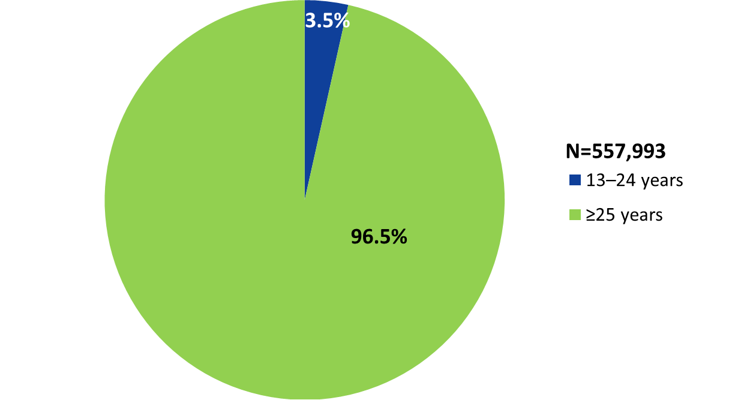
Clients Aged ≥13 Years Served by the Ryan White HIV/AIDS Program, by Age Group, 2020—United States and 3 Territoriesª
ª Guam, Puerto Rico, and the U.S. Virgin Islands.
Notes:
In 2020, of the 557,993 clients aged 13 years and older served by the RWHAP, 3.5% (19,700 clients) were youth and young adults aged 13 to 24 years.
The three territories include Guam, Puerto Rico, and the U.S. Virgin Islands.

Slide 4
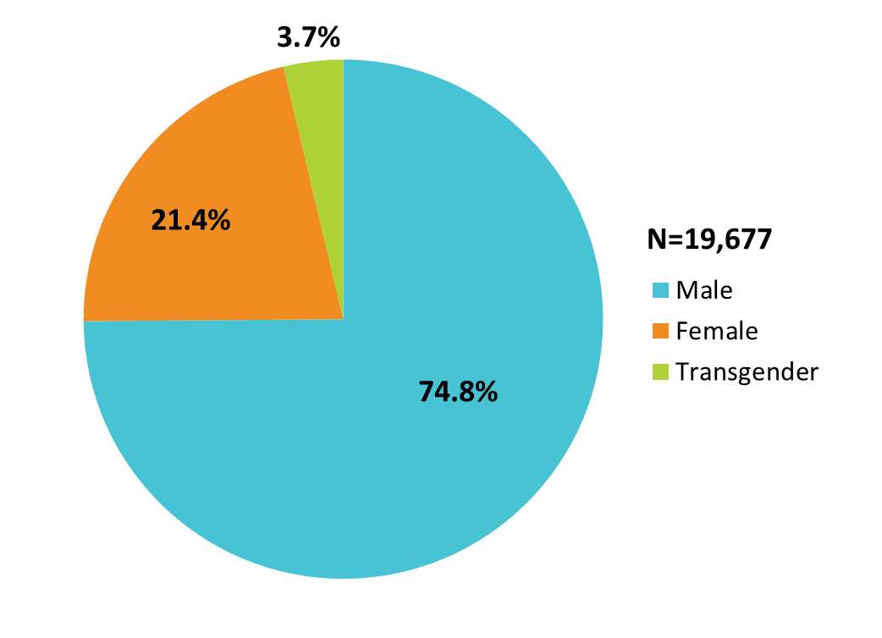
Youth and Young Adults Aged 13–24 Years Served by the Ryan White HIV/AIDS Program, by Gender, 2020—United States and 3 Territoriesª
To ensure confidentiality, data for transgender youth aged 13-14 years are not included.
ª Guam, Puerto Rico, and the U.S. Virgin Islands.
Notes:
In 2020, of the 19,677 youth and young adults served by the RWHAP with a reported gender, 74.8% were male, 21.4% were female, and 3.7% were transgender.
The three territories include Guam, Puerto Rico, and the U.S. Virgin Islands.

Slide 5
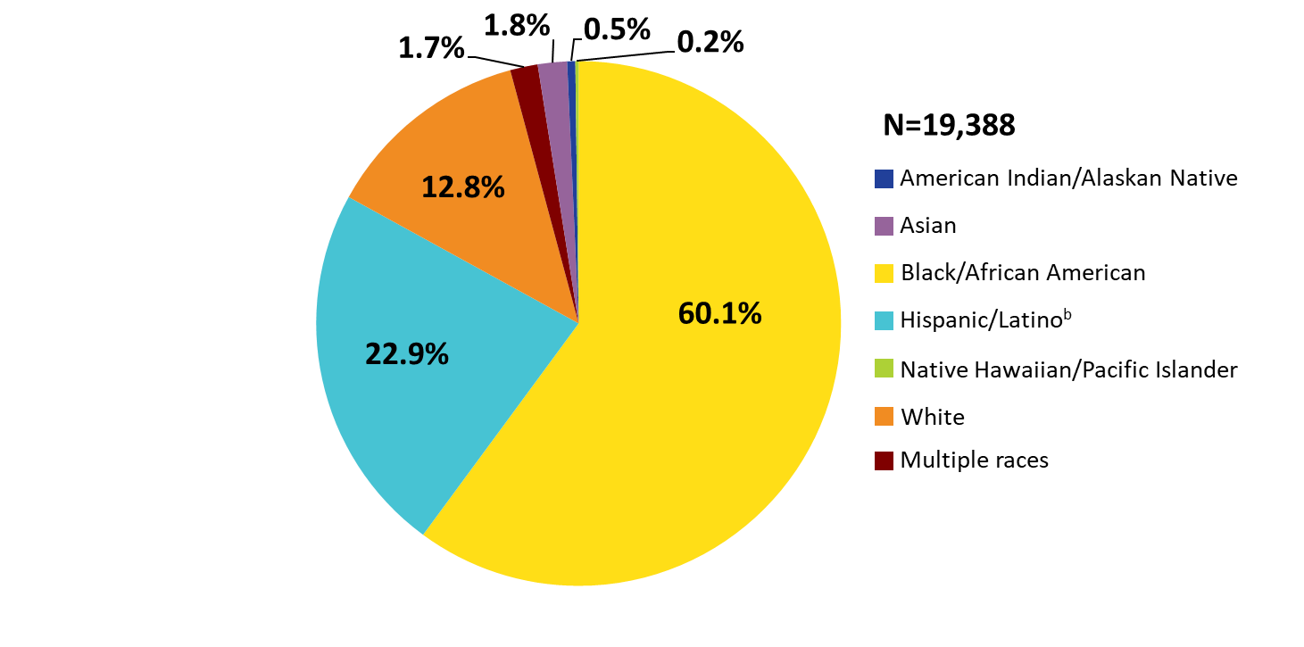
Youth and Young Adults Aged 13–24 Years Served by the Ryan White HIV/AIDS Program, by Race/Ethnicity, 2020—United States and 3 Territoriesª
ª Guam, Puerto Rico, and the U.S. Virgin Islands.
^{b} Hispanics/Latinos can be of any race.
Notes:
In 2020, 87.2% of youth and young adults served by the RWHAP were racial/ethnic minorities. Of the 19,388 clients with reported race/ethnicity information, 60.1% identified as Black/African American and 22.9% identified as Hispanic/Latino. For reference, White clients appear in the pie chart in orange shading.
Hispanics/Latino clients can be of any race.
The three territories include Guam, Puerto Rico, and the U.S. Virgin Islands.

Slide 6
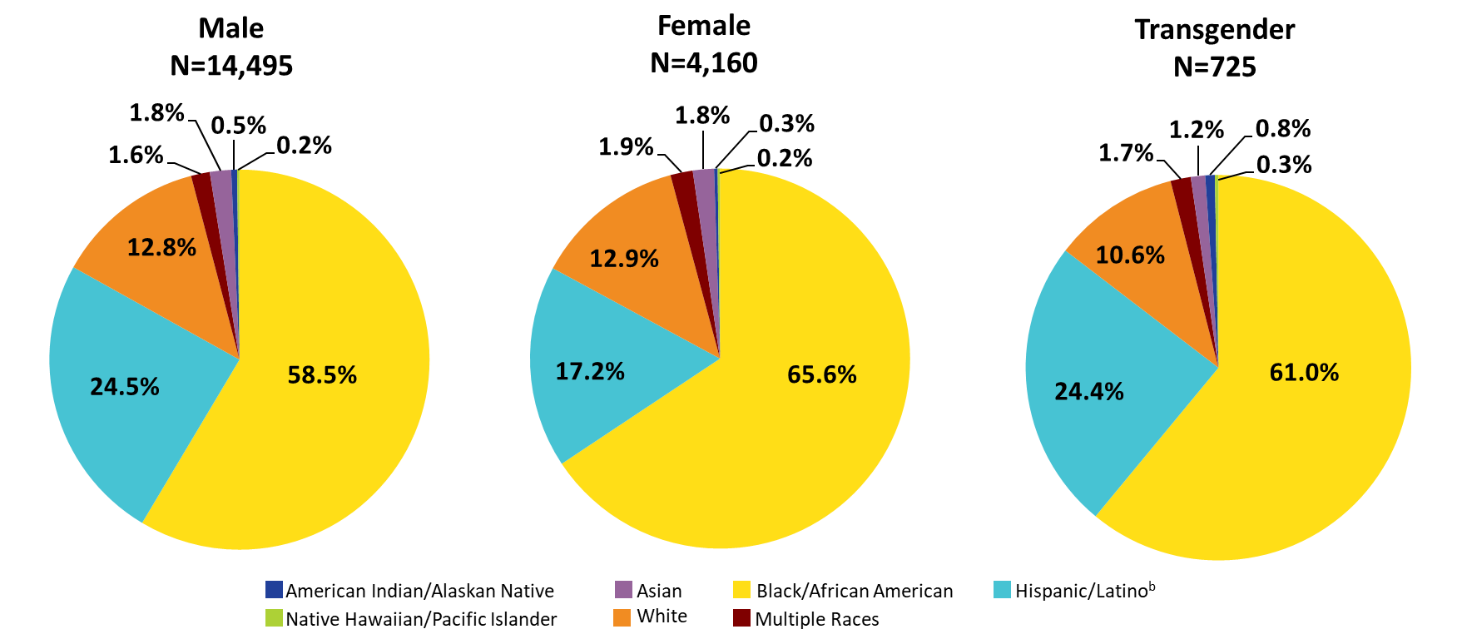
Youth and Young Adults Aged 13–24 Years Served by the Ryan White HIV/AIDS Program, by Gender and Race/Ethnicity, 2020—United States and 3 Territoriesª
ª Guam, Puerto Rico, and the U.S. Virgin Islands.
^{b} Hispanics/Latinos can be of any race.
Notes:
In 2020, 87.2% of male clients, 87.1% of female clients, and 89.4% of transgender clients were racial/ethnic minorities. For reference, White clients appear in each pie chart in orange shading.
Hispanics/Latinos can be of any race.
The three territories include Guam, Puerto Rico, and the U.S. Virgin Islands.

Slide 7
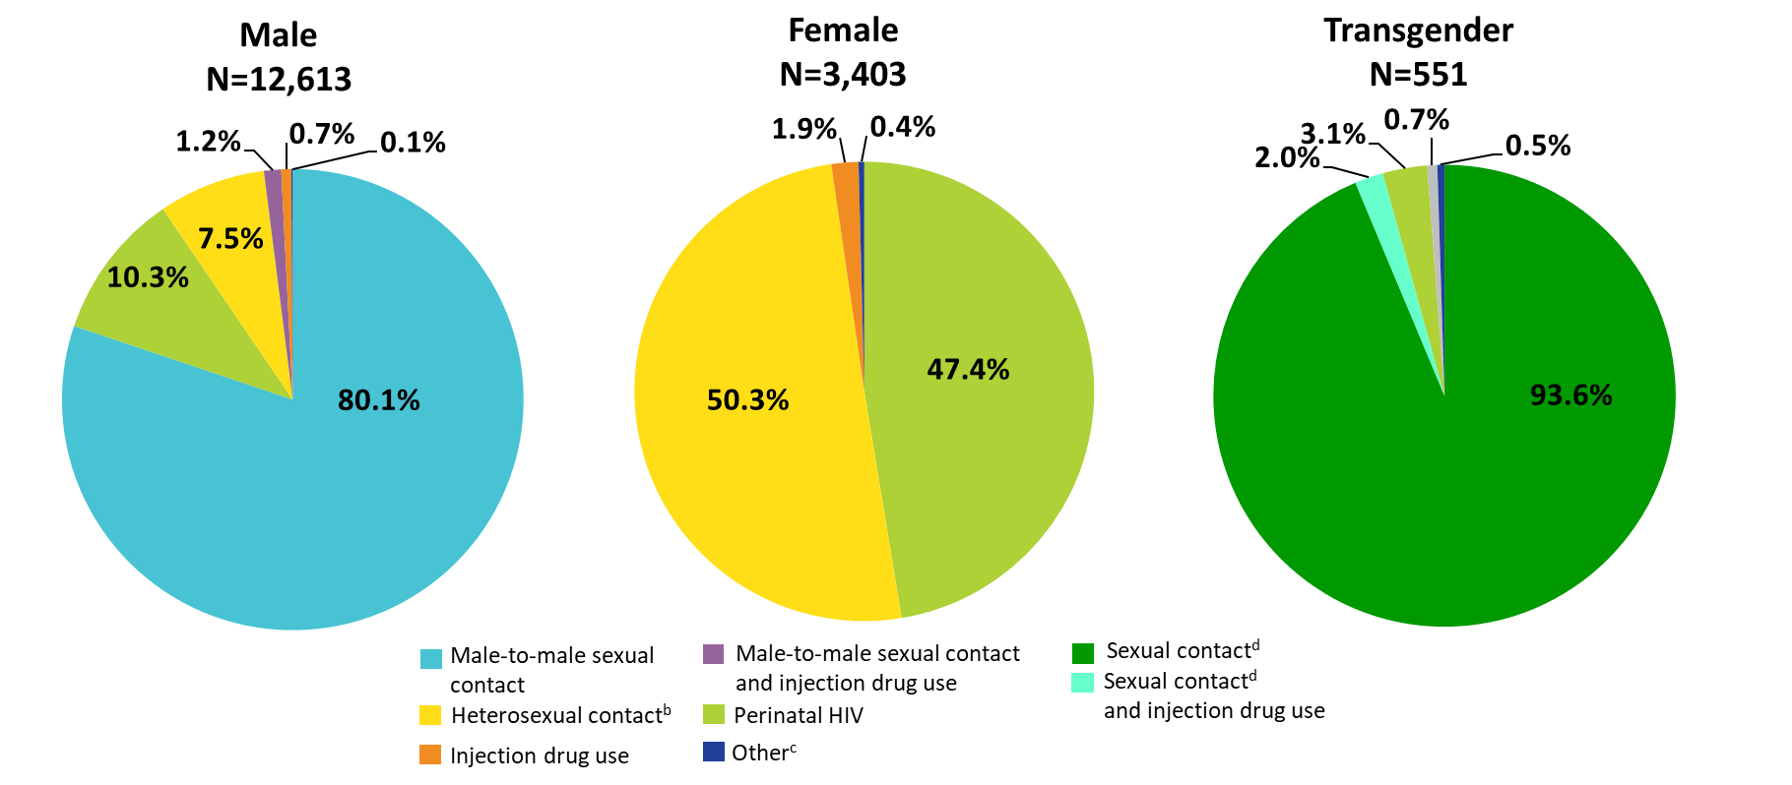
Youth and Young Adults Aged 13–24 Years Served by the Ryan White HIV/AIDS Program, by Gender and Transmission Category, 2020—United States and 3 Territoriesª
ª Guam, Puerto Rico, and the U.S. Virgin Islands.
^{b} Heterosexual contact with a person know to have, or be at high risk for, HIV infection.
^{c} Includes hemophilia and blood transfusion.
^{d} Includes any reported sexual transmission category among transgender clients.
Notes:
Among young male RWHAP clients in 2020, 80.1% had HIV attributed to male-to-male sexual contact, 10.3% to perinatal HIV, and 7.5% to heterosexual contact.
Among young female RWHAP clients, 50.3% had HIV attributed to heterosexual contact and 47.4% to perinatal infection.
Among transgender RWHAP clients, 93.6% had HIV attributed to sexual contact and 3.1% to perinatal infection.
The three territories include Guam, Puerto Rico, and the U.S. Virgin Islands.
Heterosexual contact includes heterosexual contact with a person known to have, or to be at high risk for, HIV infection.
Other includes hemophilia and blood transfusion.
Sexual contact includes any sexual transmission category reported by transgender clients.

Slide 8
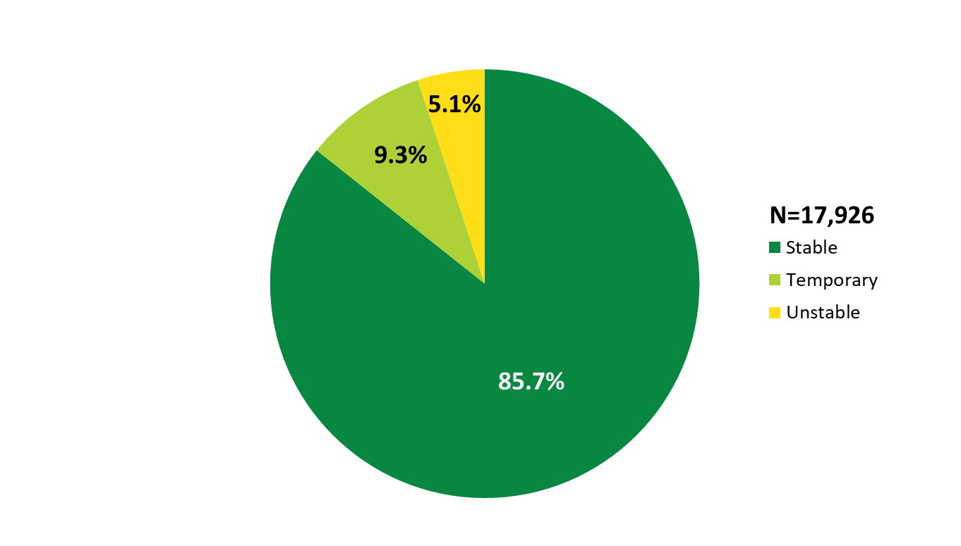
Youth and Young Adults Aged 13–24 Years Served by the Ryan White HIV/AIDS Program, by Housing Status, 2020—United States and 3 Territoriesª
ª Guam, Puerto Rico, and the U.S. Virgin Islands.
Notes:
In 2020, among youth and young adults served by the RWHAP with reported housing status, 9.3% had temporary housing and 5.1% had unstable housing.
The three territories include Guam, Puerto Rico, and the U.S. Virgin Islands.

Slide 9
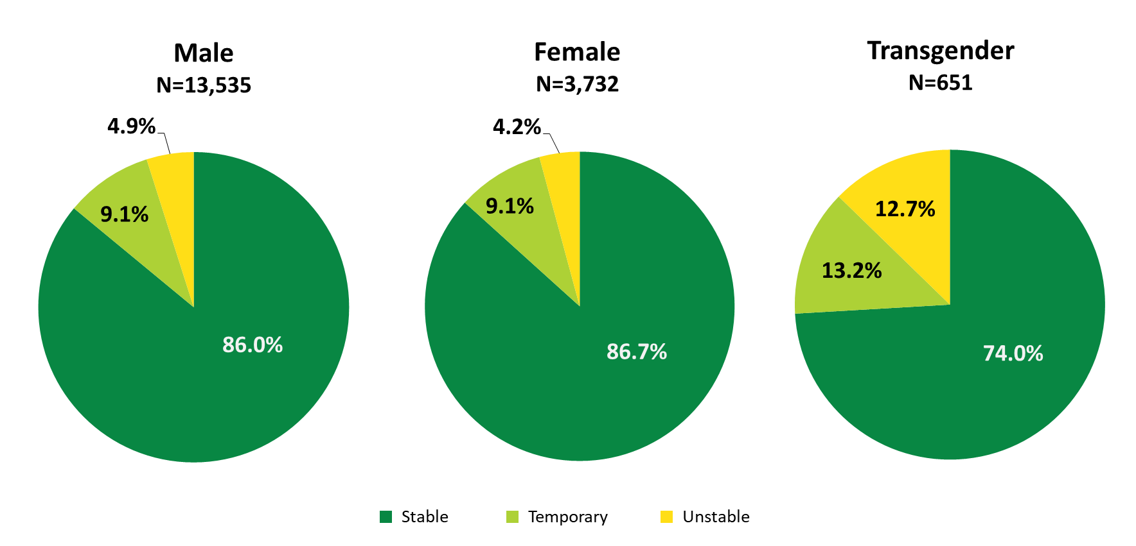
Youth and Young Adults Aged 13–24 Years Served by the Ryan White HIV/AIDS Program, by Gender and Housing Status, 2020—United States and 3 Territoriesª
ª Guam, Puerto Rico, and the U.S. Virgin Islands.
Notes:
In 2020, a lower proportion of young transgender clients served by the RWHAP had stable housing compared to young male and female clients. Among young male clients, 9.1% had temporary housing and 4.9% had unstable housing. Among young female clients, 9.1% had temporary housing and 4.2% had unstable housing. Among young transgender clients, 13.2% had temporary housing and 12.7% had unstable housing.
The three territories include Guam, Puerto Rico, and the U.S. Virgin Islands.

Slide 10
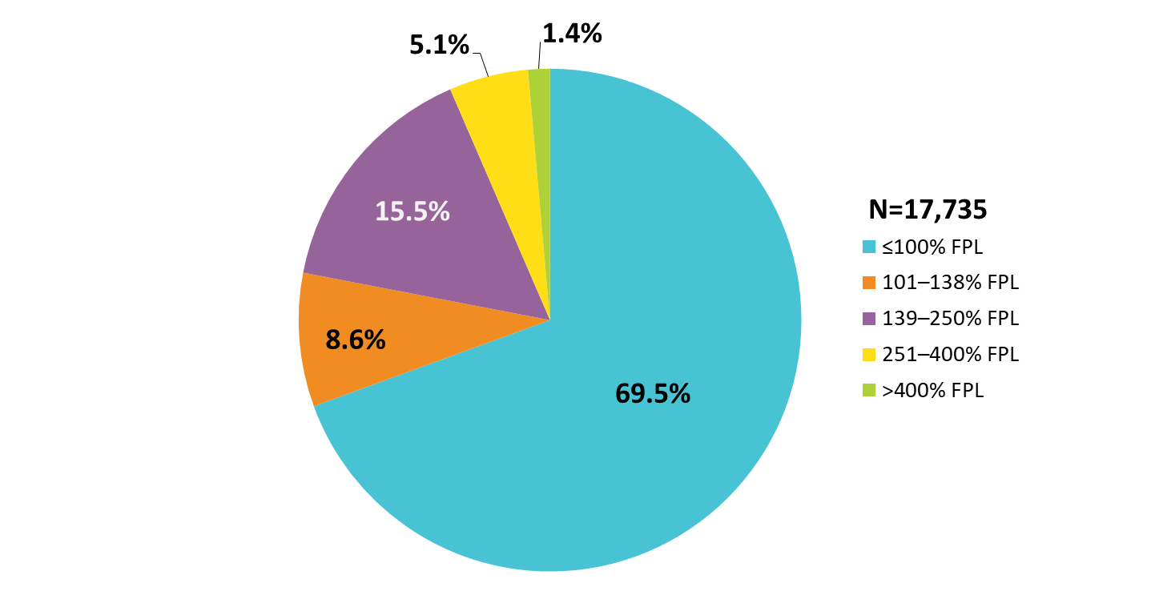
Youth and Young Adults Aged 13–24 Years Served by the Ryan White HIV/AIDS Program, by Federal Poverty Level, 2020—United States and 3 Territoriesª
FPL: federal poverty level.
ª Guam, Puerto Rico, and the U.S. Virgin Islands
Notes:
In 2020, 69.5% of the 17,735 youth and young adults served by the RWHAP with income information were living at or below 100% of the federal poverty level (FPL).
FPL is federal poverty level.
The three territories include Guam, Puerto Rico, and the U.S. Virgin Islands.

Slide 11
Viral Suppression
Youth and Young Adults, Aged 13–24 Years

Slide 12
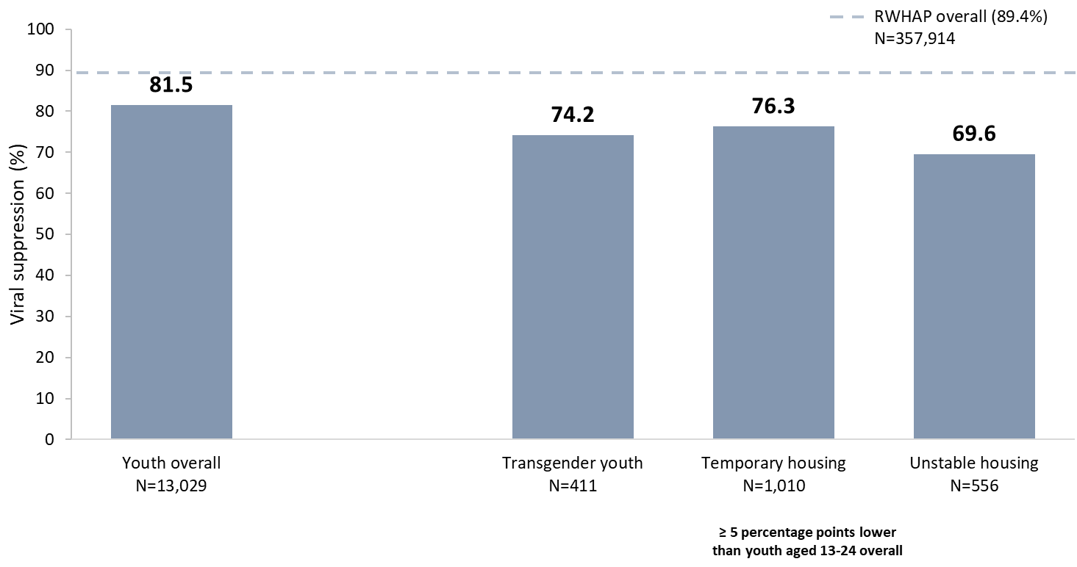
Viral Suppression among Youth Aged 13–24 Years Served by the Ryan White HIV/AIDS Program, 2020—United States and 3 Territoriesª
N represents the total number of clients in the specific population.
Viral suppression: ≥1 OAHS visit during the calendar year and ≥1 viral load reported, with the last viral load result <200 copies/mL.
ª Guam, Puerto Rico, and the U.S. Virgin Islands.
Notes:
In 2020, among youth aged 13–24 years, viral suppression (81.5%) was lower than the RWHAP average (89.4%) – indicated by the dashed grey line.
Viral suppression was lowest among transgender youth (74.2%), youth with temporary housing (76.3%) and youth with unstable housing (69.6%).
N represents the total number of clients in the specific subpopulation.
Viral suppression is defined as ≥1 outpatient/ambulatory health services visit during the calendar year and ≥1 viral load reported, with the last viral load result <200 copies/mL.
The three territories include Guam, Puerto Rico, and the U.S. Virgin Islands.

Slide 13
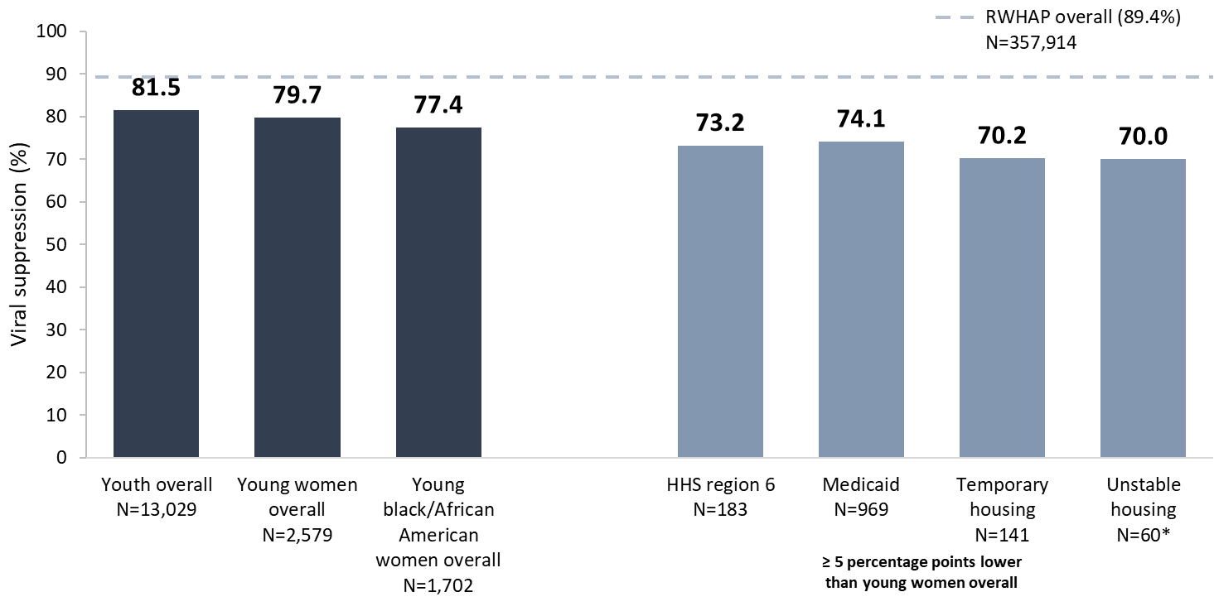
Viral Suppression among Young, Black/African American Women Aged 13–24 Years Served by the Ryan White HIV/AIDS Program, 2020—United States and 3 Territoriesª
N represents the total number of clients in the specific population.
Viral suppression: ≥1 OAHS visit during the calendar year and ≥1 viral load reported, with the last viral load result <200 copies/mL.
* Use caution when interpreting results based on small numbers.
ª Guam, Puerto Rico, and the U.S. Virgin Islands.
Notes:
In 2020, viral suppression for young, Black/African American women aged 13–24 years (77.4%) was lower than the national RWHAP average (89.4%) – indicated by the dashed grey line – lower than youth overall (81.5%), and slightly lower than young women overall (79.7%).
Viral suppression for young, Black/African American women was lowest among those receiving care in HHS Region 6 (73.2%), those with Medicaid coverage (74.1%), and those with temporary (70.2%) and unstable (70.0%) housing. Use caution when interpreting data on housing due to variability from small numbers.
N represents the total number of clients in the specific subpopulation.
Viral suppression is defined as ≥1 outpatient/ambulatory health services visit during the calendar year and ≥1 viral load reported, with the last viral load result <200 copies/mL.
The three territories include Guam, Puerto Rico, and the U.S. Virgin Islands.

Slide 14
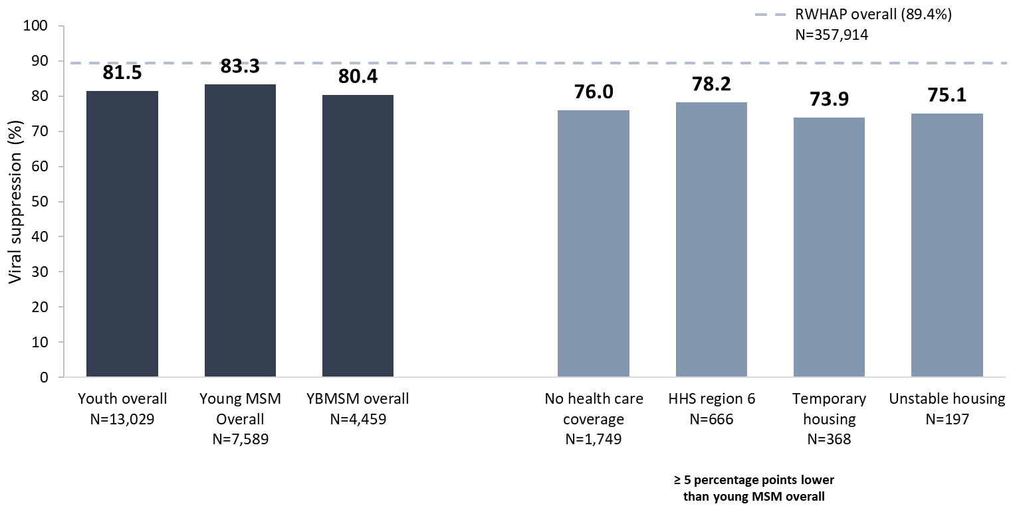
Viral Suppression among Young, Black/African American MSM (YBMSM) Aged 13–24 Years Served by the Ryan White HIV/AIDS Program, 2020—United States and 3 Territoriesª
N represents the total number of clients in the specific population.
Viral suppression: ≥1 OAHS visit during the calendar year and ≥1 viral load reported, with the last viral load result <200 copies/mL.
ª Guam, Puerto Rico, and the U.S. Virgin Islands.
Notes:
In 2020, viral suppression for young Black/African American MSM aged 13-24 years (YBMSM; 80.4%) was lower than the national RWHAP average (89.4%) – indicated by the dashed grey line – and slightly lower than the averages for young MSM overall (83.3%) and youth overall (81.5%).
Viral suppression for YBMSM was lowest among those with no health care coverage (76.0%); those in HHS region 6 (78.2%); and those with temporary (73.9%) and unstable (75.1%) housing.
N represents the total number of clients in the specific subpopulation.
Data for MSM include MSM who also reported injection drug use as a transmission risk category; data may not reflect current injection drug use behavior.
Viral suppression is defined as ≥1 outpatient/ambulatory health services visit during the calendar year and ≥1 viral load reported, with the last viral load result <200 copies/mL.
See Technical Notes of the Source document for the states/territories included in each HHS Region.
The three territories include Guam, Puerto Rico, and the U.S. Virgin Islands.

