Slide 1
Clients Served by the Ryan White HIV/AIDS Program, 2020 Clients with HIV Attributed to Injection Drug Use
Released MONTH 2022
Notes:
HRSA is on four social media platforms. We encourage you to follow along and share our content on Twitter, Facebook, LinkedIn and Instagram to stay up-to-date on the latest HRSA news. Our account/handle on each platform is @HRSAgov.
Additionally, we also encourage you to sign up for HRSA’s e-News, a biweekly email of comprehensive HRSA news, and to sign up for HRSA press releases. You can also visit our website www.HRSA.gov for more detailed information about all of our programs.

Slide 2
Demographic Characteristics
Clients with HIV Attributed to Injection Drug Use

Slide 3
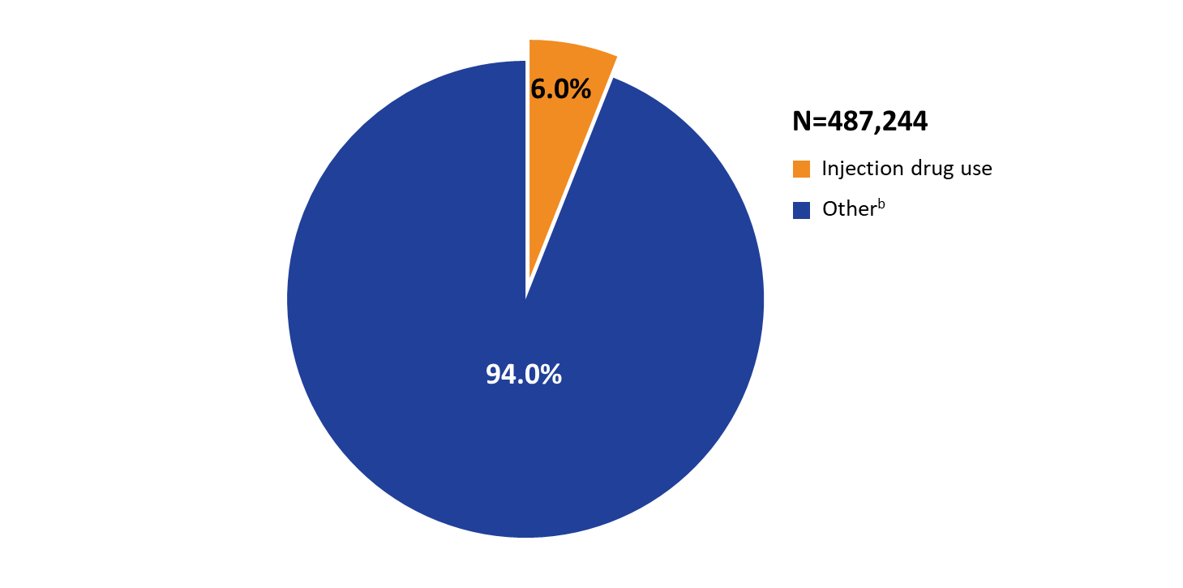
Ryan White HIV/AIDS Program Clients Aged ≥13 Years with HIV Attributed to Injection Drug Use, 2020—United States and 3 Territoriesª
Data represent clients who reported injection drug use as their transmission category data may not reflect current behavior.
ª Guam, Puerto Rico, and the U.S. Virgin Islands.
^{b} Includes male-to-male sexual contact, heterosexual contact, perinatal HIV, hemophilia, blood transfusion, male-male sexual contact and injection drug use, and any sexual contact among transgender persons including sexual contact and injection drug use.
Notes:
In 2020, among 487,244 RWHAP clients aged 13 years and older with reported age and transmission information, 6.0% had HIV attributed to injection drug use.
Data represent clients who reported injection drug use as their transmission category; data may not reflect current behavior.
The three territories are Guam, Puerto Rico, and the U.S. Virgin Islands.
Other includes male-to-male sexual contact, heterosexual contact, perinatal HIV, hemophilia, blood transfusion, male-male sexual contact and injection drug use, and any sexual contact among transgender clients including sexual contact and injection drug use.

Slide 4
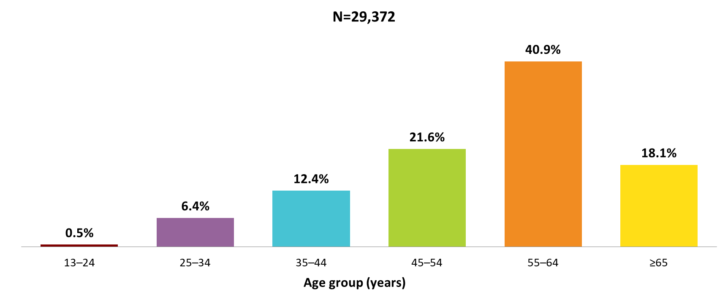
Clients with HIV Attributed to Injection Drug Use Aged ≥13 Years Served by the Ryan White HIV/AIDS Program, by Age Group, 2020—United States and 3 Territoriesª
Data represent clients who reported injection drug use as their transmission category; data may not reflect current behavior.
Data do not include male-to-male sexual contact and injection drug use nor sexual contact and injection drug use among transgender clients.
ª Guam, Puerto Rico, and the U.S. Virgin Islands.
Notes:
In 2020, 62.5% of clients with HIV attributed to injection drug use served by the RWHAP were aged 45–64 years (21.6% aged 45–54 and 40.9% aged 55–64). Another 18.1% were aged 65 years and older, 12.4% were aged 35–44 years, and 6.4% were aged 25–34 years.
Data represent clients who reported injection drug use as their transmission category; data may not reflect current behavior. Data do not include male-to-male sexual contact and injection drug use nor sexual contact and injection drug use among transgender clients.
The three territories are Guam, Puerto Rico, and the U.S. Virgin Islands.

Slide 5
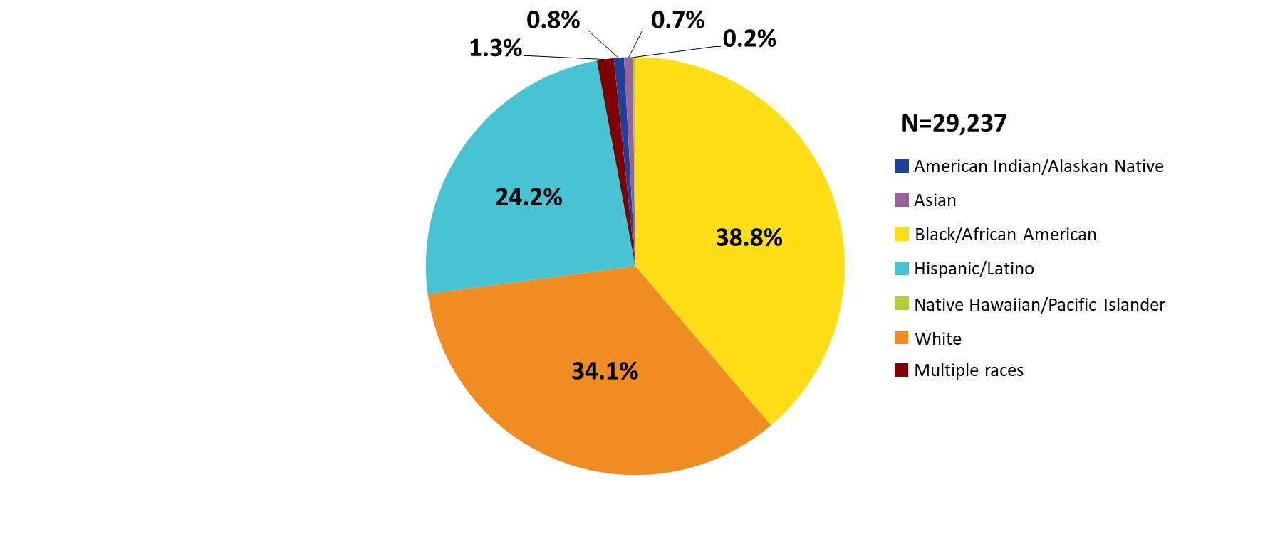
Clients with HIV Attributed to Injection Drug Use Aged ≥13 Years Served by the Ryan White HIV/AIDS Program, by Race/Ethnicity, 2020—United States and 3 Territoriesª
Data represent clients who reported injection drug use as their transmission risk category; data may not reflect current behavior.
Data do not include male-to-male sexual contact and injection drug use nor sexual contact and injection drug use among transgender clients.
Hispanics/Latinos can be of any race.
ª Guam, Puerto Rico, and the U.S. Virgin Islands.
Notes:
In 2020, among 29,237 clients served by the RWHAP with HIV attributed to injection drug use, 65.9% were racial/ethnic minority clients, including 38.8% Black/African American clients and 24.2% Hispanic/Latino clients.
Data represent clients who reported injection drug use as their transmission risk category; data may not reflect current behavior. Data do not include male-to-male sexual contact and injection drug use nor sexual contact and injection drug use among transgender clients.
Hispanics/Latinos can be of any race.
The three territories are Guam, Puerto Rico, and the U.S. Virgin Islands.

Slide 6
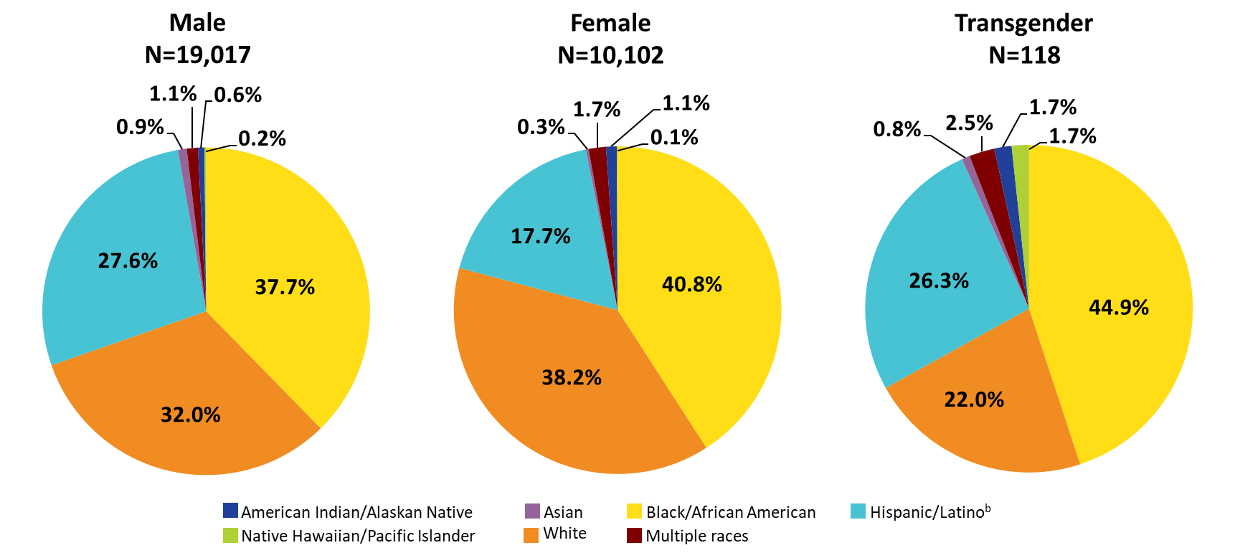
Clients with HIV Attributed to Injection Drug Use Aged ≥13 Years Served by the Ryan White HIV/AIDS Program, by Gender and Race/Ethnicity, 2020—United States and 3 Territoriesª
ª Guam, Puerto Rico, and the U.S. Virgin Islands.
^{b} Hispanics/Latinos can be of any race.
Notes:
In 2020, among clients served by the RWHAP with HIV attributed to injection drug use, 68.0% of male clients, 61.8% of female clients, and 78% of transgender clients were racial/ethnic minorities.
Data represent clients who reported injection drug use as their transmission risk category; data may not reflect current behavior. Data do not include male-to-male sexual contact and injection drug use nor sexual contact and injection drug use among transgender clients.
Hispanics/Latinos can be of any race.
The three territories are Guam, Puerto Rico, and the U.S. Virgin Islands.

Slide 7
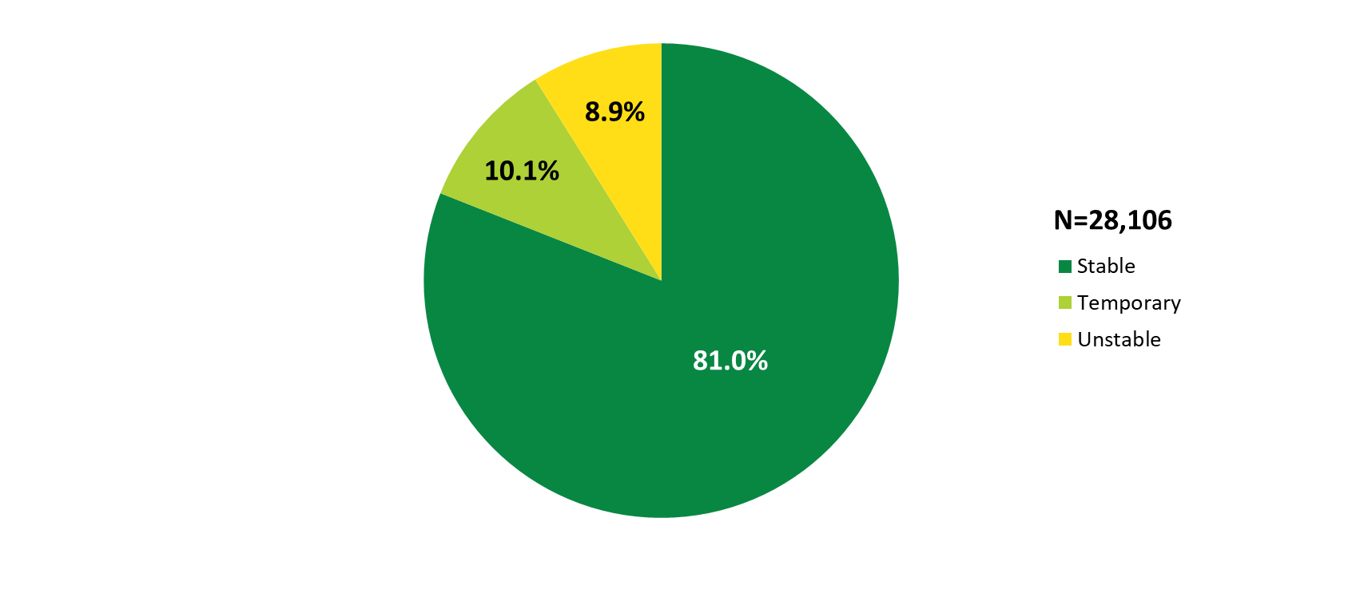
Clients with HIV Attributed to Injection Drug Use Aged ≥13 Years Served by the Ryan White HIV/AIDS Program, by Housing Status, 2020—United States and 3 Territoriesª
Data represent clients who reported injection drug use as their transmission risk category; data may not reflect current behavior.
Data do not include male-to-male sexual contact and injection drug use nor sexual contact and injection drug use among transgender clients.
ª Guam, Puerto Rico, and the U.S. Virgin Islands.
Notes:
In 2020, among 28,106 clients served by the RWHAP with HIV attributed to injection drug use and reported housing status, 10.1% had temporary housing and 8.9% had unstable housing.
Data represent clients who reported injection drug use as their transmission risk category; data may not reflect current behavior. Data do not include male-to-male sexual contact and injection drug use nor sexual contact and injection drug use among transgender clients.
The three territories are Guam, Puerto Rico, and the U.S. Virgin Islands.

Slide 8
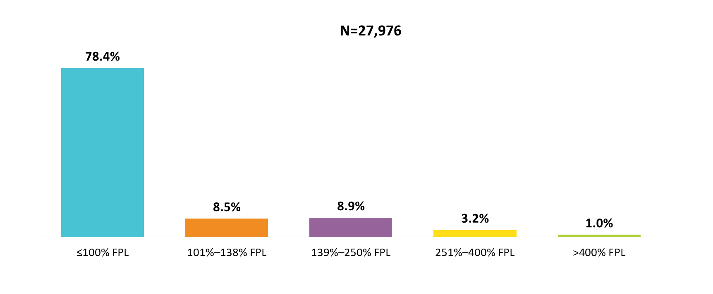
Clients with HIV Attributed to Injection Drug Use Aged ≥13 Years Served by the Ryan White HIV/AIDS Program, by Federal Poverty Level (FPL), 2020—United States and 3 Territoriesª
Data represent clients who reported injection drug use as their transmission risk category; data may not reflect current behavior.
Data do not include male-to-male sexual contact and injection drug use nor sexual contact and injection drug use among transgender clients.
ª Guam, Puerto Rico, and the U.S. Virgin Islands.
Notes:
In 2020, among 27,976 clients served by the RWHAP with HIV attributed to injection drug use and income information, 78.4% were living at or below 100% of the federal poverty level (FPL).
Data represent clients who reported injection drug use as their transmission risk category; data may not reflect current behavior. Data do not include male-to-male sexual contact and injection drug use nor sexual contact and injection drug use among transgender clients.
FPL is federal poverty level.
The three territories are Guam, Puerto Rico, and the U.S. Virgin Islands.

Slide 9
Viral Suppression Clients with HIV Attributed to Injection Drug Use

Slide 10
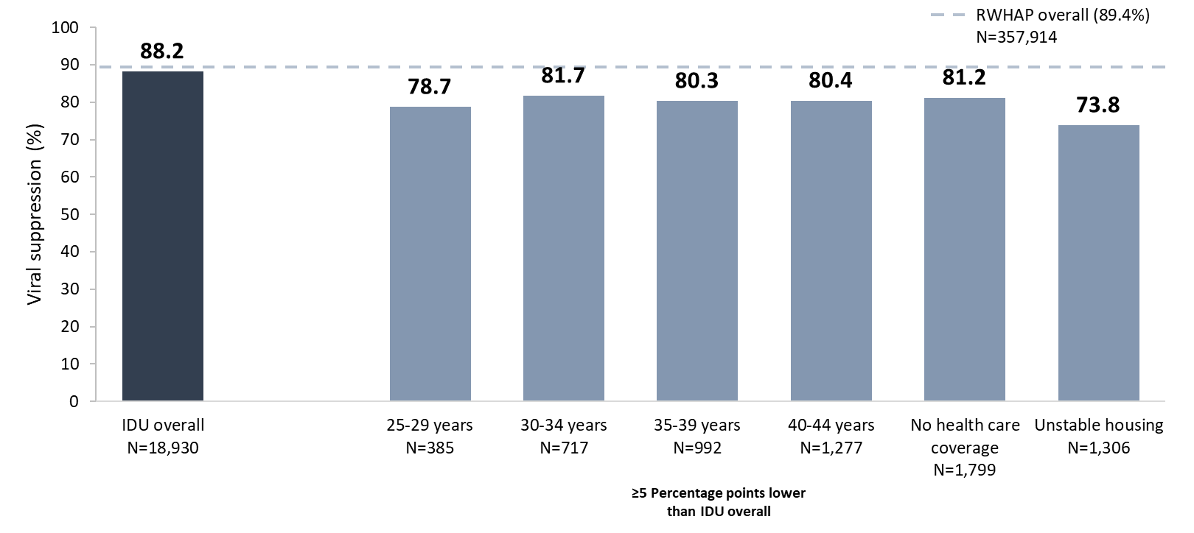
Viral Suppression among Clients with HIV Attributed to Injection Drug Use Aged ≥13 Years Served by the Ryan White HIV/AIDS Program, 2020—United States and 3 Territoriesª
IDU, injection drug use.
Includes clients aged 13 years and older. Data represent clients who reported injection drug use as their transmission risk category; data may not reflect current behavior. Data do not include male-to-male sexual contact and injection drug use among male clients nor sexual contact and injection drug use among transgender clients.
N represents the total number of clients in the specific subpopulation.
Viral suppression is defined as ≥1 OAHS visit during the calendar year and ≥1 viral load reported, with the last viral load result <200 copies/mL.
ª Guam, Puerto Rico, and the U.S. Virgin Islands.
Notes:
In 2020, for clients with HIV attributed to injection drug use (IDU), viral suppression (88.2%) was close but lower than the national RWHAP average (89.4%) – indicated by the dashed grey line.
Viral suppression was lowest among clients in each 5-year age group from 25-44 years (range: 78.7%-81.7%); among those with no health care coverage (81.2%); and among those with unstable (73.8%) housing.
Data represent clients who reported injection drug use as their transmission category; data may not reflect current behavior. Data do not include people with HIV attributed to male-to-male sexual contact and injection drug use nor sexual contact and injection drug use among transgender clients.
N represents the total number of clients in the specific subpopulation.
Viral suppression is defined as ≥1 outpatient ambulatory health services visit during the calendar year and ≥1 viral load reported, with the last viral load result <200 copies/mL.
The three territories include Guam, Puerto Rico, and the U.S. Virgin Islands.

