Slide 1
Women Served by the Ryan White HIV/AIDS Program, 2020
Released October 2022
Notes:
HRSA is on four social media platforms. We encourage you to follow along and share our content on Twitter, Facebook, LinkedIn and Instagram to stay up-to-date on the latest HRSA news. Our account/handle on each platform is @HRSAgov.
Additionally, we also encourage you to sign up for HRSA’s e-News, a biweekly email of comprehensive HRSA news, and to sign up for HRSA press releases. You can also visit our website www.HRSA.gov for more detailed information about all of our programs.

Slide 2
Demographic Characteristics
Women, Aged 13 Years and Older

Slide 3
Clients Aged 13 Years and Older Served by the Ryan White HIV/AIDS Program, by Gender, 2020—United States and 3 Territoriesª
ª Guam, Puerto Rico, and the U.S. Virgin Islands.
Notes:
In 2020, of the 557,706 clients aged 13 years and older served by the RWHAP with reported gender information, 72.2% were male, 25.8% were female, and 2.1% were transgender.
The three territories include Guam, Puerto Rico, and the U.S. Virgin Islands.

Slide 4
Women Aged 13 Years and Older Served by the Ryan White HIV/AIDS Program, by Age Group, 2020—United States and 3 Territoriesª
ª Guam, Puerto Rico, and the U.S. Virgin Islands.
Notes:
In 2020, 65.1% of women served by the RWHAP were aged 45 years and older.
Data presented do not include transgender women.
The three territories include Guam, Puerto Rico, and the U.S. Virgin Islands.

Slide 5
Women Aged 13 Years and Older Served by the Ryan White HIV/AIDS Program, by Race/Ethnicity, 2020—United States and 3 Territoriesª
Hispanics/Latinas can be of any race.
ª Guam, Puerto Rico, and the U.S. Virgin Islands.
Notes:
In 2020, 83.6% of women served by the RWHAP were racial/ethnic minorities. Of the 142,201 women with reported race/ethnicity information, 61.2% were Black/African American and 19.6% were Hispanic/Latina. Whites accounted for 16.4% of women served by the RWHAP.

Slide 6
Women Aged 13 Years and Older Served by the Ryan White HIV/AIDS Program, by Transmission Category, 2020—United States and 3 Territoriesª
ª Guam, Puerto Rico, and the U.S. Virgin Islands.
^{b} Heterosexual contact with a person known to have, or to be at high risk for, HIV infection.
^{c} Includes hemophilia and blood transfusion.
Notes:
In 2020, among the 124,444 women aged 13 years or older served by the RWHAP with a reported transmission category, 87.5% had HIV attributed to heterosexual contact, 8.2% to injection drug use, and 3.1% to perinatal HIV.
Data presented do not include transgender women.
Heterosexual contact includes specific heterosexual contact with a person known to have, or to be at high risk for, HIV infection.
The three territories include Guam, Puerto Rico, and the U.S. Virgin Islands.
Other includes hemophilia and blood transfusion.

Slide 7
Women Aged 13 Years and Older Served by the Ryan White HIV/AIDS Program, by Race/Ethnicity and Transmission Category, 2020—United States and 3 Territoriesª
Hispanics/Latinas can be of any race.
ª Guam, Puerto Rico, and the U.S. Virgin Islands.
^{b} Heterosexual contact with a person known to have, or to be at high risk for, HIV infection.
^{c} Includes hemophilia and blood transfusion.
Notes:
In 2020, among Black/African American women aged 13 years and older served by the RWHAP, 90.2% had HIV infection attributed to heterosexual contact, 5.5% to injection drug use, and 3.3% to perinatal HIV. Among Hispanic/Latina women, 88.0% had HIV infection attributed to heterosexual contact, 7.2% to injection drug use, and 3.4% to perinatal HIV. Among White women, 78.0% had HIV infection attributed to heterosexual contact, 18.8% to injection drug use, and 1.9% to perinatal HIV.
Data presented do not include transgender women.
Hispanics/Latinas can be of any race.
The three territories include Guam, Puerto Rico, and the U.S. Virgin Islands.
Heterosexual contact includes specific heterosexual contact with a person known to have, or to be at high risk for, HIV infection.
Other includes hemophilia and blood transfusion.

Slide 8
Women Aged 13 Years and Older Served by the Ryan White HIV/AIDS Program, by Housing Status, 2020—United States and 3 Territoriesª
ª Guam, Puerto Rico, and the U.S. Virgin Islands.
Notes:
In 2020, among the 133,190 women aged 13 years and older served by the RWHAP with reported housing status, 6.1% had temporary housing and 3.6% had unstable housing.
The data presented do not include transgender women.
The three territories include Guam, Puerto Rico, and the U.S. Virgin Islands.

Slide 9
Women Aged 13 Years and Older Served by the Ryan White HIV/AIDS Program, by Race/Ethnicity and Housing Status, 2020—United States and 3 Territoriesª
ª Guam, Puerto Rico, and the U.S. Virgin Islands.
Notes:
In 2020, among Black/African American women served by the RWHAP, 6.1% had temporary housing and 3.3% had unstable housing. Among Hispanic/Latina women, 5.1% had temporary housing and 2.8% had unstable housing. Among White women, 7.0% had temporary housing and 5.2% had unstable housing.
The data presented do not include transgender women.
The three territories include Guam, Puerto Rico, and the U.S. Virgin Islands.

Slide 10
Women Aged 13 Years and Older Served by the Ryan White HIV/AIDS Program, by Federal Poverty Level (FPL), 2020—United States and 3 Territoriesª
ª Guam, Puerto Rico, and the U.S. Virgin Islands.
Notes:
In 2020, among 131,227 women aged 13 years and older served by the RWHAP with income information, 69.7% were living at or below 100% of the federal poverty level (FPL).
FPL is federal poverty level.
The data presented do not include transgender women.
The three territories include Guam, Puerto Rico, and the U.S. Virgin Islands.

Slide 11
Women Aged 13 Years and Older Served by the Ryan White HIV/AIDS Program, Living ≤100% Federal Poverty Level (FPL), by Race/Ethnicity, 2020—United States and 3 Territoriesª
Hispanics/Latinas can be of any race.
N represents the total number of clients in the specific subpopulation.
ª Guam, Puerto Rico, and the U.S. Virgin Islands.
Notes:
In 2020, among Black/African American women aged 13 years and older served by the RWHAP with income information, 69.1% were living at or below 100% of the federal poverty level (FPL). Among Hispanic/Latina women, 76.3% were living at or below 100% FPL. Among White women, 64.5% were living at or below 100% FPL.
The data presented do not include transgender women.
Hispanics/Latinas can be of any race.
N represents the total number of clients in the specific subpopulation.
FPL is federal poverty level.
The three territories include Guam, Puerto Rico, and the U.S. Virgin Islands.

Slide 12
Women Aged 13 Years and Older Served by the Ryan White HIV/AIDS Program, by Health Care Coverage, 2020—United States and 3 Territoriesª
ª Guam, Puerto Rico, and the U.S. Virgin Islands.
Notes:
In 2020, the majority (84.6%) of women aged 13 years and older served by the RWHAP had some form of health care coverage. Among women served by the RWHAP with reported health care coverage information, 39.4% were covered by Medicaid, 10.1% by Medicare, and an additional 9.1% were dually eligible for Medicare and Medicaid. 15.4% of women had no health care coverage in 2020.
The data presented do not include transgender women.
The three territories include Guam, Puerto Rico, and the U.S. Virgin Islands.

Slide 13
Women Aged 13 Years and Older Served by the Ryan White HIV/AIDS Program with Any Health Care Coverage, by Race/Ethnicity, 2020—United States and 3 Territoriesª
Hispanics/Latinas can be of any race.
N represents the total number of clients in the specific subpopulation.
ª Guam, Puerto Rico, and the U.S. Virgin Islands.
Notes:
In 2020, the majority (84.6%) of women aged 13 years and older served by the RWHAP had some form of health care coverage. Among women served by the RWHAP with reported health care coverage information, 39.4% were covered by Medicaid, 10.1% by Medicare, and an additional 9.1% were dually eligible for Medicare and Medicaid. 15.4% of women had no health care coverage in 2020.
The data presented do not include transgender women.
The three territories include Guam, Puerto Rico, and the U.S. Virgin Islands.

Slide 14
Viral Suppression
Women, aged 13 years and older
Notes:
This is a transition slide to introduce the section focused on viral suppression among women aged 13 years and older served by the Ryan White HIV/AIDS Program in 2020.

Slide 15
Viral Suppression among Women Aged 13 and Older Served by the Ryan White HIV/AIDS Program, 2010–2020—United States and 3 Territoriesª
Viral suppression: ≥1 OAHS visit during the calendar year and ≥1 viral load reported, with the last viral load result <200 copies/mL.
ª Guam, Puerto Rico, and the U.S. Virgin Islands.
Notes:
The percentage of women aged 13 and older served by the RWHAP with suppressed viral load increased from 66.2% in 2010 to 89.4% in 2020.
The data presented do not include transgender women.
Viral suppression is defined as having ≥1 outpatient/ambulatory health services visit during the calendar year and ≥1 viral load reported, with the last viral load result <200 copies/mL.
The three territories include Guam, Puerto Rico, and the U.S. Virgin Islands.

Slide 16
Viral Suppression Among Women Aged 13 Years and Older Served by the Ryan White HIV/AIDS Program, by Age Group, 2020—United States and 3 Territoriesª
N represents the total number of clients in the specific population.
Viral suppression: ≥1 OAHS visit during the calendar year and ≥1 viral load reported, with the last viral load result <200 copies/mL.
ª Guam, Puerto Rico, and the U.S. Virgin Islands.
Notes:
In 2020, among women aged 13 years and older served by the RWHAP, viral suppression varied across age groups, with notably lower viral suppression among the younger age groups. Viral suppression was lowest among women aged 13–24 years (79.7%) and highest among women aged 65 years and older (95.4%).
The data presented do not include transgender women.
N represents the total number of women in the specific subpopulation.
Viral suppression is defined as having ≥1 outpatient/ambulatory health services visit during the calendar year and ≥1 viral load reported, with the last viral load result <200 copies/mL.
The three territories include Guam, Puerto Rico, and the U.S. Virgin Islands.

Slide 17
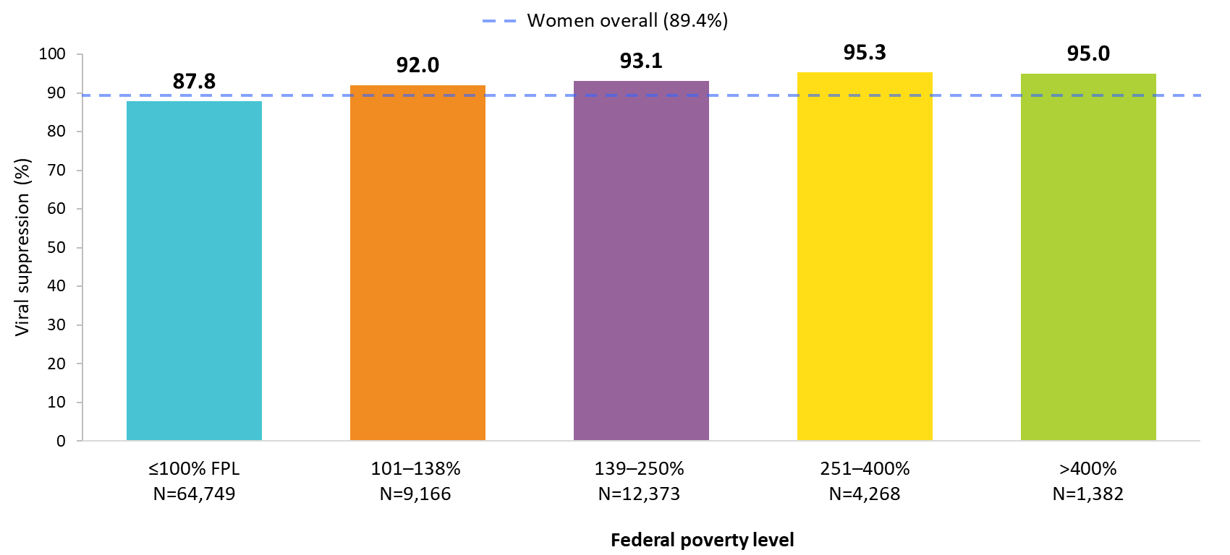
Viral Suppression Among Women Aged 13 Years and Older Served by the Ryan White HIV/AIDS Program, by Federal Poverty Level (FPL), 2020—United States and 3 Territoriesª
N represents the total number of clients in the specific population.
Viral suppression: ≥1 OAHS visit during the calendar year and ≥1 viral load reported, with the last viral load result <200 copies/mL.
ª Guam, Puerto Rico, and the U.S. Virgin Islands.
Notes:
In 2020, 87.8% of women aged 13 years and older who were virally suppressed lived at or below the federal poverty level.
The data presented do not include transgender women.
N represents the total number of women in the specific subpopulation.
Viral suppression is defined as having ≥1 outpatient/ambulatory health services visit during the calendar year and ≥1 viral load reported, with the last viral load result <200 copies/mL.
The three territories include Guam, Puerto Rico, and the U.S. Virgin Islands.

Slide 18
Viral Suppression Among Women Aged 13 Years and Older Served by the Ryan White HIV/AIDS Program, by Federal Poverty Level (FPL), 2020—United States and 3 Territoriesª
N represents the total number of clients in the specific population.
Viral suppression: ≥1 OAHS visit during the calendar year and ≥1 viral load reported, with the last viral load result <200 copies/mL.
ª Guam, Puerto Rico, and the U.S. Virgin Islands.
Notes:
In 2020, 87.8% of women aged 13 years and older who were virally suppressed lived at or below the federal poverty level.
The data presented do not include transgender women.
N represents the total number of women in the specific subpopulation.
Viral suppression is defined as having ≥1 outpatient/ambulatory health services visit during the calendar year and ≥1 viral load reported, with the last viral load result <200 copies/mL.
The three territories include Guam, Puerto Rico, and the U.S. Virgin Islands.

Slide 19
Viral Suppression Among Women Aged 13 Years and Older Served by the Ryan White HIV/AIDS Program, by Housing Status, 2020—United States and 3 Territoriesª
N represents the total number of clients in the specific population.
Viral suppression: ≥1 OAHS visit during the calendar year and ≥1 viral load reported, with the last viral load result <200 copies/mL.
ª Guam, Puerto Rico, and the U.S. Virgin Islands.
Notes:
In 2020, viral suppression varied by housing status among women aged 13 years and older served by the RWHAP. Viral suppression was highest among women with stable housing (90.1%), followed by those with temporary housing (84.2%); viral suppression was lowest among women with unstable housing (76.7%).
The data presented do not include transgender women.
N represents the total number of women in the specific subpopulation.
Viral suppression is defined as having ≥1 outpatient/ambulatory health services visit during the calendar year and ≥1 viral load reported, with the last viral load result <200 copies/mL.
The three territories include Guam, Puerto Rico, and the U.S. Virgin Islands.

Slide 20
Viral Suppression Disparities
Women, aged 13 years and older
Notes:
This is a transition slide to introduce the section focused on viral suppression disparities among women aged 13 years and older served by the Ryan White HIV/AIDS Program in 2020.

Slide 21
Viral Suppression among Black/African American Women Served by the Ryan White HIV/AIDS Program, 2020—United States and 3 Territoriesª
N represents the total number of clients in the specific population.
Includes females aged 13 years and older.
Viral suppression: ≥1 OAHS visit during the calendar year and ≥1 viral load reported, with the last viral load result <200 copies/mL.
ª Guam, Puerto Rico, and the U.S. Virgin Islands.
Notes:
In 2020, the percentage of Black/African American women who were virally suppressed (88.4%) was slightly lower than the national RWHAP average (89.4%) – indicated by the dashed grey line – and the percentage for women overall (89.4%).
Among Black/African American women, viral suppression was lowest in each 5-year age group from 15–34 years (range: 75.8% to 81.9%); those with perinatal HIV (74.4%); and those with temporary (83.0%) or unstable housing (77.7%).
N represents the total number of clients in the specific subpopulation.
Viral suppression is defined as ≥1 outpatient/ambulatory health services visit during the calendar year and ≥1 viral load reported, with the last viral load result <200 copies/mL.
The three territories include Guam, Puerto Rico, and the U.S. Virgin Islands.

Slide 22
Viral Suppression among Hispanic/Latina Women Served by the Ryan White HIV/AIDS Program, 2020—United States and 3 Territoriesª
N represents the total number of clients in the specific population.
Includes females aged 13 years and older.
Hispanics/Latinos can be of any race.
Viral suppression: ≥1 OAHS visit during the calendar year and ≥1 viral load reported, with the last viral load result <200 copies/mL.
ª Guam, Puerto Rico, and the U.S. Virgin Islands.
Notes:
Overall, in 2020, viral suppression among Hispanic/Latina women (91.1%) was higher than the national RWHAP average (89.4%) – indicated by the dashed grey line – and that of women overall (89.4%).
Among Hispanic/Latina women, viral suppression was lowest in each 5-year age group from 20–34 years (range: 79.6% to 85.9%); those with perinatal HIV (77.6%); and those with temporary (85.5%) and unstable (77.8%) housing.
N represents the total number of clients in the specific subpopulation.
Hispanics/Latinas can be of any race.
Viral suppression is defined as ≥1 outpatient/ambulatory health services visit during the calendar year and ≥1 viral load reported, with the last viral load result <200 copies/mL.
The three territories include Guam, Puerto Rico, and the U.S. Virgin Islands.

Slide 23
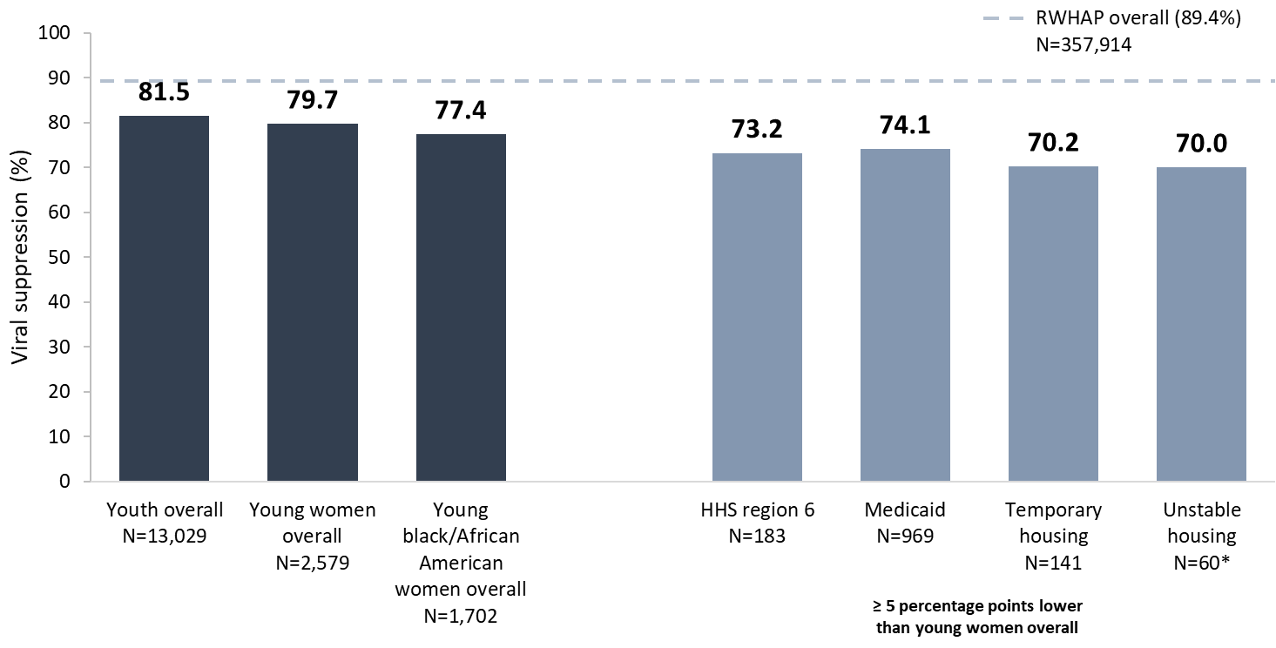
Viral Suppression among Young, Black/African American Women Aged 13–24 Years Served by the Ryan White HIV/AIDS Program, 2020—United States and 3 Territoriesª
N represents the total number of clients in the specific population.
Viral suppression: ≥1 OAHS visit during the calendar year and ≥1 viral load reported, with the last viral load result <200 copies/mL.
* Use caution when interpreting results based on small numbers.
ª Guam, Puerto Rico, and the U.S. Virgin Islands.
Notes:
In 2020, viral suppression for young, Black/African American women aged 13–24 years (77.4%) was lower than the national RWHAP average (89.4%) – indicated by the dashed grey line – lower than youth overall (81.5%), and slightly lower than young women overall (79.7%).
Viral suppression for young, Black/African American women was lowest among those receiving care in HHS Region 6 (73.2%), those with Medicaid coverage (74.1%), and those with temporary (70.2%) and unstable (70.0%) housing. Use caution when interpreting data on housing due to variability from small numbers.
N represents the total number of clients in the specific subpopulation.
Viral suppression is defined as ≥1 outpatient/ambulatory health services visit during the calendar year and ≥1 viral load reported, with the last viral load result <200 copies/mL.
The three territories include Guam, Puerto Rico, and the U.S. Virgin Islands.

Slide 24
Viral Suppression among Young, Black/African American Women Aged 13–24 Years Served by the Ryan White HIV/AIDS Program, 2020—United States and 3 Territoriesª
N represents the total number of clients in the specific population.
Viral suppression: ≥1 OAHS visit during the calendar year and ≥1 viral load reported, with the last viral load result <200 copies/mL.
* Use caution when interpreting results based on small numbers.
ª Guam, Puerto Rico, and the U.S. Virgin Islands.
Notes:
In 2020, viral suppression for young, Black/African American women aged 13–24 years (77.4%) was lower than the national RWHAP average (89.4%) – indicated by the dashed grey line – lower than youth overall (81.5%), and slightly lower than young women overall (79.7%).
Viral suppression for young, Black/African American women was lowest among those receiving care in HHS Region 6 (73.2%), those with Medicaid coverage (74.1%), and those with temporary (70.2%) and unstable (70.0%) housing. Use caution when interpreting data on housing due to variability from small numbers.
N represents the total number of clients in the specific subpopulation.
Viral suppression is defined as ≥1 outpatient/ambulatory health services visit during the calendar year and ≥1 viral load reported, with the last viral load result <200 copies/mL.
The three territories include Guam, Puerto Rico, and the U.S. Virgin Islands.

