Slide 1
Clients Aged 50 Years and Older Served by the Ryan White HIV/AIDS Program, 2021
Released February 2023
Notes:
HRSA is on four social media platforms. We encourage you to follow along and share our content on Twitter, Facebook, LinkedIn and Instagram to stay up-to-date on the latest HRSA news. Our account/handle on each platform is @HRSAgov.
Additionally, we also encourage you to sign up for HRSA’s e-News, a biweekly email of comprehensive HRSA news, and to sign up for HRSA press releases. You can also visit our website www.HRSA.gov for more detailed information about all of our programs.

Slide 2
Demographic Characteristics
Adults Aged 50 Years and Older

Slide 3
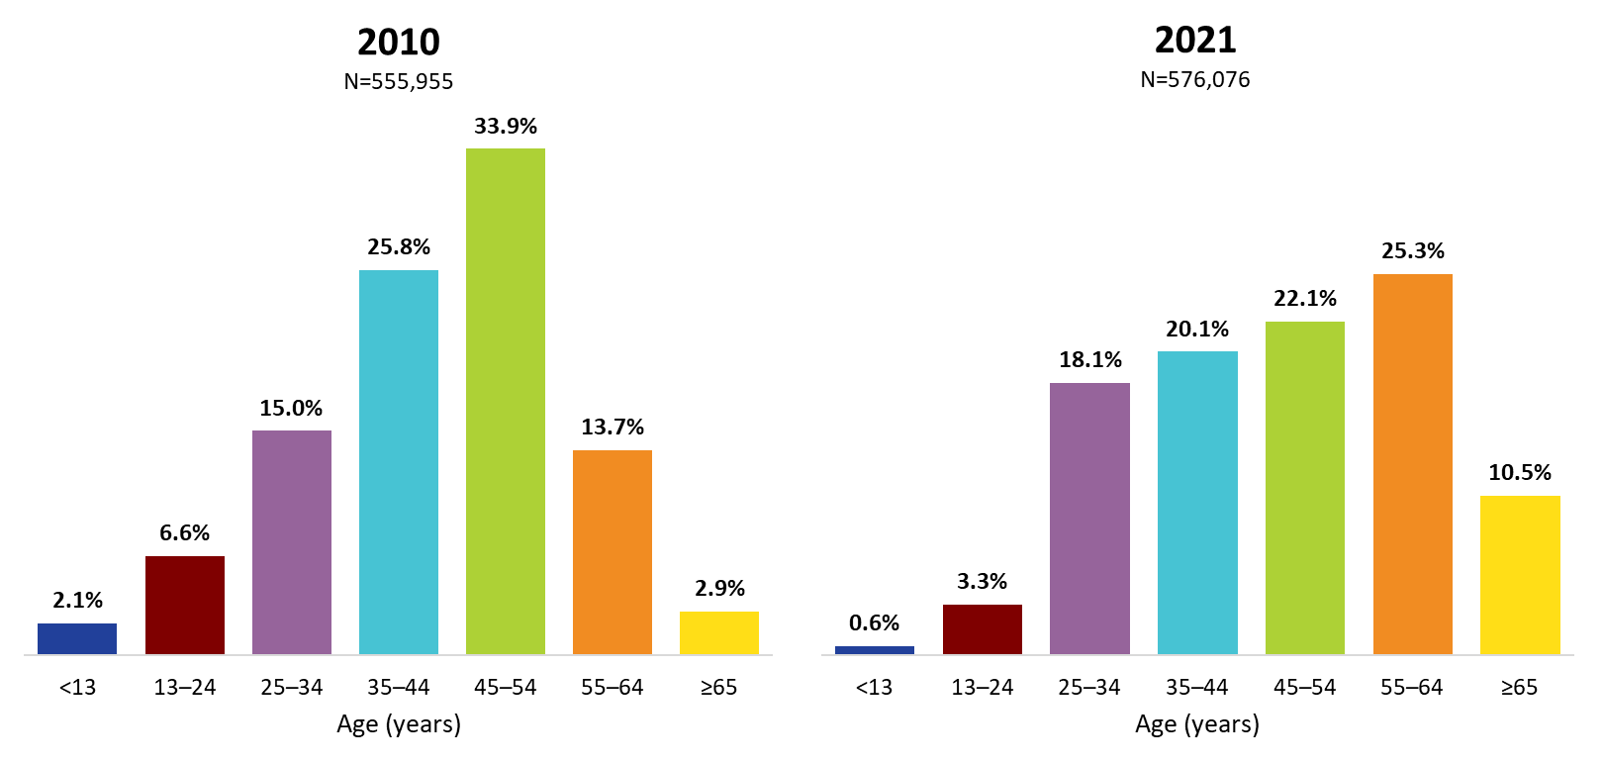
Ryan White HIV/AIDS Program Clients, by Age Group, 2010 and 2021—United States and 3 Territoriesª
ª Guam, Puerto Rico, and the U.S. Virgin Islands.
Notes:
The age distribution is shifting among RWHAP clients. From 2010 through 2021, the percentage of clients aged 35–54 years decreased (combined, 59.7% of the RWHAP population was aged 35–54 in 2010, decreasing to 42.2% in 2021), while the percentage increased during this time for those aged 55 and older (combined, from 16.6% in 2010 to 35.8% in 2021). Clients aged 65 years and older accounted for 29.4% of clients aged 55 and older in 2021, an increase from 2.9% in 2010.
The three territories include Guam, Puerto Rico, and the U.S. Virgin Islands.

Slide 4
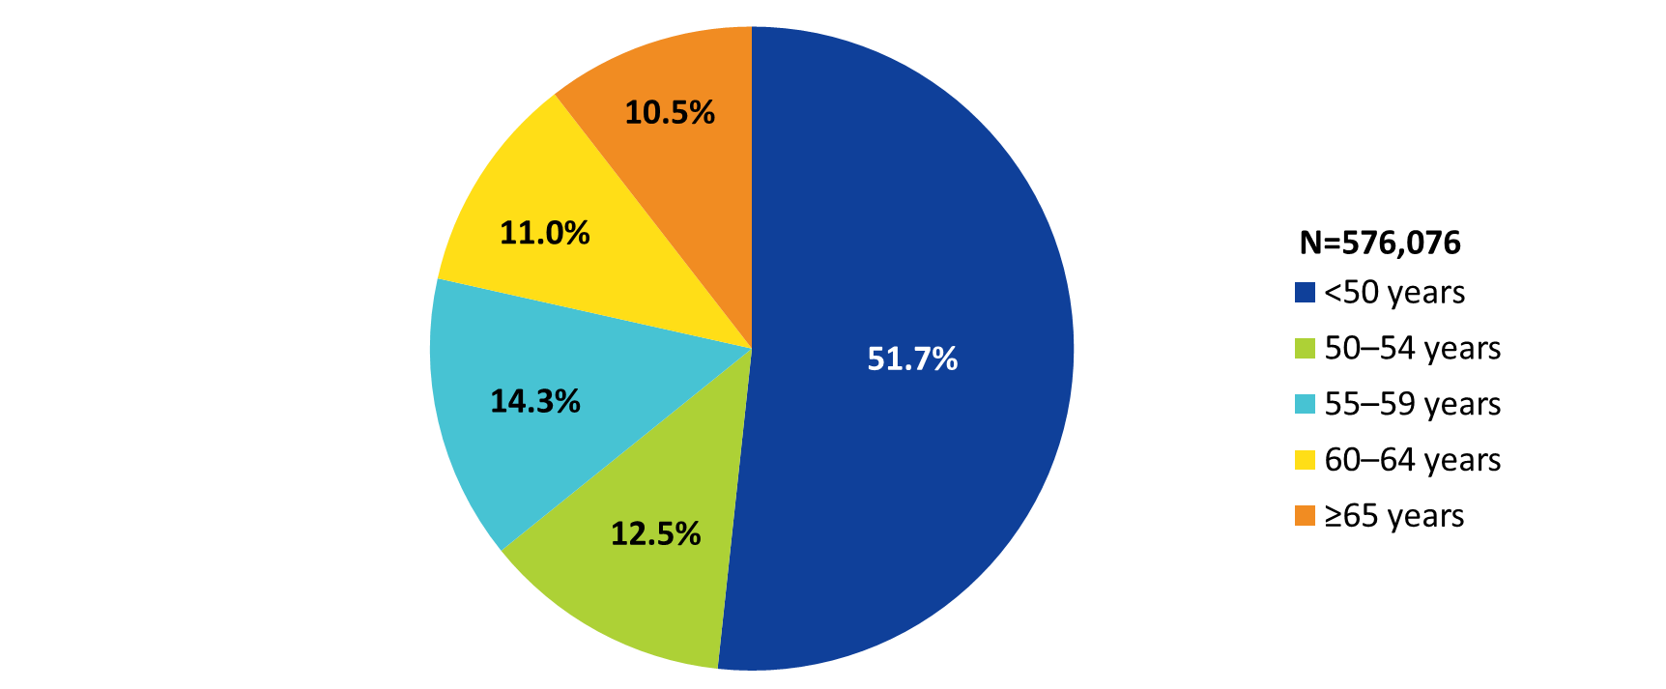
Clients Served by the Ryan White HIV/AIDS Program, by Age Group, 2021—United States and 3 Territoriesª
ª Guam, Puerto Rico, and the U.S. Virgin Islands.
Notes:
In 2021, 48.3% of the 576,076 clients served by the Ryan White HIV/AIDS Program with reported age information were aged 50 years and older. Among clients with reported age information, 12.5% were aged 50–54 years, 14.3% were aged 55–59 years, 11.0% were aged 60–64 years, and 10.5% were aged 65 years and older.
The three territories include Guam, Puerto Rico, and the U.S. Virgin Islands.

Slide 5
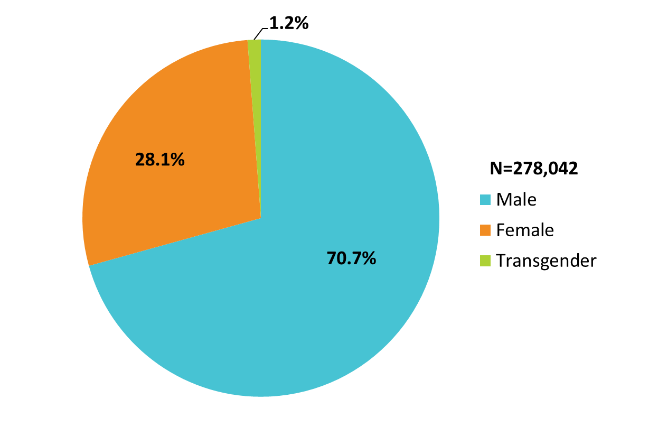
Clients Aged 50 Years and Older Served by the Ryan White HIV/AIDS Program, by Gender, 2021—United States and 3 Territoriesª
ª Guam, Puerto Rico, and the U.S. Virgin Islands.
Notes:
In 2021, of the 278,042 RWHAP clients aged 50 years and older with a reported gender, 70.7% were male, 28.1% were female, and 1.2% were transgender.
The three territories include Guam, Puerto Rico, and the U.S. Virgin Islands.

Slide 6
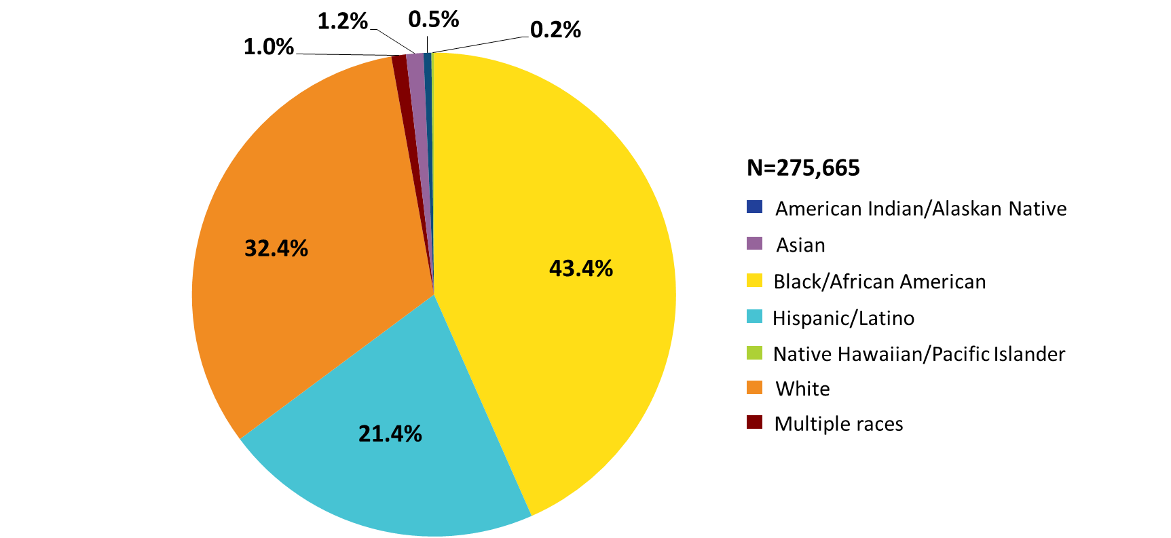
Clients Aged 50 Years and Older Served by the Ryan White HIV/AIDS Program, by Race/Ethnicity, 2021—United States and 3 Territoriesª
Hispanics/Latinos can be of any race.
ª Guam, Puerto Rico, and the U.S. Virgin Islands.
Notes:
In 2021, of the 275,665 adults aged 50 years and older with reported race/ethnicity information, 43.4% self-identified as Black/African American, 21.4% Hispanic/Latino, and Whites accounted for 32.4% of clients. Combined, American Indian/Alaska Native, Asian, Native Hawaiian/Pacific Islander, and clients of multiple races accounted for less than 3% of clients.
Hispanics/Latinos can be of any race.
The three territories include Guam, Puerto Rico, and the U.S. Virgin Islands.

Slide 7
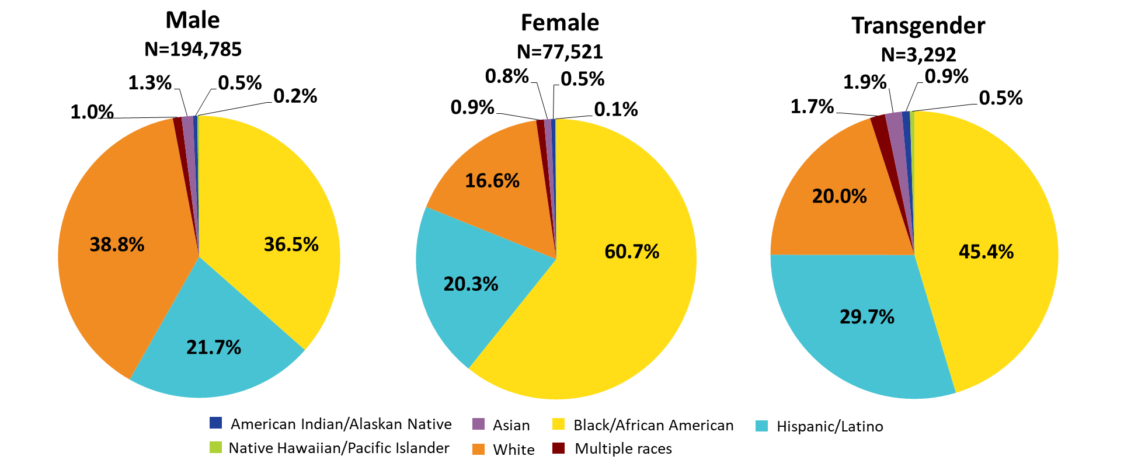
Clients Aged 50 Years and Older Served by the Ryan White HIV/AIDS Program, by Gender and Race/Ethnicity, 2021—United States and 3 Territoriesª
Hispanics/Latinos can be of any race.
ª Guam, Puerto Rico, and the U.S. Virgin Islands.
Notes:
In 2021, of clients aged 50 years and older, 61.2% of male clients, 83.4% of female clients, and 80.0% of transgender clients were racial/ethnic minorities. For reference, white clients appear in each pie chart in orange shading.
Hispanics/Latinos can be of any race.
Due to rounding, percentages may not add to 100%.
The three territories include Guam, Puerto Rico, and the U.S. Virgin Islands.

Slide 8
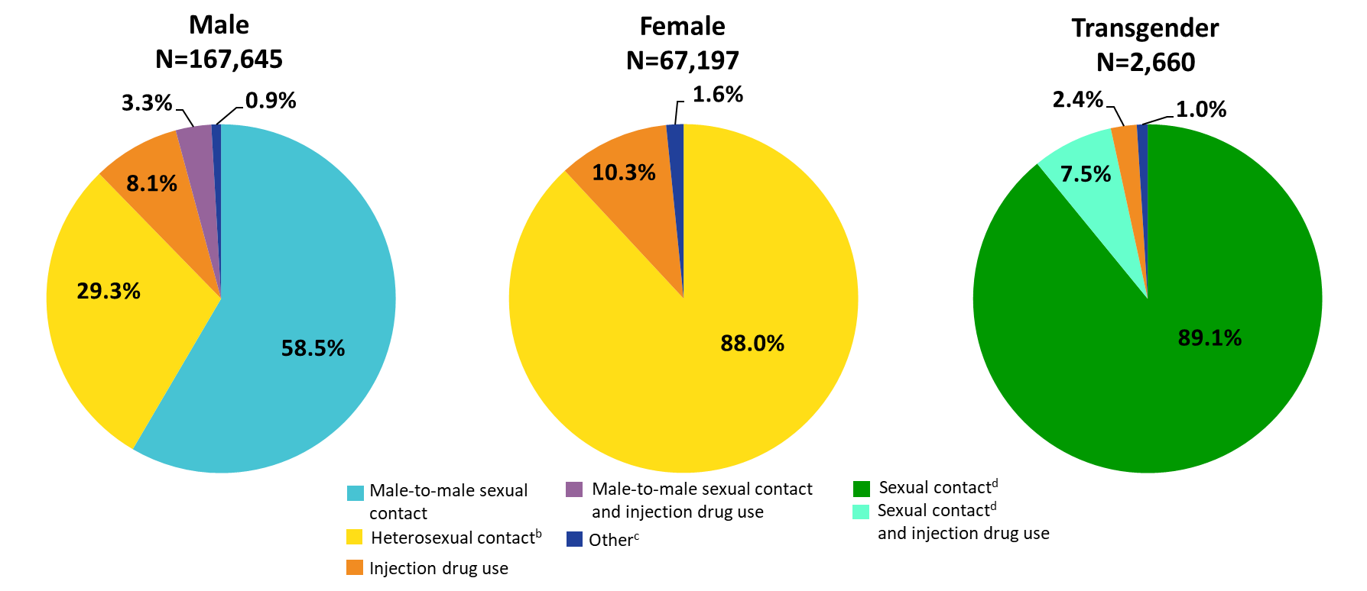
Clients Aged 50 Years and Older Served by the Ryan White HIV/AIDS Program, by Gender and Transmission Category, 2021—United States and 3 Territoriesª
ª Guam, Puerto Rico, and the U.S. Virgin Islands.
^{b} Heterosexual contact with a person know to have, or be at high risk for, HIV.
^{c} Includes hemophilia and blood transfusion.
^{d} Includes any reported sexual transmission category.
Notes:
By gender and transmission category, among male clients aged 50 years and older, 58.5 % had HIV attributed to male-to-male sexual contact; 29.3% had HIV attributed to heterosexual contact; 8.1% to injection drug use, and 3.3% to male-to-male sexual contact and injection drug use.
Among female clients aged 50 years and older, 88.0% had HIV attributed to heterosexual contact and 10.3% to injection drug use.
Among transgender clients aged 50 years and older, 89.1% had HIV attributed to some form of sexual contact, 7.5% to sexual contact and injection drug use, and 2.4% to injection drug use.
Heterosexual contact includes specific heterosexual contact with a person known to have, or to be at high risk for, HIV.
Other includes hemophilia, blood transfusion, and unknown risk factor.
Sexual contact includes any reported sexual transmission category for transgender clients.
Due to rounding, percentages may not add to 100%.
The three territories include Guam, Puerto Rico, and the U.S. Virgin Islands.

Slide 9
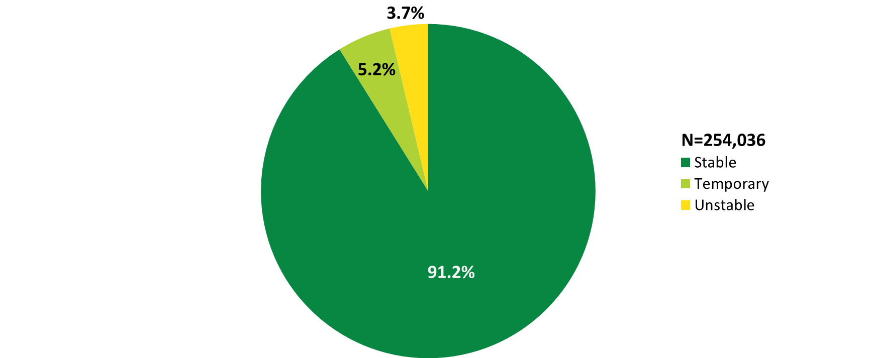
Clients Aged 50 Years and Older Served by the Ryan White HIV/AIDS Program, by Housing Status, 2021—United States and 3 Territoriesª
ª Guam, Puerto Rico, and the U.S. Virgin Islands.
Notes:
In 2021, of the 254,036 clients aged 50 years and older with reported housing status, 5.2% had temporary housing and 3.7% had unstable housing.
The three territories include Guam, Puerto Rico, and the U.S. Virgin Islands.

Slide 10
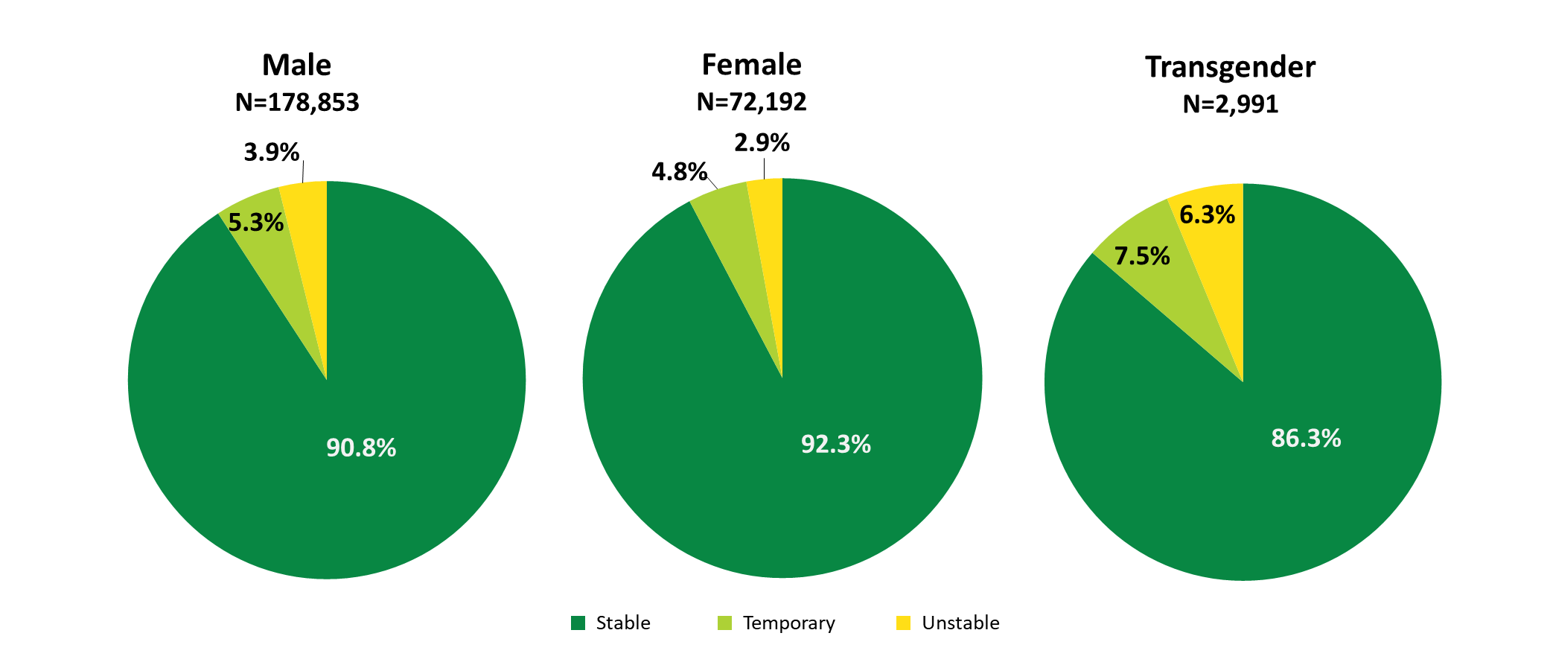
Clients Aged 50 Years and Older Served by the Ryan White HIV/AIDS Program, by Gender and Housing Status, 2021—United States and 3 Territoriesª
ª Guam, Puerto Rico, and the U.S. Virgin Islands.
Notes:
A slightly higher proportion of older female RWHAP clients had stable housing in 2021, compared with older male and transgender clients. Among female RWHAP clients aged 50 years and older, 4.8% had temporary housing and 2.9% had unstable housing. Among male clients aged 50 years and older, 5.3% had temporary housing and 3.9% had unstable housing. Among transgender clients aged 50 years and older, 7.5% had temporary housing and 6.3% had unstable housing.
Due to rounding, percentages may not sum to 100%.
The three territories include Guam, Puerto Rico, and the U.S. Virgin Islands.

Slide 11
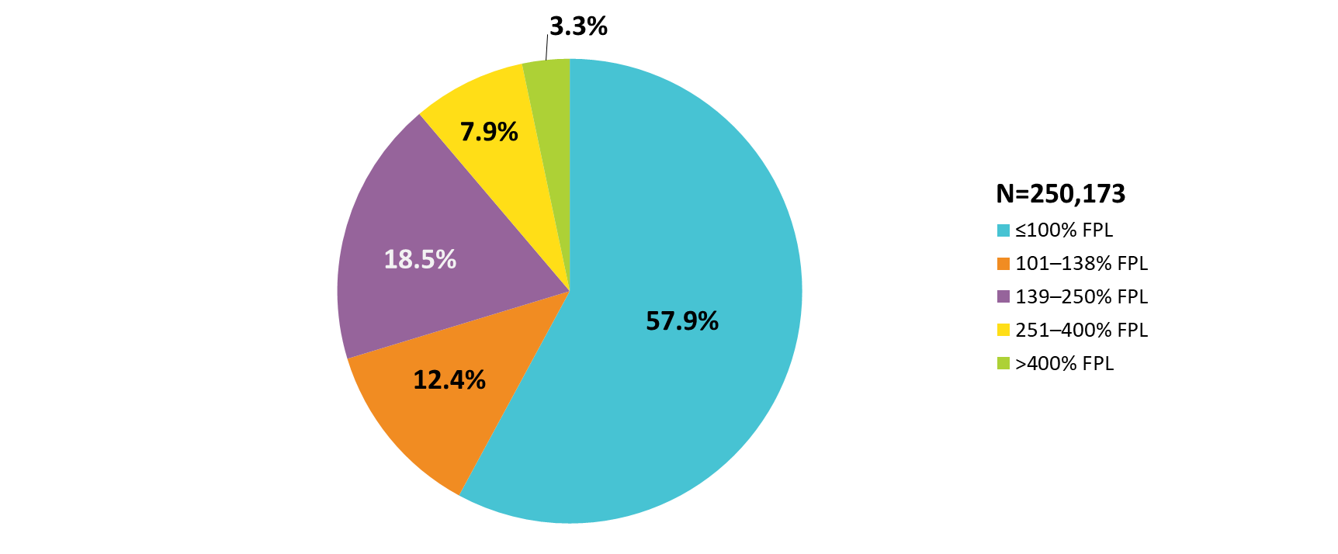
Clients Aged 50 Years and Older Served by the Ryan White HIV/AIDS Program, by Federal Poverty Level, 2021—United States and 3 Territoriesª
FPL: federal poverty level.
ª Guam, Puerto Rico, and the U.S. Virgin Islands.
Notes:
In 2021, 57.9% of the 250,173 clients aged 50 years and older with age information were living at or below 100% of the federal poverty level (FPL).
The three territories include Guam, Puerto Rico, and the U.S. Virgin Islands.

Slide 12
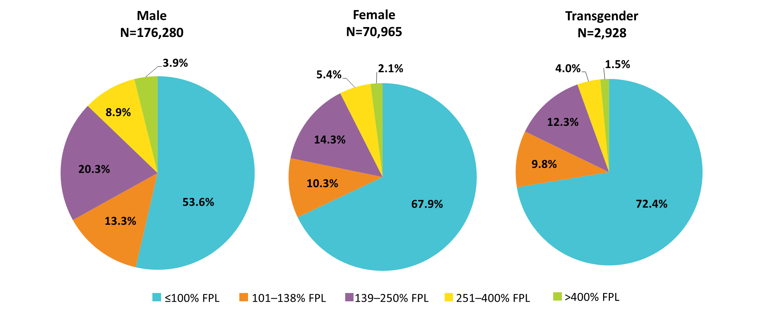
Clients Aged 50 Years and Older Served by the Ryan White HIV/AIDS Program, by Gender and Federal Poverty Level, 2021—United States and 3 Territoriesª
FPL: federal poverty level.
ª Guam, Puerto Rico, and the U.S. Virgin Islands.
Notes:
Older female and transgender clients had lower incomes than older male clients. Among the 70,965 female clients aged 50 years and older with poverty level information in 2021, 67.9% were living at or below 100% of the federal poverty level (FPL). Among the 2,928 transgender clients aged 50 years and older with poverty level information, 72.4% were living at or below 100% FPL. These percentages are compared to 53.6% of the 176,280 older males with poverty level information living at or below 100% FPL.
The three territories include Guam, Puerto Rico, and the U.S. Virgin Islands.

Slide 13
Viral Suppression
Adults Aged 50 Years and Older

Slide 14
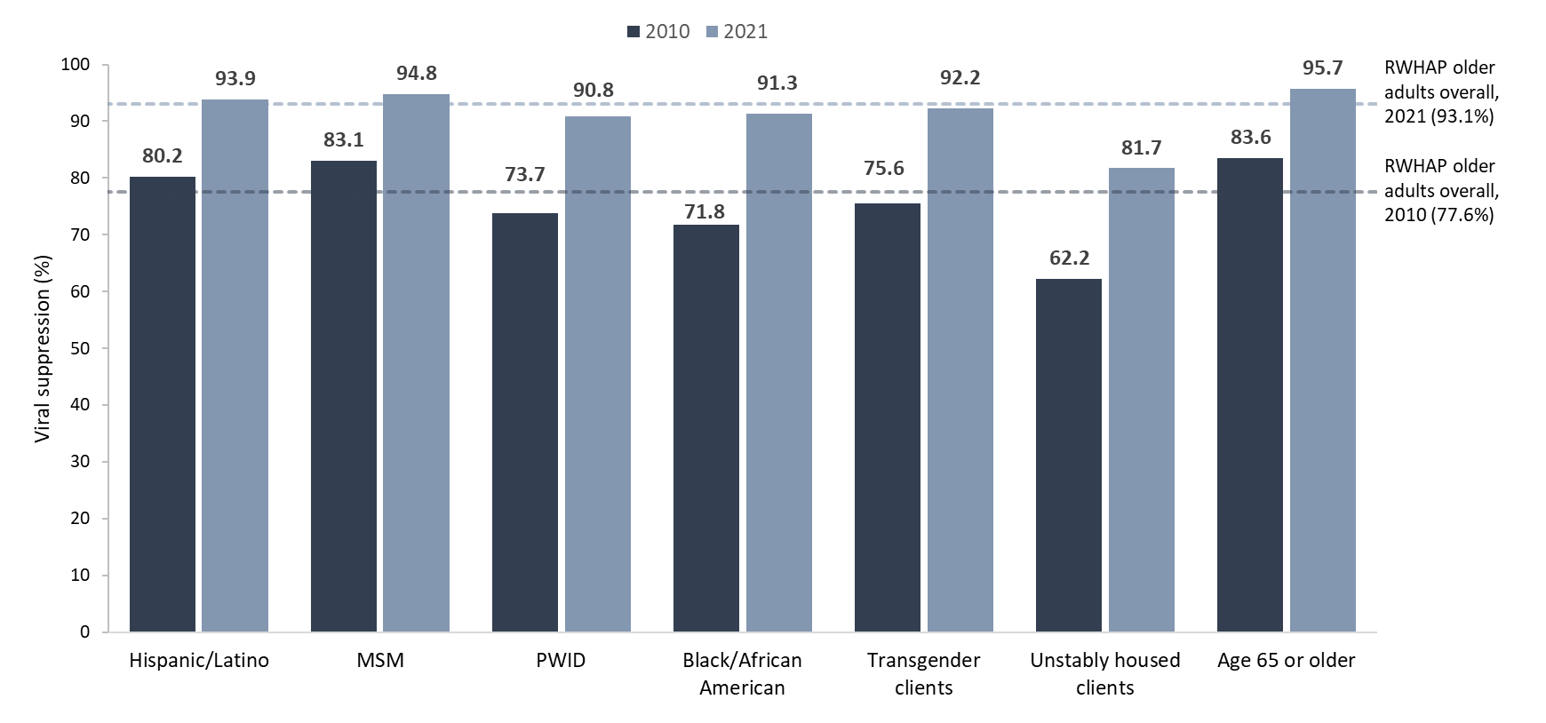
Adults Aged 50 Years and Older - Viral Suppression among Key Populations Served by the Ryan White HIV/AIDS Program, 2010 and 2021—United States and 3 Territoriesª
Hispanics/Latinos can be of any race.
Viral suppression: ≥1 OAHS visit during the calendar year and ≥1 viral load reported, with the last viral load result <200 copies/mL.
ª Guam, Puerto Rico, and the U.S. Virgin Islands.
Notes:
This chart shows viral suppression among key populations of older adults served by the RWHAP. It shows a side-by-side comparison of viral suppression for each subpopulation in 2010 – indicated by a dark grey bar, and in 2021 – indicated by a light grey bar. For comparison, viral suppression for all RWHAP clients aged 50 years and older overall in 2010 was 77.6% indicated by the dark grey line and was 93.1% in 2021 indicated by the light grey line. This upward trend in viral suppression occurred across all key populations.
However, it is important to note that challenges remain in achieving viral suppression for certain populations. Most notably, in 2021, the client subpopulations with viral suppression lower than the overall percentage of 93.1% were clients with unstable housing (81.7%); slightly lower were transgender clients (92.2%), Blacks/African Americans (91.3%), and clients with HIV attributed to injection drug use (90.8%).
Viral suppression is defined as ≥1 outpatient/ambulatory health services visit during the calendar year and ≥1 viral load reported, with the last viral load result <200 copies/mL.
The three territories include Guam, Puerto Rico, and the U.S. Virgin Islands.

