Slide 1

Clients and Patients Served by the Ryan White HIV/AIDS Program
2023
Overview and HIV Care Outcomes
Released July 2025

Slide 2
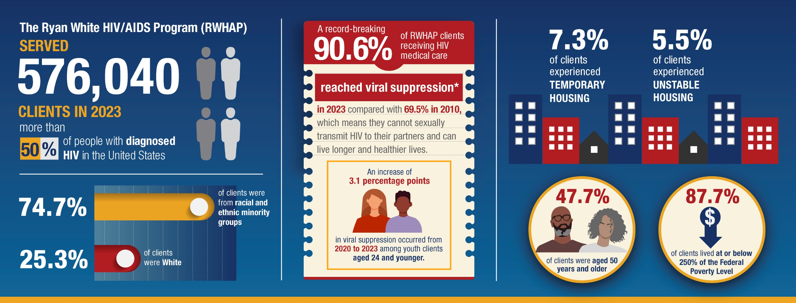
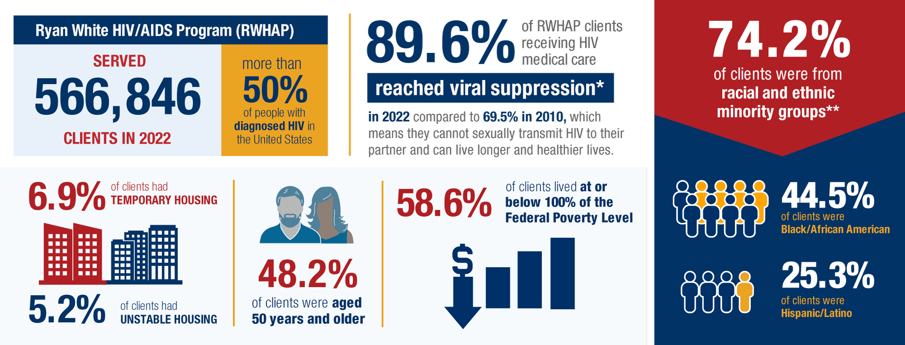
HRSA’s Ryan White HIV/AIDS Program BY THE NUMBERS: 2023
* Viral suppression is based on data for people with HIV who had at least one outpatient ambulatory health services visit and at least one viral load test during the measurement year and whose most recent viral load test result was less than 200 copies/mL.
Source: 2023 Ryan White HIV/AIDS Program Annual Data Report.
Notes:
In 2023, the RWHAP served more than 576,000 clients, the majority of whom were people with HIV. This represents more than half of all people with diagnosed HIV in the U.S.
Almost 50% of clients were aged 50 years and older.
Nearly 88% of RWHAP clients were living at or below 250% of the Federal Poverty Level and over 12% experienced temporary or unstable housing.
In 2023, a record-breaking 90.6% of RWHAP clients receiving HIV medical care reached viral suppression, compared with 69.5% in 2010! People who are virally suppressed cannot sexually transmit HIV to their partners and can live longer and healthier lives.

Slide 3
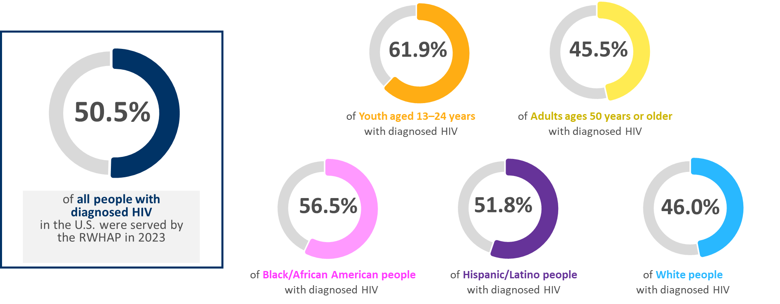
Percentage of People with Diagnosed HIV Served by the RWHAP, 2023—United States and 3 Territoriesª
ª Guam, Puerto Rico, and the U.S. Virgin Islands.
Denominator source: HIV Diagnoses, Deaths, and Prevalence. Centers for Disease Control and Prevention, 2023. Published April 29, 2025. Accessed [May 7, 2025]. https://www.cdc.gov/hiv-data/nhss/hiv-diagnoses-deaths-prevalence.html.
Notes:
To provide some context to the RWHAP client data, this graphics shows RWHAP clients with HIV as a proportion of all people with diagnosed HIV in the United States, according to the published HIV surveillance data from the CDC.
The far-left box shows that RWHAP served nearly 51% of all people with diagnosed HIV in the U.S. and territories. The proportion varies by population. For example, RWHAP served: 61.9% of all youth with diagnosed HIV in the U.S., but only 45.5% of all adults aged 50 years or older. Additionally, the RWHAP served 55.9% of all women with diagnosed HIV in the U.S., 56.5% of Black/African Americans with diagnosed HIV, 51.8% of Hispanics or Latinos with diagnosed HIV, and 46.0% of Whites with diagnosed HIV.
The three territories include Guam, Puerto Rico, and the U.S. Virgin Islands.

Slide 4
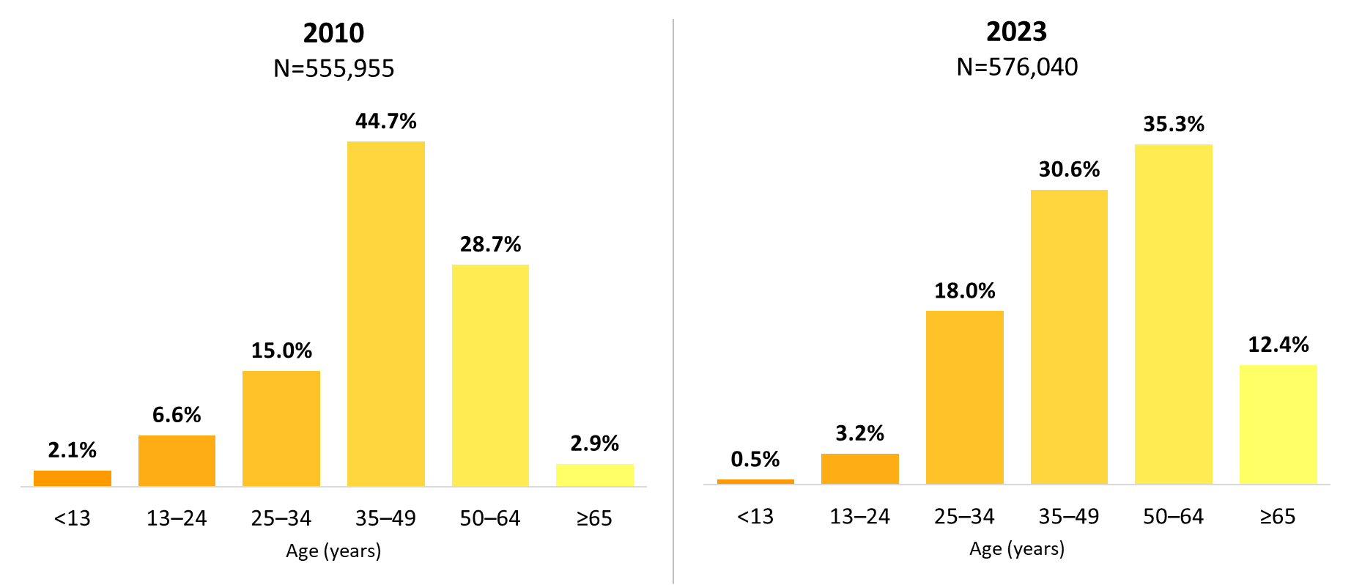
Ryan White HIV/AIDS Program Clients, by Age Group, 2010 and 2023—United States and 3 Territoriesª
ª Guam, Puerto Rico, and the U.S. Virgin Islands.
Notes:
The age distribution is shifting among RWHAP clients. From 2010 to 2023, the percentage of clients aged 50 and older increased from 31.6% in 2010 to 47.7% in 2023. Clients aged 65 years and older accounted for 12.4% of all clients in 2023, but more than a quarter (26.0%) of clients aged 50 and older.
The three territories include Guam, Puerto Rico, and the U.S. Virgin Islands.

Slide 5
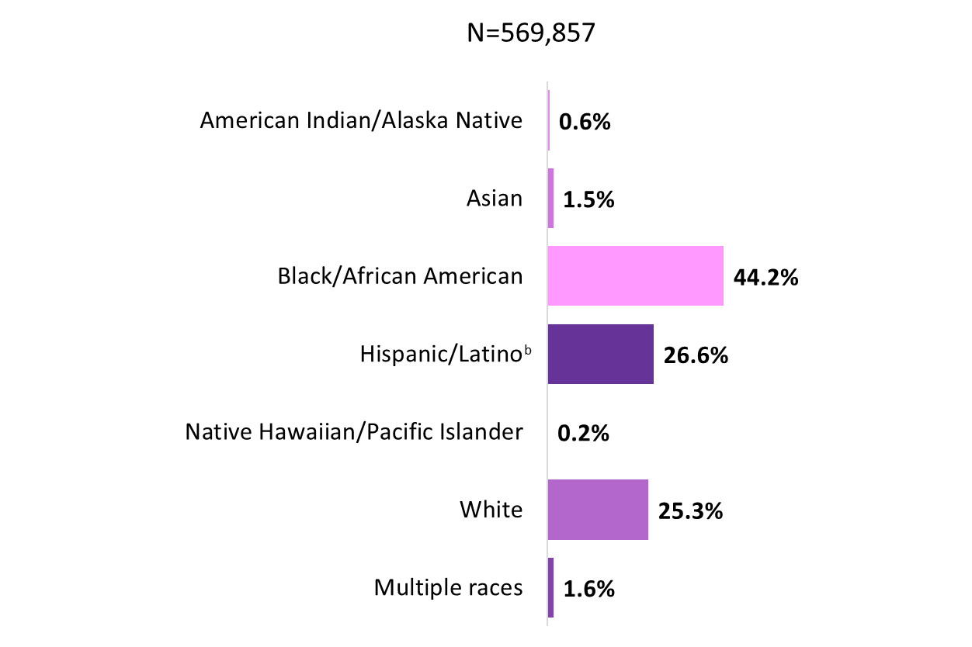
Clients Served by the Ryan White HIV/AIDS Program, by Race/Ethnicity, 2023—United States and 3 Territoriesª
ª Guam, Puerto Rico, and the U.S. Virgin Islands.
^{b} Hispanics/Latinos can be of any race.
Notes:
In 2023, of the 569,857 clients with reported race/ethnicity information, nearly three-quarters (74.7%) of RWHAP clients were from racial and ethnic minority groups. Clients who self-identified as White accounted for 25.3% of clients. Approximately 44% self-identified as Black/African American, 27% self-identified as Hispanic/Latino, and less than 2% each self-identified as American Indian/Alaska Native, Asian, Native Hawaiian/Pacific Islander, and people of multiple races. The percentage distribution of race/ethnicity has remained consistent since 2010.
Hispanics/Latinos can be of any race.
The three territories include Guam, Puerto Rico, and the U.S. Virgin Islands.

Slide 6
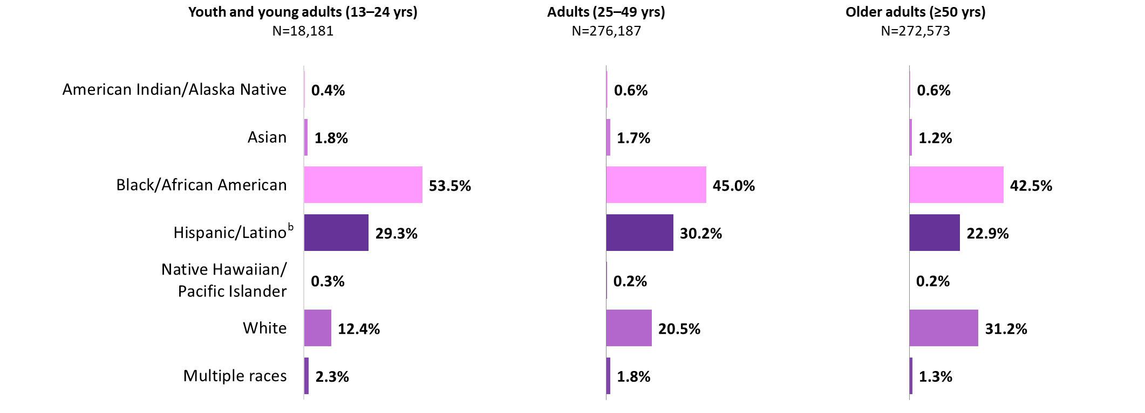
Clients Served by the Ryan White HIV/AIDS Program, by Age Group and Race/Ethnicity, 2023—United States and 3 Territoriesª
ª Guam, Puerto Rico, and the U.S. Virgin Islands.
^{b} Hispanics/Latinos can be of any race.
Notes:
In 2023, 87.6% of youth and young adult clients aged 13–24 years, 79.5% of adult clients aged 25–49 years, and 68.8% of older adult clients aged 50 years or older were from racial and ethnic minority groups. White clients represented approximately 12% of youth/young adults, 21% of adults aged 25–49, and 31% of older adults aged 50 years or older.
Hispanics/Latinos can be of any race.
The three territories include Guam, Puerto Rico, and the U.S. Virgin Islands.

Slide 7
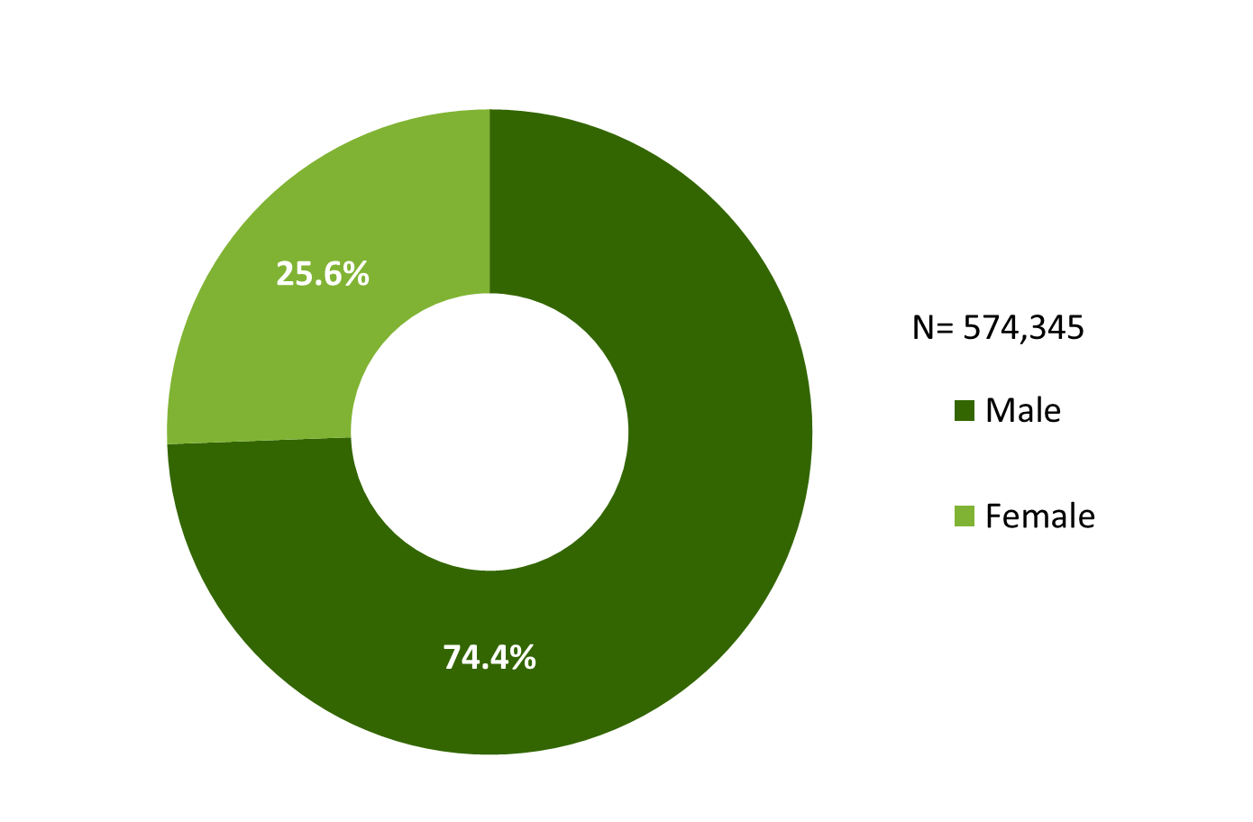
Clients Served by the Ryan White HIV/AIDS Program, by Sex, 2023 — United States and 3 Territoriesª
ª Guam, Puerto Rico, and the U.S. Virgin Islands.
Notes:
The RWHAP serves over half a million people each year. In 2023, of the 574,345 clients with a reported sex, 74.4% were male and 25.6% were female.
The three territories include Guam, Puerto Rico, and the U.S. Virgin Islands.
Due to rounding, percentages may not sum to 100.0%.

Slide 8
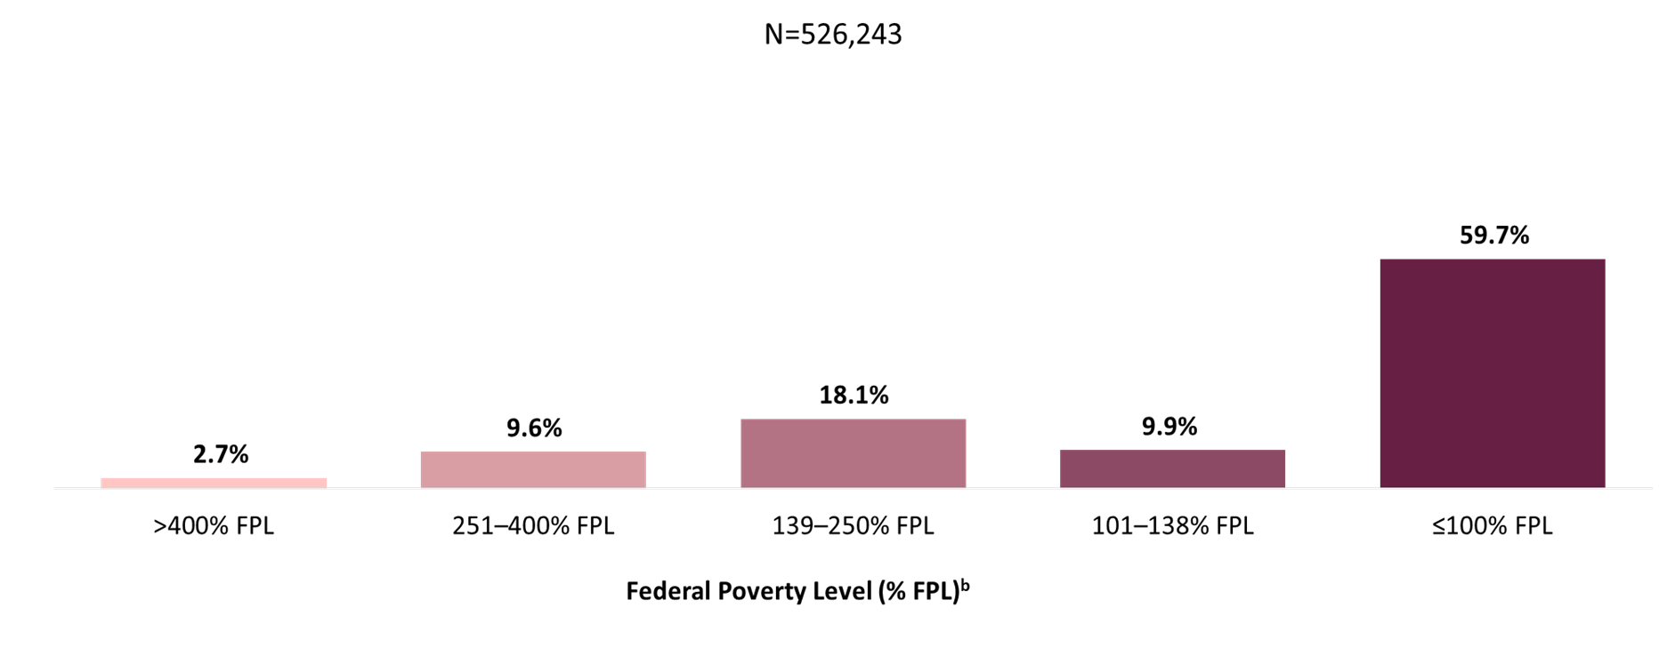
Clients Served by the Ryan White HIV/AIDS Program, by Federal Poverty Level, 2023—United States and 3 Territoriesª
ª Guam, Puerto Rico, and the U.S. Virgin Islands.
^{b} Poverty thresholds vary by household size. For example, the annual income threshold in 2023 was $14,580 for a household of 1 and $30,000 for a household of 4 in the 48 contiguous states and D.C., using a simplified calculation method. Different thresholds apply for Alaska and Hawaii. Source: U.S. Department of Health and Human Services, 2023 Poverty Guidelines.
Notes:
In 2023, 59.7% of the 526,243 clients with income information were living at or below 100% of the federal poverty level (FPL), and 87.7% were living at or below 250% FPL.
Poverty thresholds vary by household size. For example, the annual income threshold in 2023 was $14,580 for a household of 1 and $30,000 for a household of 4 in the 48 contiguous states and D.C., using a simplified calculation method. Different thresholds apply for Alaska and Hawaii.
The three territories include Guam, Puerto Rico, and the U.S. Virgin Islands.

Slide 9
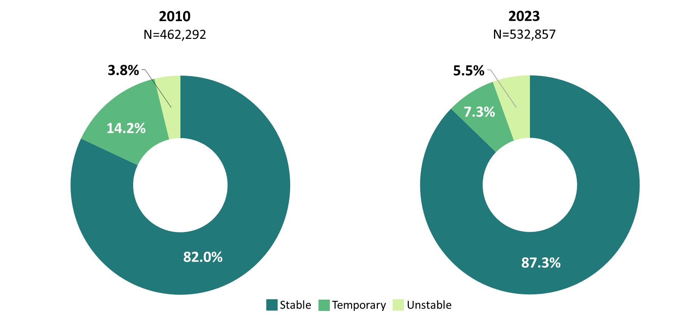
Clients Served by the Ryan White HIV/AIDS Program, by Housing Status, 2010 and 2023—United States and 3 Territoriesª
ª Guam, Puerto Rico, and the U.S. Virgin Islands.
Notes:
In 2023, of the 532,857 clients with reported housing status, 7.3% experienced temporary housing and 5.5% experienced unstable housing. Compared with clients served in 2010, a greater proportion of clients were stably housed in 2023 (87.3%) than in 2010 (82.0%).
The three territories include Guam, Puerto Rico, and the U.S. Virgin Islands.

Slide 10
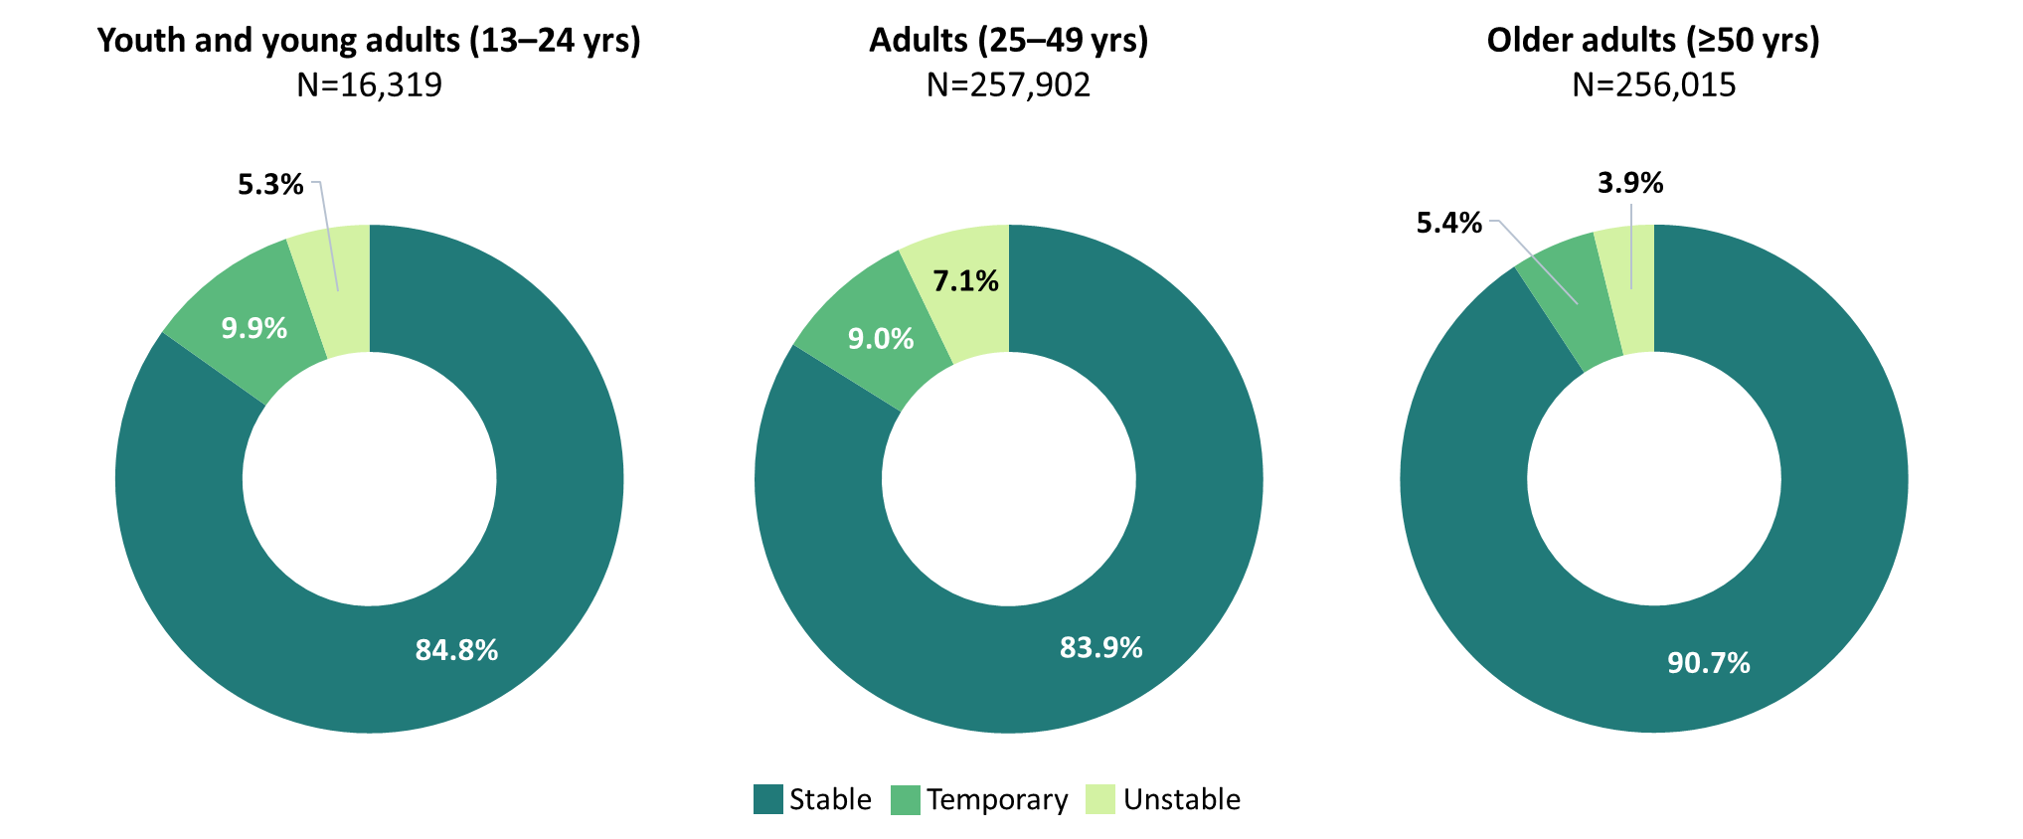
Clients Served by the Ryan White HIV/AIDS Program, by Age Group and Housing Status, 2023—United States and 3 Territoriesª
ª Guam, Puerto Rico, and the U.S. Virgin Islands.
Notes:
A greater proportion of older adult RWHAP clients aged 50 or older (90.7%) experienced stable housing in 2023, compared with adult clients aged 25–49 years (83.9%) and youth/young adult clients aged 13–24 years (84.8%). Among youth/young adult clients, 9.9% experienced temporary housing and 5.3% experienced unstable housing. Among adult clients, 9.0% experienced temporary housing and 7.1% experienced unstable housing. Among older adult clients, 5.4% experienced temporary housing and 3.9% experienced unstable housing.
The three territories include Guam, Puerto Rico, and the U.S. Virgin Islands.

Slide 11
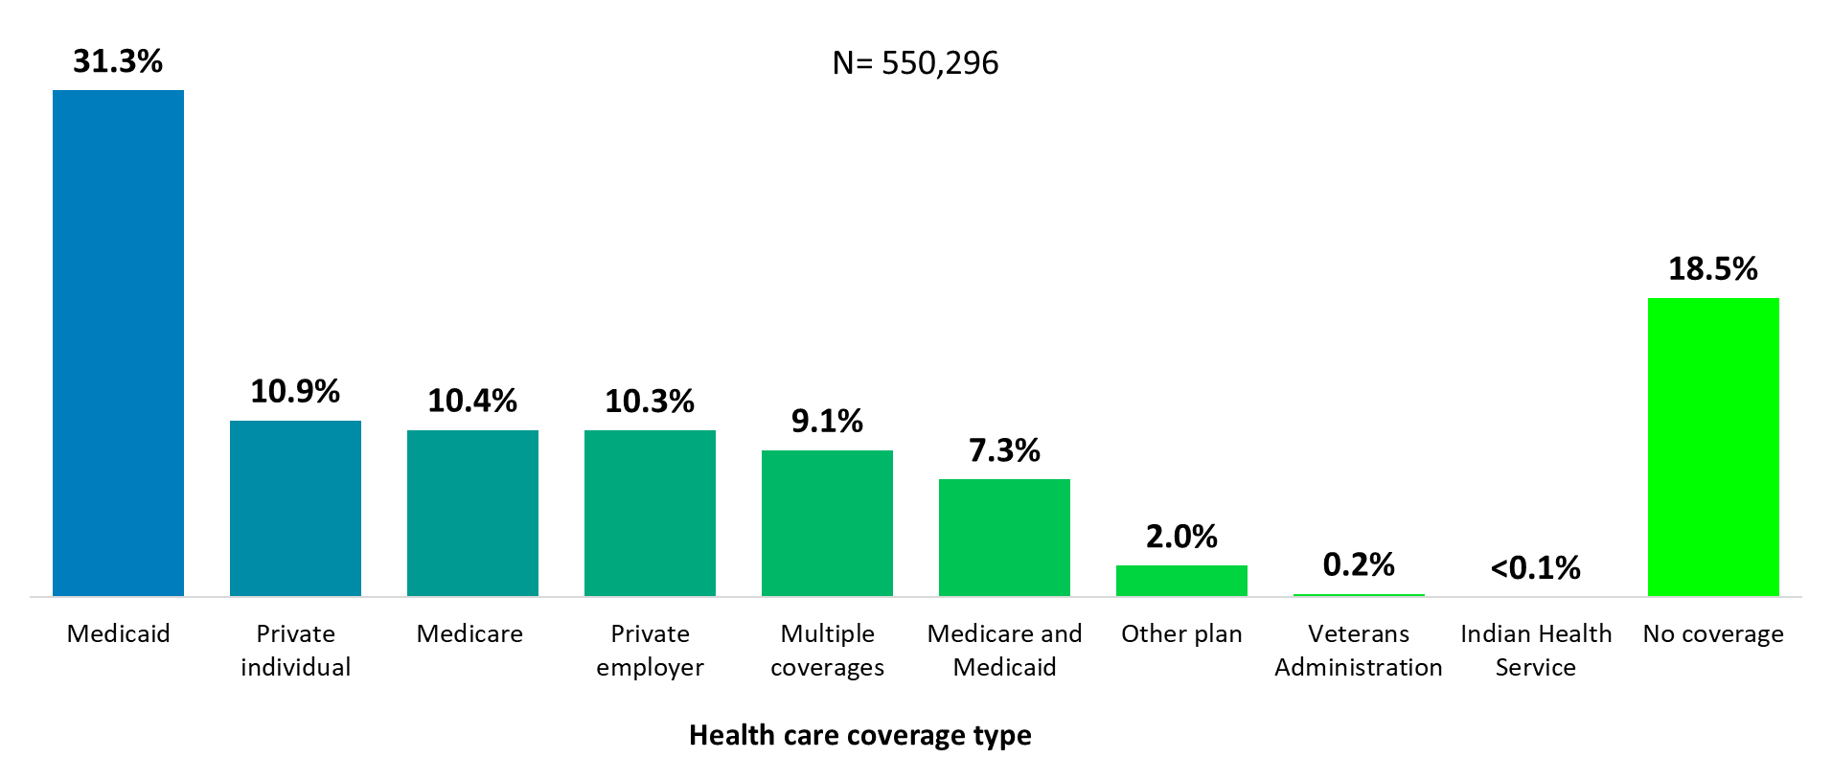
Clients Served by the Ryan White HIV/AIDS Program, by Health Care Coverage, 2023—United States and 3 Territoriesª
ª Guam, Puerto Rico, and the U.S. Virgin Islands.
Notes:
In 2023, 81.5% of RWHAP clients had some form of health care coverage. Of the 550,296 clients with reported health care coverage information, 31.3% were covered by Medicaid, 10.9% had private individual coverage, 10.4% were covered by Medicare, 10.3% had private employer coverage, 9.1% had multiple forms of coverage, and 7.3% had both Medicare and Medicaid dual coverage. Nearly one-fifth (18.5%) of RWHAP clients had no health care coverage in 2023.
Multiple coverage includes any combination of coverage types except for the Medicare and Medicaid dual enrollment category, which is displayed separately.
The three territories include Guam, Puerto Rico, and the U.S. Virgin Islands.

Slide 12
Trends in Viral Suppression Among Patients Served by the Ryan White HIV/AIDS Program

Slide 13
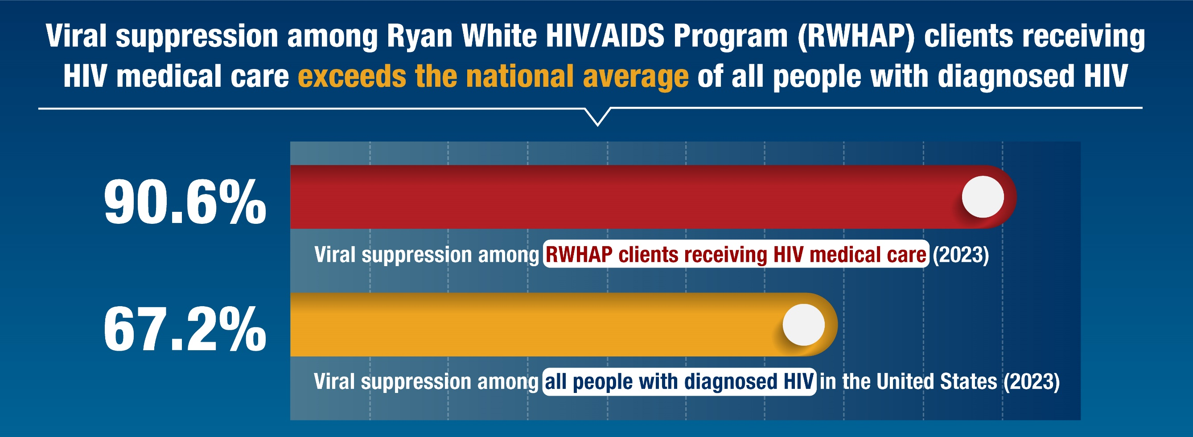
Ryan White HIV/AIDS Program Viral Suppression vs.
National Viral Suppression
Sources
1. Health Resources and Services Administration. December 2024. Ryan White HIV/AIDS Program Annual Data Report 2023.
2. Monitoring Selected National HIV Prevention and Care Objectives by Using HIV Surveillance Data—United States and 6 Territories and Freely Associated States, 2023. Centers for Disease Control and Prevention. Published April 29, 2025. Accessed June 4, 2025. https://www.cdc.gov/hiv-data/nhss/national-hiv-prevention-and-care-outcomes.html
Notes:
In 2023, 90.6% of RWHAP clients receiving HIV medical care reached viral suppression. Viral suppression among RWHAP clients receiving HIV medical care exceeded the national average of all people with diagnosed HIV (67.2% vs. 90.6%, respectively).
The three territories include Guam, Puerto Rico, and the U.S. Virgin Islands.

Slide 14
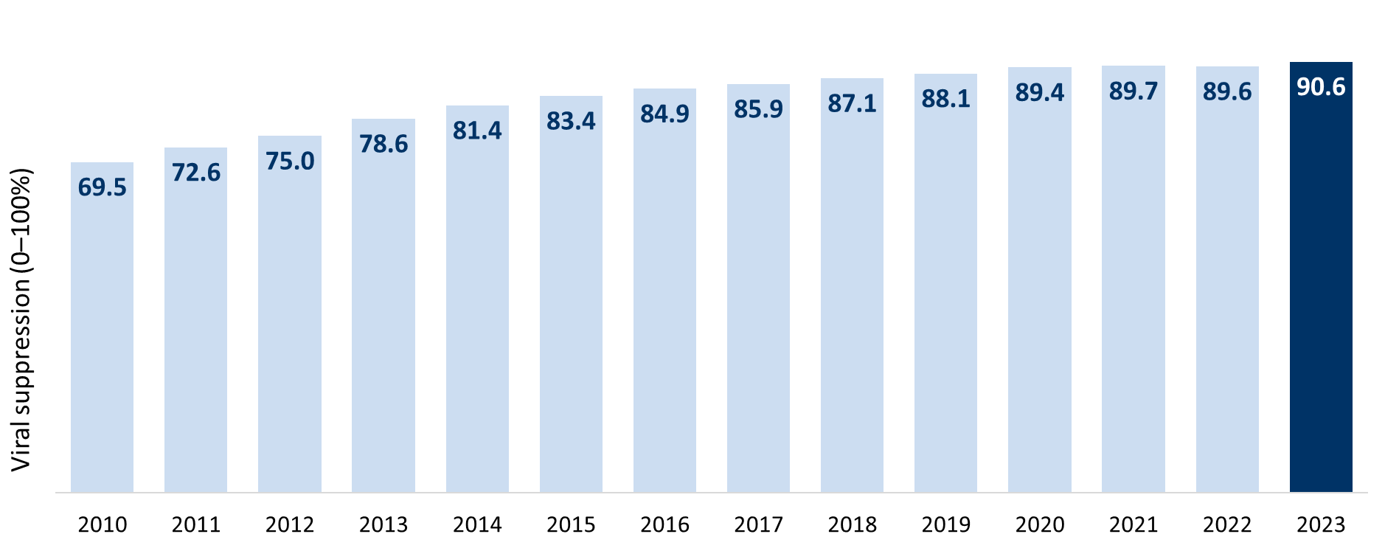
Viral Suppression among Patients Served by the Ryan White HIV/AIDS Program (non-ADAP), 2010–2023—United States and 3 Territoriesª
Viral suppression: ≥1 OAHS visit during the calendar year and ≥1 viral load reported, with the last viral load result <200 copies/mL.
ª Guam, Puerto Rico, and the U.S. Virgin Islands.
Notes:
This chart shows the proportion of RWHAP patients that reached viral suppression from 2010 through 2023. Viral suppression increased steadily over the fourteen-year period, from 69.5% in 2010 to 90.6% in 2023.
Viral suppression is defined as ≥1 outpatient/ambulatory health services visit during the calendar year and ≥1 viral load reported, with the last viral load result <200 copies/mL.
The three territories include Guam, Puerto Rico, and the U.S. Virgin Islands. 2019 and 2020 data for Guam are unavailable.

Slide 15
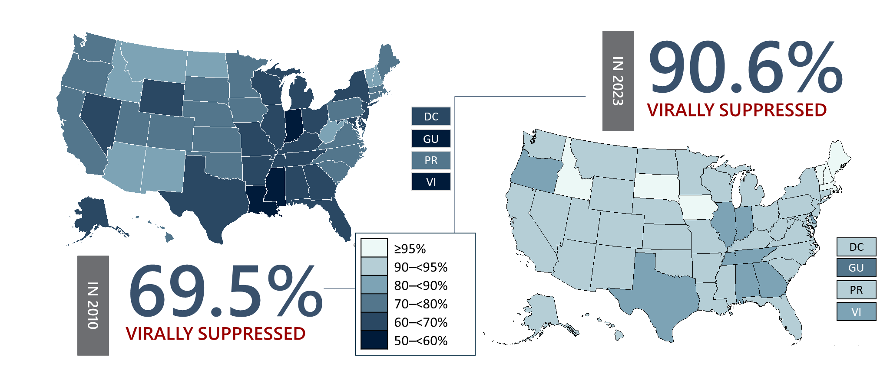
Viral Suppression among RWHAP Patients, by State, 2010 and 2023—United States and 3 Territoriesª
Viral suppression: ≥1 OAHS visit during the calendar year and ≥1 viral load reported, with the last viral load result <200 copies/mL.
ª Guam, Puerto Rico, and the U.S. Virgin Islands.
Notes:
This slide shows the variation in viral suppression by state among Ryan White HIV/AIDS Program patients in 2010 and in 2023, with darker blue indicating lower percentages of viral suppression and lighter shades indicating higher percentages.
From 2010 to 2023, all states showed increases in viral suppression; however, some states, particularly in the Southern U.S. continued to have room for improvement.
Viral suppression is defined as ≥1 outpatient/ambulatory health services visit during the calendar year and ≥1 viral load reported, with the last viral load result <200 copies/mL.
The three territories include Guam, Puerto Rico, and the U.S. Virgin Islands.

Slide 16
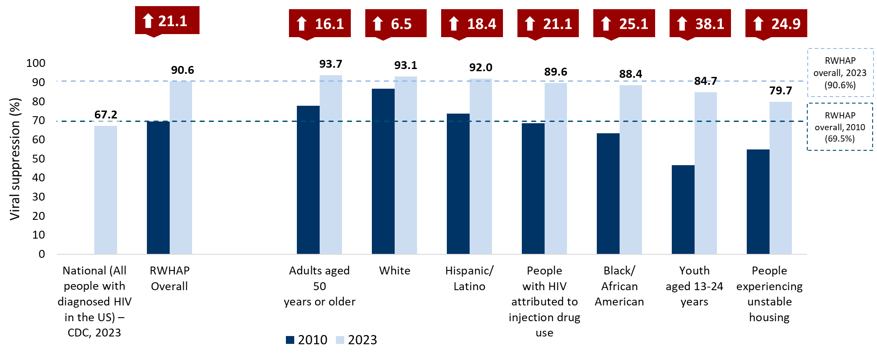
Viral Suppression among Populations Served by the Ryan White HIV/AIDS Program, 2010 and 2023—United States and 3 Territoriesª
Hispanics/Latinos can be of any race.
Viral suppression: ≥1 OAHS visit during the calendar year and ≥1 viral load reported, with the last viral load result <200 copies/mL.
ª Guam, Puerto Rico, and the U.S. Virgin Islands.
Notes:
This chart shows viral suppression among people disproportionately affected by HIV that were served by the RWHAP. It shows a side-by-side comparison of viral suppression for each population in 2010 – indicated by a dark blue bar, and in 2023 – indicated by a light blue bar. For comparison, viral suppression for all RWHAP patients overall in 2010 was 69.5% indicated by the dark blue line. Viral suppression for all RWHAP patients overall in 2023 was 90.6%, compared to 67.2% for all people in the U.S. with HIV in 2023.
Viral suppression increased across all people disproportionately affected by HIV, most notably among people experiencing unstable housing (increase 24.9 percentage points), Black/African American patients (25.1 percentage points), and youth aged 13-24 years (38.1 percentage points).
However, it is important to note that challenges remain in reaching viral suppression for certain populations. Most notably, in 2023, the patient populations with viral suppression lower than the overall percentage of 90.6% were people with HIV attributed at diagnosis to injection drug use (89.6%), Black/African American patients (88.4%), youth aged 13-24 years (84.7%), and people experiencing unstable housing (79.7%).
Hispanics/Latinos can be of any race.
RWHAP viral suppression is defined as ≥1 outpatient/ambulatory health services visit during the calendar year and ≥1 viral load reported, with the last viral load result <200 copies/mL.
National viral suppression is reported through the CDC’s National HIV Surveillance System. CDC’s national viral suppression estimate reflects all people with diagnosed HIV. Source: Source: Monitoring Selected National HIV Prevention and Care Objectives by Using HIV Surveillance Data—United States and 6 Territories and Freely Associated States, 2023. Centers for Disease Control and Prevention. Published April 29, 2025. Accessed [date]. https://www.cdc.gov/hiv-data/nhss/national-hiv-prevention-and-care-outcomes.html
The three territories include Guam, Puerto Rico, and the U.S. Virgin Islands.

Slide 17

Connect with the Ryan White HIV/AIDS Program
Learn more about our program at our website:
ryanwhite.hrsa.gov
Sign up for the Ryan White HIV/AIDS Program Listserv:
https://public.govdelivery.com/accounts/USHHSHRSA/signup/29907

Slide 18






Connect with HRSA
Learn more about our agency at:
www.HRSA.gov
Sign up for the HRSA eNews
FOLLOW US:
Notes:
HRSA is on four social media platforms. We encourage you to follow along and share our content on Twitter, Facebook, LinkedIn and Instagram to stay up-to-date on the latest HRSA news. Our account/handle on each platform is @HRSAgov.
Additionally, we also encourage you to sign up for HRSA’s e-News, a biweekly email of comprehensive HRSA news, and to sign up for HRSA press releases. You can also visit our website www.HRSA.gov for more detailed information about all of our programs.

