Slide 1
Clients Served by the Ryan White HIV/AIDS Program 2020
Overview
Released December 2021

Slide 2
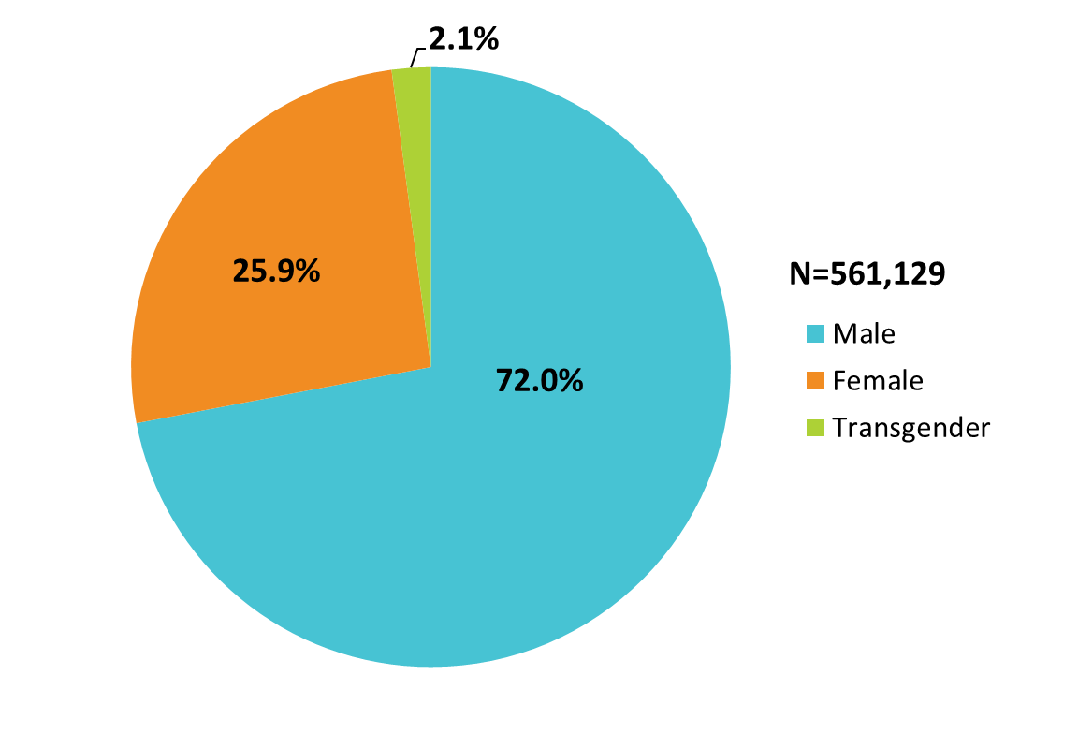
Clients Served by the Ryan White HIV/AIDS Program, by Gender, 2020—United States and 3 Territoriesª
ª Guam, Puerto Rico, and the U.S. Virgin Islands.
Source: HRSA. Ryan White HIV/AIDS Program Data Report (RSR) 2020. Does not include AIDS Drug Assistance Program data.
Notes:
The RWHAP serves over half a million people each year. In 2020, of the 561,129 clients with a reported gender, 72.0% were male, 25.9% were female, and 2.1% were transgender.
The three territories include Guam, Puerto Rico, and the U.S. Virgin Islands.

Slide 3
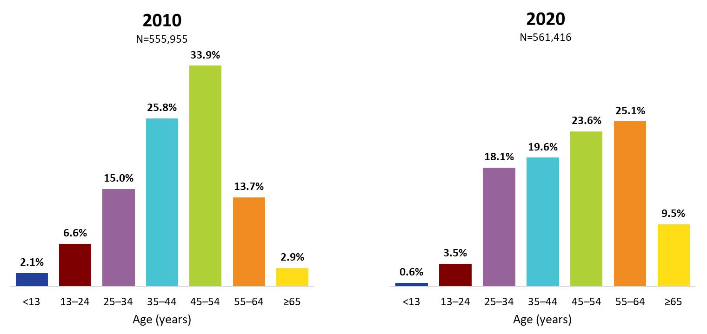
Ryan White HIV/AIDS Program Clients, by Age Group, 2010 and 2020—United States and 3 Territoriesª
ª Guam, Puerto Rico, and the U.S. Virgin Islands.
Source: HRSA. Ryan White HIV/AIDS Program Data Report (RSR) 2020. Does not include AIDS Drug Assistance Program data.
Notes:
The age distribution is shifting among RWHAP clients. From 2010 through 2020, the percentage of clients aged 35–54 years decreased (combined, 59.7% of the RWHAP population was aged 35–54 in 2010, decreasing to 43.2% in 2020), while the percentage increased during this time for those aged 55 and older (combined, from 16.6% in 2010 to 34.6% in 2020). Clients aged 65 years and older accounted for 9.5% of all clients in 2020, but nearly one-third (27.4%) of clients aged 55 and older.
The three territories include Guam, Puerto Rico, and the U.S. Virgin Islands.

Slide 4
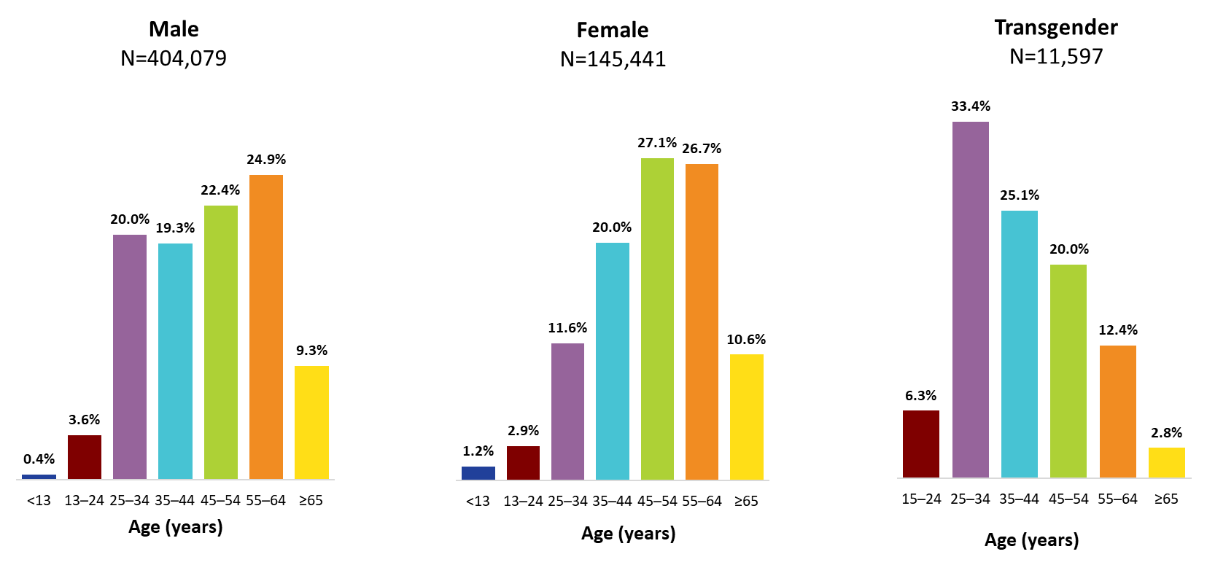
Clients Served by the Ryan White HIV/AIDS Program, by Gender and Age Group, 2020—United States and 3 Territoriesª
ª Guam, Puerto Rico, and the U.S. Virgin Islands.
To ensure confidentiality, data have been suppressed for transgender clients aged less than 15 years.
Source: HRSA. Ryan White HIV/AIDS Program Data Report (RSR) 2020. Does not include AIDS Drug Assistance Program data.
Notes:
In 2020, among male clients, 47.3% were aged 45–64 years (22.4% aged 45–54 years and 24.9% aged 54–64 years).
Among female clients, 53.8% were aged 45–64 years (27.1% aged 45–54 years and 26.7% aged 55–64 years).
Transgender clients were younger than male and female clients; 58.5% were aged 25–44 years (33.4% aged 25–34 and 25.1% aged 35–44 years).
The three territories include Guam, Puerto Rico, and the U.S. Virgin Islands.
To ensure confidentiality, data were suppressed for transgender clients aged less than 15 years.
Due to rounding, percentages may not sum to 100.0%.

Slide 5
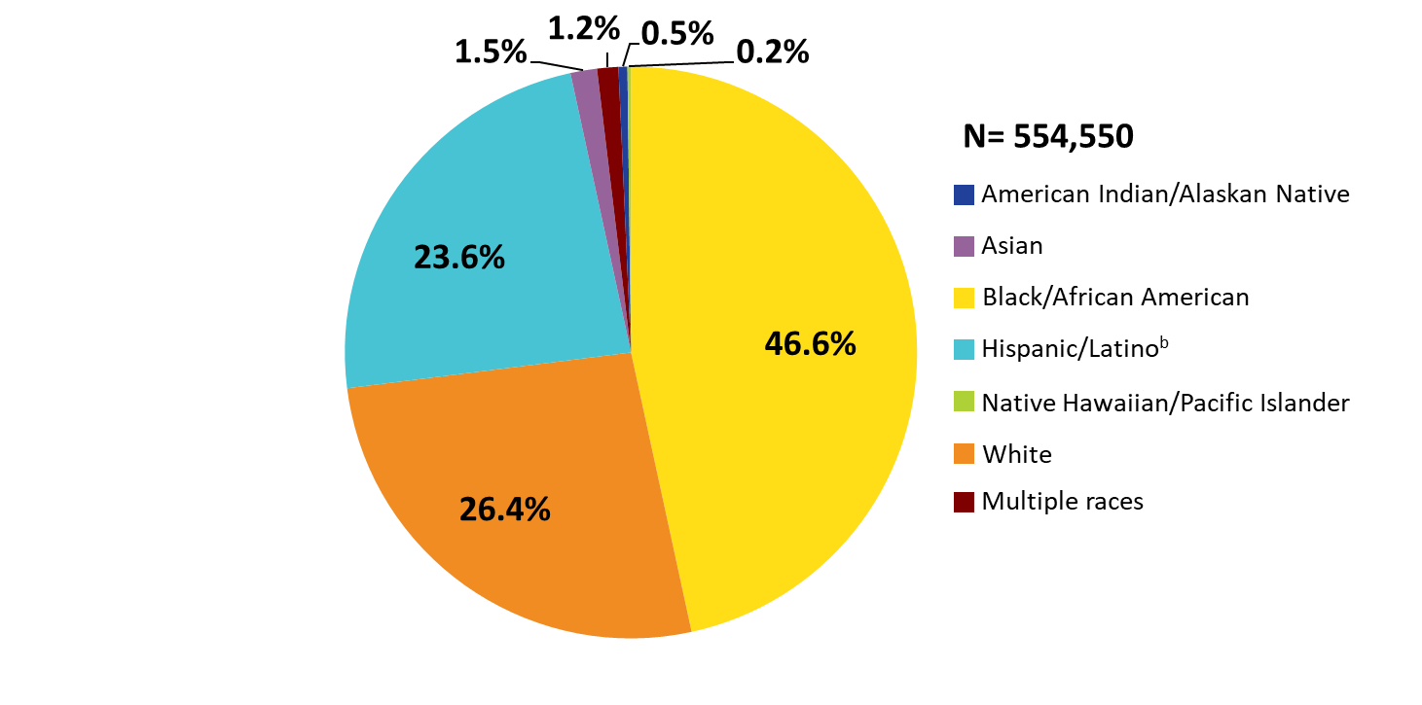
Clients Served by the Ryan White HIV/AIDS Program, by Race/Ethnicity, 2020—United States and 3 Territoriesª
ª Guam, Puerto Rico, and the U.S. Virgin Islands.
^{b} Hispanics/Latinos can be of any race.
Source: HRSA. Ryan White HIV/AIDS Program Data Report (RSR) 2020. Does not include AIDS Drug Assistance Program data.
Notes:
Nearly three-quarters (73.6%) of RWHAP clients are from racial/ethnic minority populations. In 2020, of the 554,550 clients with reported race/ethnicity information, 46.6% self-identified as Black/African American, 23.6% Hispanic/Latino, and less than 3.4% each American Indian/Alaska Native, Asian, Native Hawaiian/Pacific Islander, and people of multiple races. Whites accounted for 26.4% of clients. The percentage distribution has remained consistent since 2010.
Hispanics/Latinos can be of any race.
The three territories include Guam, Puerto Rico, and the U.S. Virgin Islands.

Slide 6
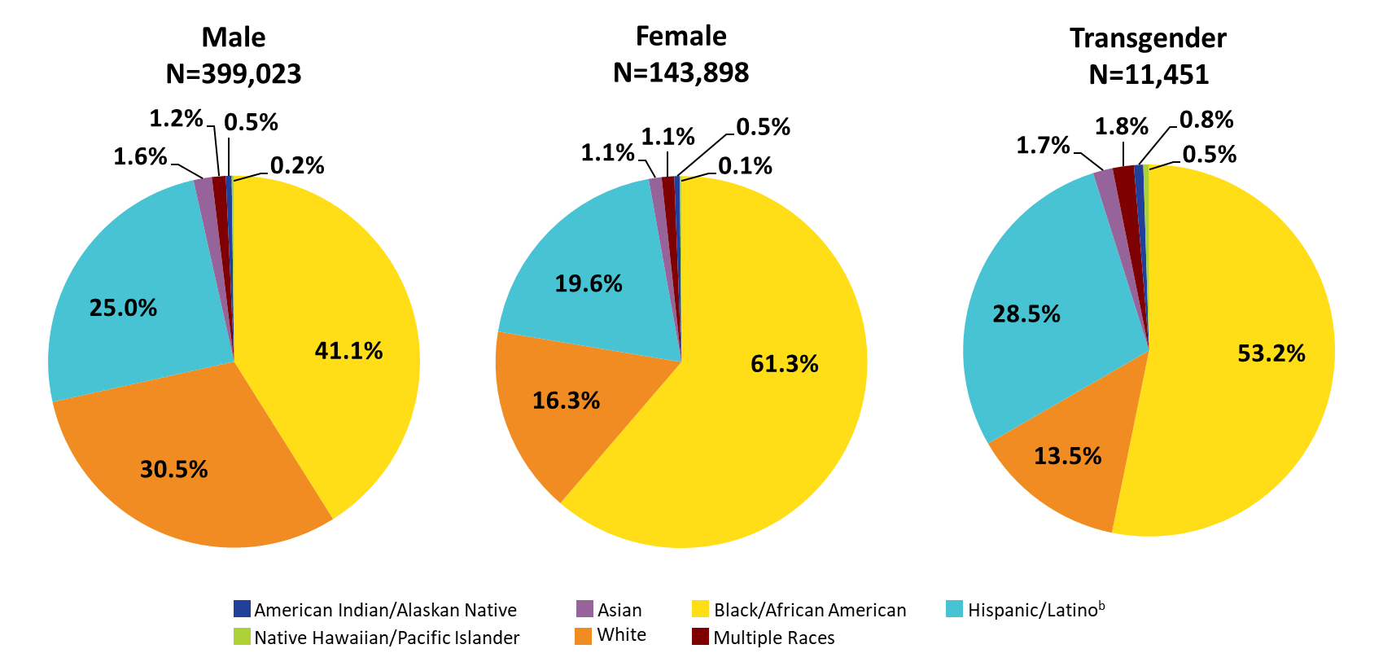
Clients Served by the Ryan White HIV/AIDS Program, by Gender and Race/Ethnicity, 2020—United States and 3 Territoriesª
ª Guam, Puerto Rico, and the U.S. Virgin Islands.
^{b} Hispanics/Latinos can be of any race.
Source: HRSA. Ryan White HIV/AIDS Program Data Report (RSR) 2020. Does not include AIDS Drug Assistance Program data.
Notes:
In 2020, 69.5% of male clients, 83.7% of female clients, and 86.5% of transgender clients were racial/ethnic minorities. For reference, white clients appear in each pie chart in orange shading.
Hispanics/Latinos can be of any race.
The three territories include Guam, Puerto Rico, and the U.S. Virgin Islands.

Slide 7
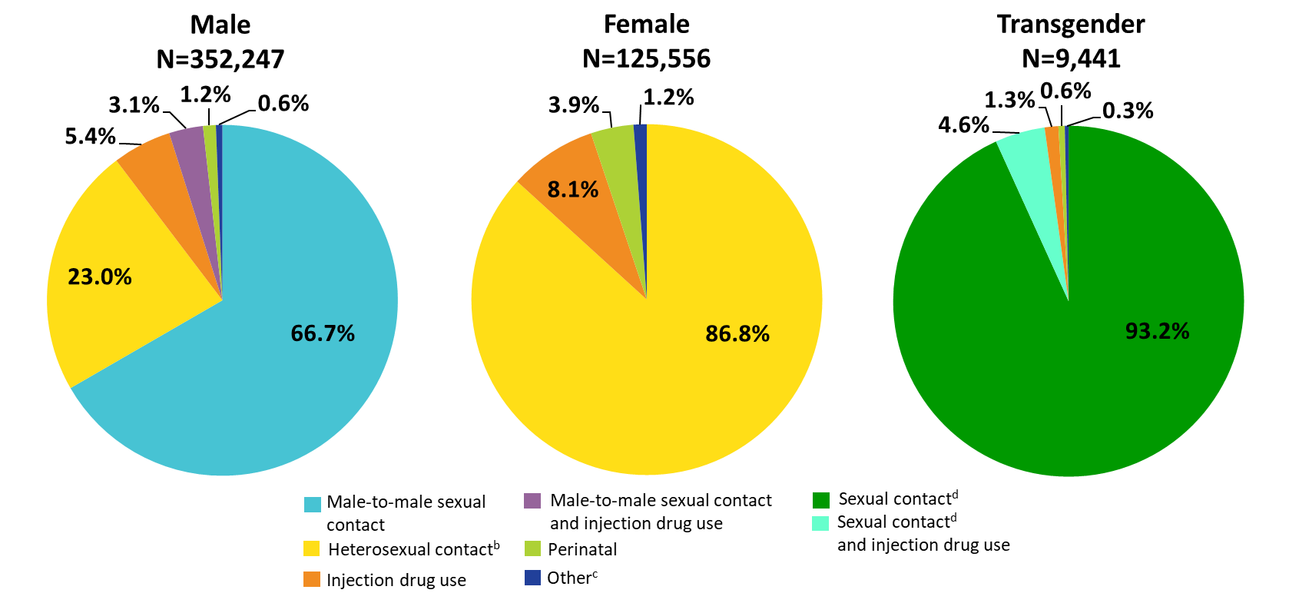
Clients Served by the Ryan White HIV/AIDS Program by Gender and Transmission Category, 2020—United States and 3 Territoriesª
ª Guam, Puerto Rico, and the U.S. Virgin Islands.
^{b} Heterosexual contact with a person know to have, or be at high risk for, HIV.
^{c} Includes hemophilia and blood transfusion.
^{d} Includes any reported sexual transmission category.
Source: HRSA. Ryan White HIV/AIDS Program Data Report (RSR) 2020. Does not include AIDS Drug Assistance Program data.
Notes:
By gender and transmission category, among male clients, 66.7% had HIV attributed to male-to-male sexual contact; 23.0% had HIV attributed to heterosexual contact; 5.4% to injection drug use; 3.1% to male-to-male sexual contact and injection drug use; and 1.2% to perinatal acquisition.
Among female clients, 86.8% had HIV attributed to heterosexual contact; 8.1% to injection drug use, and 3.9% to perinatal acquisition.
Among transgender clients, 93.2% had HIV attributed to some form of sexual contact, 4.6% to sexual contact and injection drug use, and 1.3% to injection drug use.
Heterosexual contact includes specific heterosexual contact with a person known to have, or to be at high risk for, HIV.
Other includes hemophilia, blood transfusion, and unknown risk factor.
Sexual contact includes any reported sexual transmission risk category for transgender clients.
The three territories include Guam, Puerto Rico, and the U.S. Virgin Islands.

Slide 8
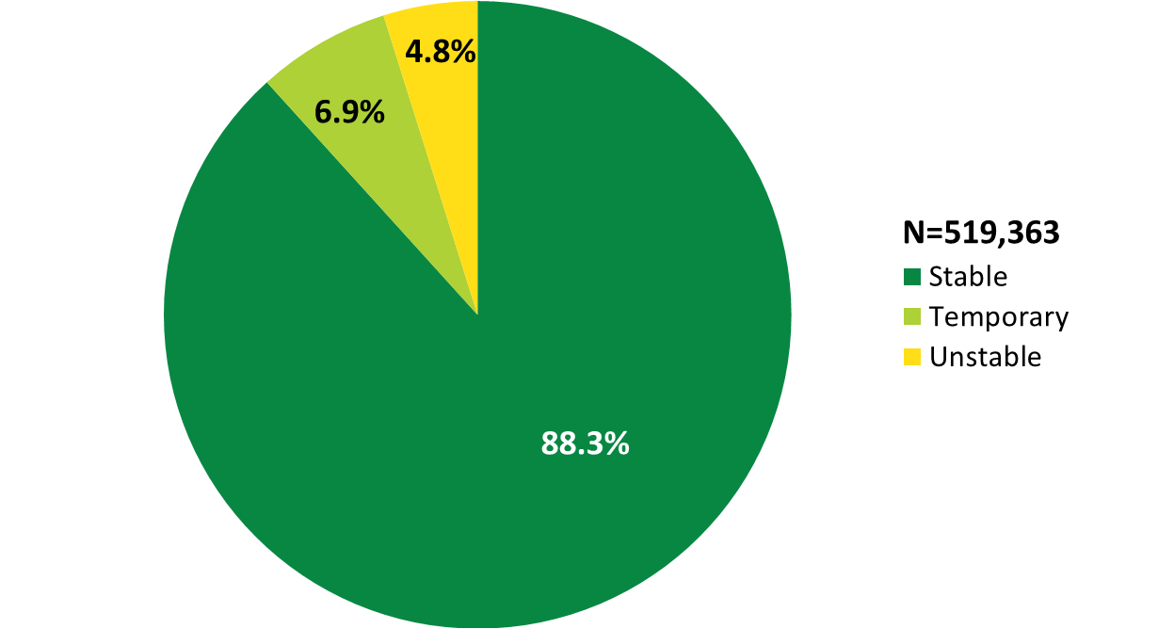
Clients Served by the Ryan White HIV/AIDS Program, by Housing Status, 2020—United States and 3 Territoriesª
ª Guam, Puerto Rico, and the U.S. Virgin Islands.
Source: HRSA. Ryan White HIV/AIDS Program Data Report (RSR) 2020. Does not include AIDS Drug Assistance Program data.
Notes:
In 2020, of the 519,363 clients with reported housing status, 6.9% had temporary housing and 4.8% had unstable housing.
The three territories include Guam, Puerto Rico, and the U.S. Virgin Islands.

Slide 9
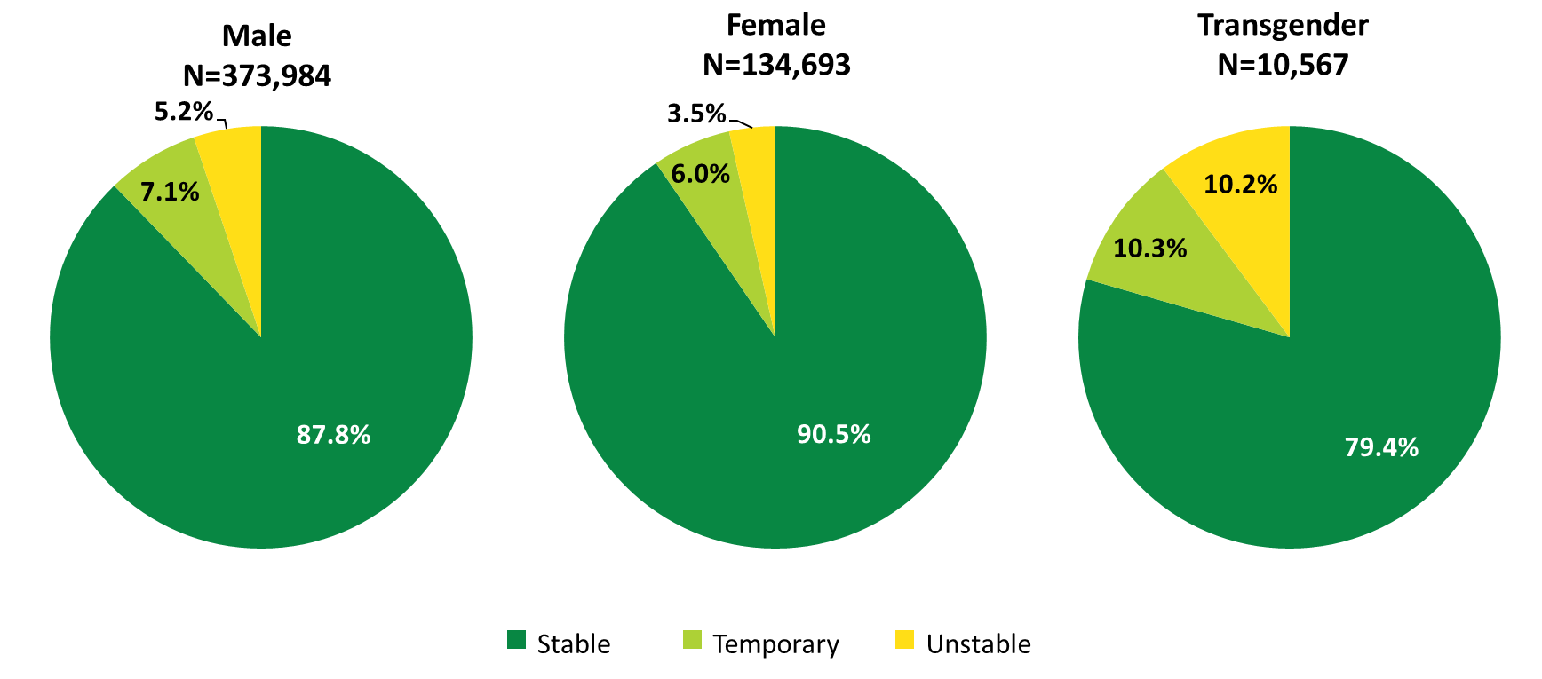
Clients Served by the Ryan White HIV/AIDS Program, by Gender and Housing Status, 2020—United States and 3 Territoriesª
ª Guam, Puerto Rico, and the U.S. Virgin Islands.
Source: HRSA. Ryan White HIV/AIDS Program Data Report (RSR) 2020. Does not include AIDS Drug Assistance Program data.
Notes:
A greater proportion of female RWHAP clients had stable housing in 2020, compared with male and transgender clients. Among female RWHAP clients, 6.0% had temporary housing and 3.5% had unstable housing. Among male clients, 7.1% had temporary housing and 5.2% had unstable housing. Among transgender clients, more than one-fifth of clients did not have stable housing: 10.3% had temporary housing and 10.2% had unstable housing.
The three territories include Guam, Puerto Rico, and the U.S. Virgin Islands.

Slide 10
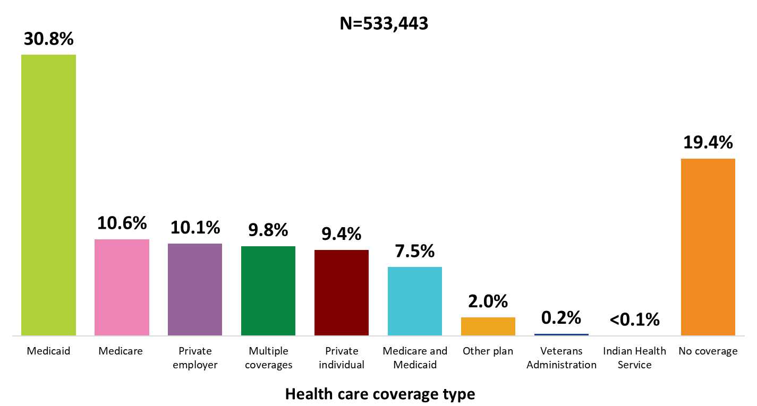
Clients Served by the Ryan White HIV/AIDS Program, by Health Care Coverage, 2020—United States and 3 Territoriesª
ª Guam, Puerto Rico, and the U.S. Virgin Islands.
Source: HRSA. Ryan White HIV/AIDS Program Data Report (RSR) 2020. Does not include AIDS Drug Assistance Program data.
Notes:
In 2020, 80.6% of RWHAP clients had some form of health care coverage. Of the 533,443 clients with reported health care coverage information, 30.8% were covered by Medicaid, 10.6% were covered by Medicare, 10.1% had private employer coverage, 9.8% had multiple forms of coverage, 9.4% had private individual coverage, and 7.5% had both Medicare and Medicaid dual coverage. Nearly one-fifth (19.4%) of RWHAP clients had no health care coverage in 2020.
Multiple coverage includes any combination of coverage types except for the Medicare and Medicaid dual enrollment category, which is displayed separately.
The three territories include Guam, Puerto Rico, and the U.S. Virgin Islands.

Slide 11
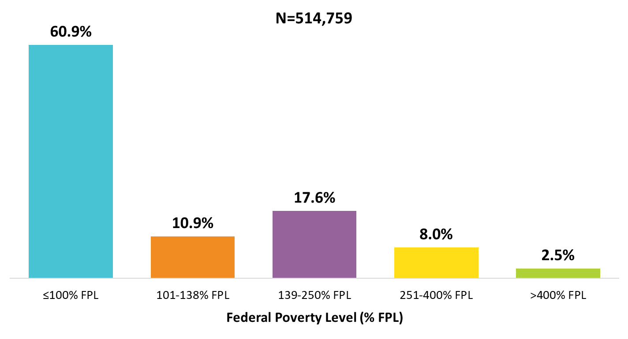
Clients Served by the Ryan White HIV/AIDS Program, by Poverty Level, 2020—United States and 3 Territoriesª
ª Guam, Puerto Rico, and the U.S. Virgin Islands.
Source: HRSA. Ryan White HIV/AIDS Program Data Report (RSR) 2020. Does not include AIDS Drug Assistance Program data.
Notes:
In 2020, 60.9% of the 514,759 clients with income information were living at or below 100% of the federal poverty level (FPL).
The three territories include Guam, Puerto Rico, and the U.S. Virgin Islands.

Slide 12
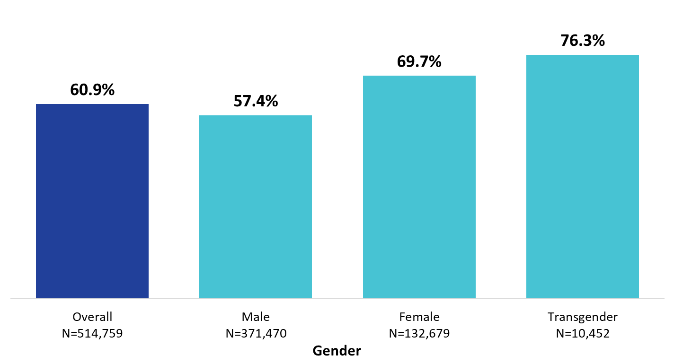
Clients Served by the Ryan White HIV/AIDS Program Living ≤100% of the Federal Poverty Level, by Gender, 2020—United States and 3 Territoriesª
ª Guam, Puerto Rico, and the U.S. Virgin Islands.
Source: HRSA. Ryan White HIV/AIDS Program Data Report (RSR) 2020. Does not include AIDS Drug Assistance Program data.
Notes:
Female and transgender clients had lower incomes than male clients. Among the 132,679 female clients with poverty level information in 2020, 69.7% were living at or below 100% of the federal poverty level (FPL). Among the 10,452 transgender clients with poverty level information, 76.3% were living at or below 100% FPL. These percentages are compared to 57.4% of male clients and the average across all RWHAP clients of 60.9%.
The three territories include Guam, Puerto Rico, and the U.S. Virgin Islands.

Slide 13
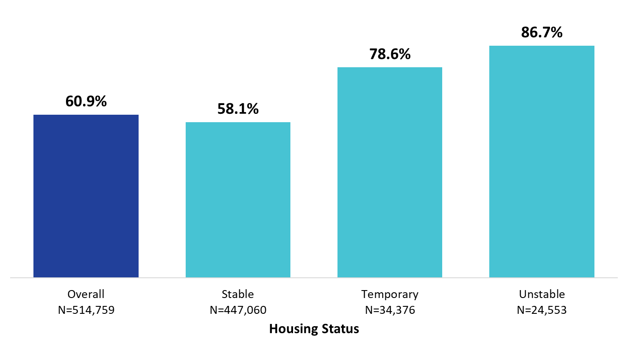
Clients Served by the Ryan White HIV/AIDS Program Living ≤100% of the Federal Poverty Level, by Housing Status, 2020—United States and 3 Territoriesª
ª Guam, Puerto Rico, and the U.S. Virgin Islands.
Source: HRSA. Ryan White HIV/AIDS Program Data Report (RSR) 2020. Does not include AIDS Drug Assistance Program data.
Notes:
Among clients with stable housing who had reported poverty level information in 2020, 58.1% were living ≤100% FPL. Among clients with temporary housing, 78.6% were living ≤100% FPL. Among clients with unstable housing, 86.7% were living ≤100% FPL.
The three territories include Guam, Puerto Rico, and the U.S. Virgin Islands.

