Slide 1
Clients Served by the Ryan White HIV/AIDS Program 2020
HIV Care Outcomes: Viral Suppression
Released December 2021

Slide 2
Trends in Viral Suppression Among Clients Served by the Ryan White HIV/AIDS Program, 2010–2020
Select characteristics and priority populations

Slide 3
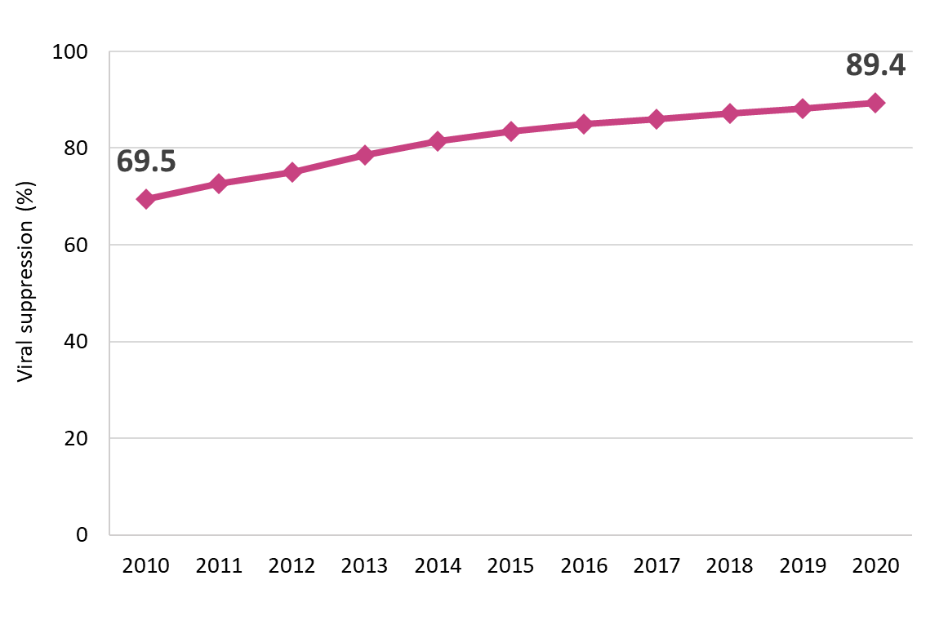
Viral Suppression among Clients Served by the Ryan White HIV/AIDS Program (non-ADAP), 2010–2020—United States and 3 Territoriesª
Viral suppression: ≥1 OAHS visit during the calendar year and ≥1 viral load reported, with the last viral load result <200 copies/mL.
ª Guam, Puerto Rico, and the U.S. Virgin Islands.
Notes:
This chart shows the proportion of RWHAP clients that reached viral suppression from 2010 to 2020. Viral suppression increased steadily over the ten-year period, from 69.5% in 2010 to 89.4% in 2020.
Viral suppression is defined as ≥1 outpatient/ambulatory health services visit during the calendar year and ≥1 viral load reported, with the last viral load result <200 copies/mL.
The three territories include Guam, Puerto Rico, and the U.S. Virgin Islands. 2019 and 2020 data for Guam are unavailable.
.

Slide 4
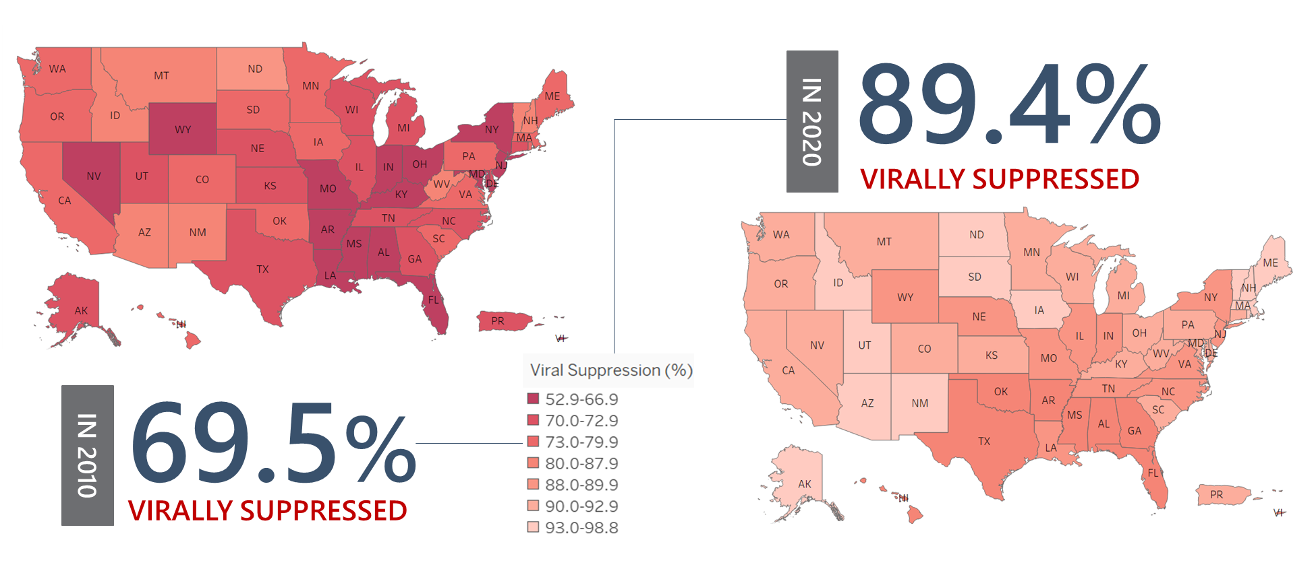
Viral Suppression among RWHAP Clients, by State, 2010 and 2020—United States and 2 Territoriesª
Viral suppression: ≥1 OAHS visit during the calendar year and ≥1 viral load reported, with the last viral load result <200 copies/mL.
ª Puerto Rico and the U.S. Virgin Islands.
Notes:
This slide shows the variation in viral suppression by state in 2010 and in 2020, with darker red indicating lower percentages of viral suppression and lighter shades indicating higher percentages.
From 2010 through 2020, all states showed increases in viral suppression; however, some states, particularly in the Southern U.S. continued to have room for improvement.
Viral suppression is defined as ≥1 outpatient/ambulatory health services visit during the calendar year and ≥1 viral load reported, with the last viral load result <200 copies/mL.
The two territories include Puerto Rico and the U.S. Virgin Islands.

Slide 5
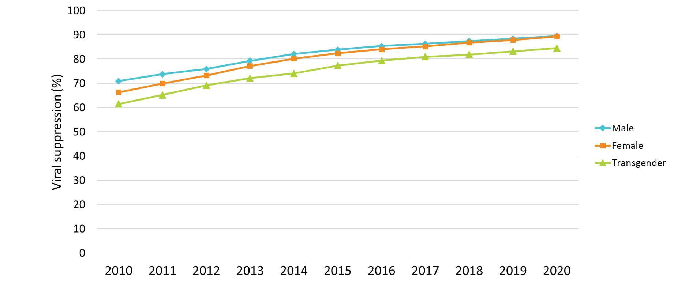
Viral Suppression among Clients Served by the Ryan White HIV/AIDS Program, by Gender, 2010–2020—United States and 3 Territoriesª
Viral suppression: ≥1 OAHS visit during the calendar year and ≥1 viral load reported, with the last viral load result <200 copies/mL.
ª Guam, Puerto Rico, and the U.S. Virgin Islands.
Notes:
Viral suppression has increased steadily over time; however, differences continue to exist across subgroups, including by gender. From 2010 through 2020, viral suppression increased from 70.9% to 89.5% among male clients; 66.3% to 89.4% among female clients; and 61.5% to 84.5% among transgender clients.
Viral suppression is defined as ≥1 outpatient/ambulatory health services visit during the calendar year and ≥1 viral load reported, with the last viral load result <200 copies/mL.
The three territories include Guam, Puerto Rico, and the U.S. Virgin Islands. 2019 and 2020 data for Guam are unavailable.

Slide 6
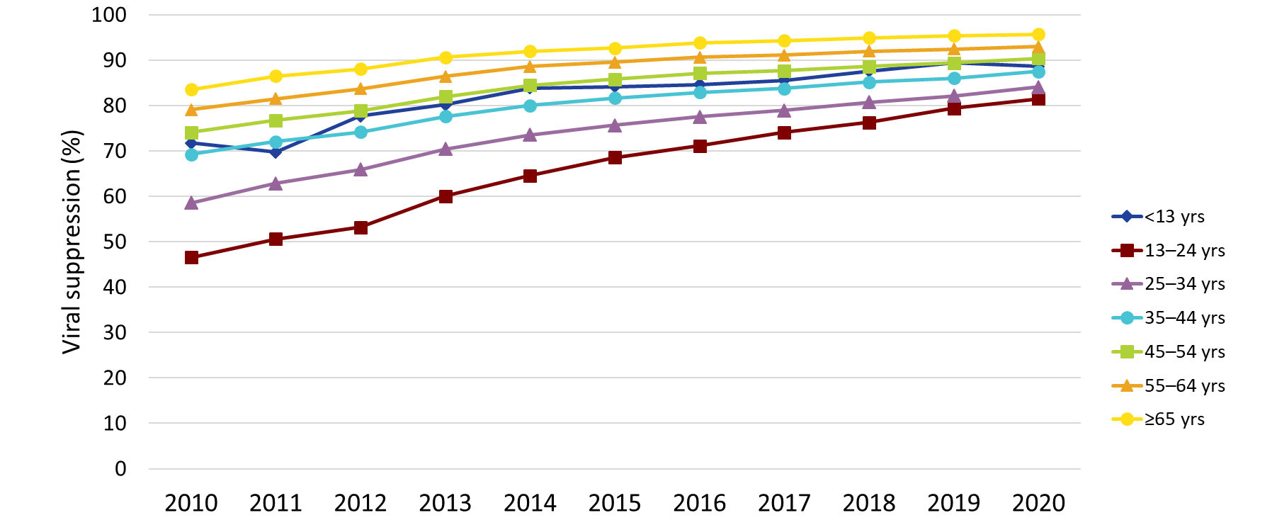
Viral Suppression among Clients Served by the Ryan White HIV/AIDS Program, by Age Group, 2010–2020—United States and 3 Territoriesª
Viral suppression: ≥1 OAHS visit during the calendar year and ≥1 viral load reported, with the last viral load result <200 copies/mL.
ª Guam, Puerto Rico, and the U.S. Virgin Islands.
Notes:
Young people aged 13–24 years and 25–34 years continue to have the lowest percentages of viral suppression across age groups; however, the gap is narrowing. Among clients aged 13–24 years, viral suppression increased from 46.6% in 2010 to 81.5% in 2020. Among clients aged 25–34 years, viral suppression increased from 58.6% in 2010 to 84.1% in 2020. Comparatively, 95.7.% of clients aged 65 and older reached viral suppression in 2020.
Viral suppression is defined as ≥1 outpatient/ambulatory health services visit during the calendar year and ≥1 viral load reported, with the last viral load result <200 copies/mL.
The three territories include Guam, Puerto Rico, and the U.S. Virgin Islands. 2019 and 2020 data for Guam are unavailable.

Slide 7
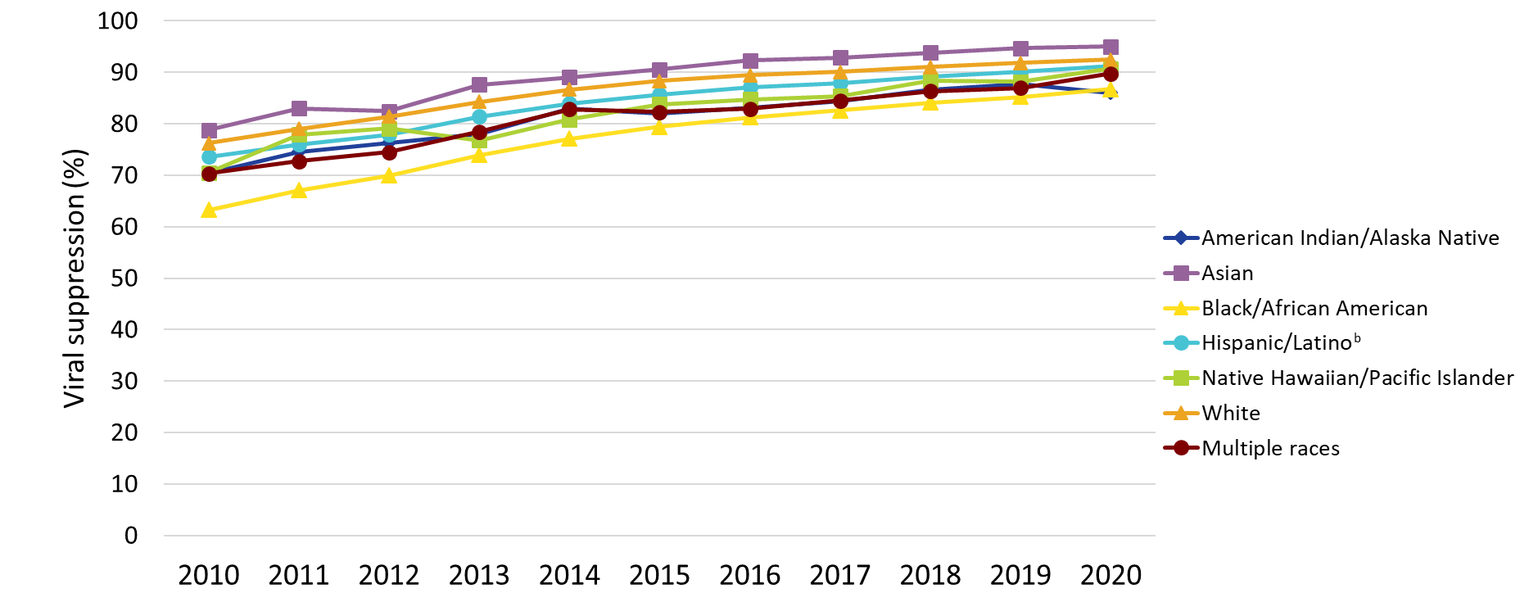
Viral Suppression among Clients Served by the Ryan White HIV/AIDS Program, by Race/Ethnicity, 2010–2020—United States and 3 Territoriesª
Viral suppression: ≥1 OAHS visit during the calendar year and ≥1 viral load reported, with the last viral load result <200 copies/mL.
ª Guam, Puerto Rico, and the U.S. Virgin Islands.
^{b} Hispanics/Latinos can be of any race.
Notes:
Nearly three-quarters of RWHAP clients are from racial/ethnic minority populations. From 2010 through 2020, viral suppression increased across almost all racial/ethnic populations. Viral suppression was consistently lower among Black/African American clients compared to other race/ethnicity groups until 2020 when viral suppression among Black/African American clients (86.7%) surpassed that of American Indian/Alaska Native clients (86.0%, which was slightly lower than in 2019, 87.8%).
Hispanics/Latinos can be of any race.
Viral suppression is defined as ≥1 outpatient/ambulatory health services visit during the calendar year and ≥1 viral load reported, with the last viral load result <200 copies/mL.
The three territories include Guam, Puerto Rico, and the U.S. Virgin Islands. 2019 and 2020 data for Guam are unavailable.

Slide 8
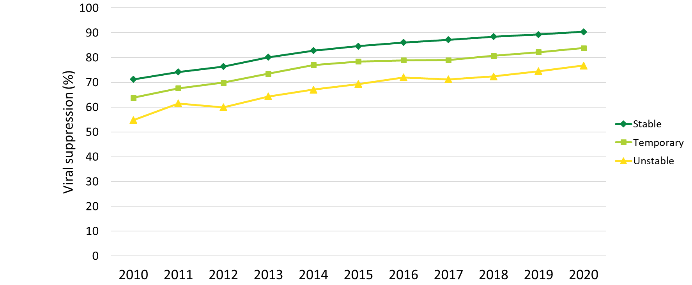
Viral Suppression among Clients Served by the Ryan White HIV/AIDS Program, by Housing Status, 2010–2020—United States and 3 Territoriesª
Viral suppression: ≥1 OAHS visit during the calendar year and ≥1 viral load reported, with the last viral load result <200 copies/mL.
ª Guam, Puerto Rico, and the U.S. Virgin Islands.
Notes:
Clients served by the RWHAP with temporary or unstable housing continue to have the lowest percentages of viral suppression, although percentages are steadily increasing. Among clients with temporary housing, viral suppression increased from 63.7% in 2010 to 83.8% in 2020. Among clients with unstable housing, viral suppression increased from 54.8% in 2010 to 76.8% in 2020. Comparatively, viral suppression among clients with stable housing increased from 71.2% in 2010 to 90.4% in 2020.
Viral suppression is defined as ≥1 outpatient/ambulatory health services visit during the calendar year and ≥1 viral load reported, with the last viral load result <200 copies/mL.
The three territories include Guam, Puerto Rico, and the U.S. Virgin Islands. 2019 and 2020 data for Guam are unavailable.

Slide 9
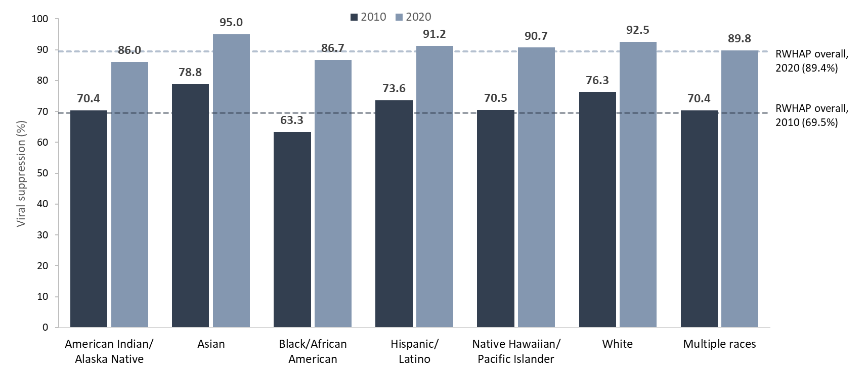
Viral Suppression among Clients Served by the Ryan White HIV/AIDS Program, by Race/Ethnicity, 2010 and 2020—United States and 3 Territoriesª
Hispanics/Latinos can be of any race.
Viral suppression: ≥1 OAHS visit during the calendar year and ≥1 viral load reported, with the last viral load result <200 copies/mL.
ª Guam, Puerto Rico, and the U.S. Virgin Islands.
Notes:
This chart shows viral suppression among clients served by the RWHAP by race/ethnicity. It shows a side-by-side comparison of viral suppression for each subpopulation in 2010 – indicated by a dark grey bar, and in 2020 – indicated by a light grey bar. For comparison, viral suppression for all RWHAP clients overall in 2010 was 69.5% indicated by the dark grey line, and was 89.4% in 2020 indicated by the light grey line.
Nearly three-quarters of RWHAP clients are from racial/ethnic minority populations. Viral suppression among Blacks/African Americans increased from 63.3% in 2010 to 86.7% in 2020; although viral suppression continued to be lower among Black/African American clients compared with most other race/ethnicity groups, the disparity has decreased substantially.
Hispanics/Latinos can be of any race.
Viral suppression is defined as ≥1 outpatient/ambulatory health services visit during the calendar year and ≥1 viral load reported, with the last viral load result <200 copies/mL.
The three territories include Guam, Puerto Rico, and the U.S. Virgin Islands.

Slide 10
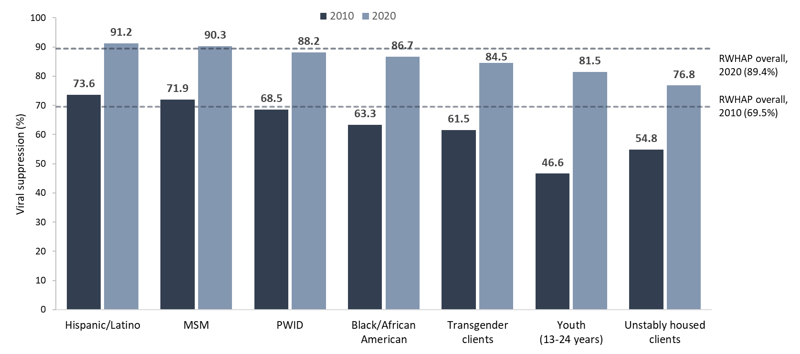
Viral Suppression among Priority Populations Served by the Ryan White HIV/AIDS Program, 2010 and 2020—United States and 3 Territoriesª
Hispanics/Latinos can be of any race.
Viral suppression: ≥1 OAHS visit during the calendar year and ≥1 viral load reported, with the last viral load result <200 copies/mL.
ª Guam, Puerto Rico, and the U.S. Virgin Islands.
Notes:
This chart shows viral suppression among priority populations served by the RWHAP. It shows a side-by-side comparison of viral suppression for each subpopulation in 2010 – indicated by a dark grey bar, and in 2020 – indicated by a light grey bar. For comparison, viral suppression for all RWHAP clients overall in 2010 was 69.5% indicated by the dark grey line, and was 89.4% in 2020 indicated by the light grey line. This upward trend in viral suppression occurred across all key populations.
However, it is important to note that challenges remain in achieving viral suppression for certain populations. Most notably, in 2020, the client subpopulations with viral suppression lower than the overall percentage of 89.4% were blacks/African Americans (86.7%), transgender clients (84.5%), youth aged 13-24 years (81.5%), and clients with unstable housing (76.8%).
Hispanics/Latinos can be of any race.
Viral suppression is defined as ≥1 outpatient/ambulatory health services visit during the calendar year and ≥1 viral load reported, with the last viral load result <200 copies/mL.
The three territories include Guam, Puerto Rico, and the U.S. Virgin Islands.

Slide 11
Viral Suppression Among Clients Served by the RWHAP, 2020
Select characteristics

Slide 12
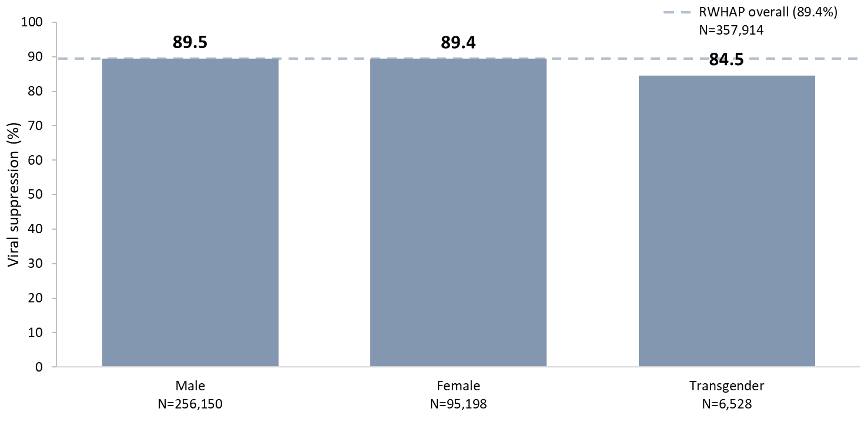
Viral Suppression among Clients Served by the Ryan White HIV/AIDS Program, by Gender, 2020—United States and 3 Territoriesª
N represents the total number of clients in the specific population.
Viral suppression: ≥1 OAHS visit during the calendar year and ≥1 viral load reported, with the last viral load result <200 copies/mL.
ª Guam, Puerto Rico, and the U.S. Virgin Islands.
Notes:
In 2020, viral suppression varied by gender; 84.5% of transgender clients achieved viral suppression, compared to 89.4% of female clients and 89.5% of male clients.
N represents the total number of clients in the specific subpopulation.
Viral suppression is defined as ≥1 outpatient/ambulatory health services visit during the calendar year and ≥1 viral load reported, with the last viral load result <200 copies/mL.
The three territories include Guam, Puerto Rico, and the U.S. Virgin Islands.

Slide 13
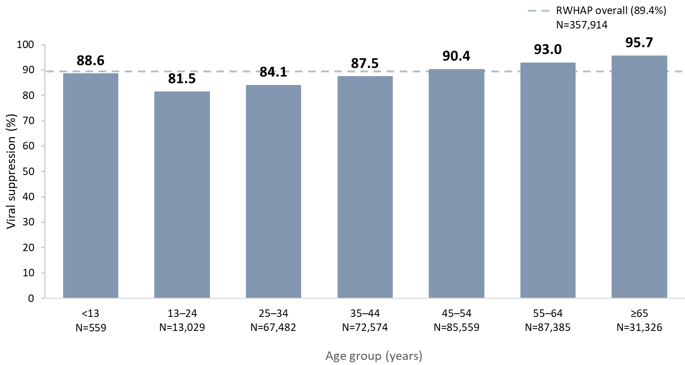
Viral Suppression among Clients Served by the Ryan White HIV/AIDS Program, by Age Group, 2020—United States and 3 Territoriesª
N represents the total number of clients in the specific population.
Viral suppression: ≥1 OAHS visit during the calendar year and ≥1 viral load reported, with the last viral load result <200 copies/mL.
ª Guam, Puerto Rico, and the U.S. Virgin Islands.
Notes:
Young people continue to have the lowest percentages of viral suppression compared to other age groups. In 2020, clients aged 13–24 years (81.5%) and 25–34 years (84.1%) had the lowest percentages of viral suppression by age group.
N represents the total number of clients in the specific subpopulation.
Viral suppression is defined as ≥1 outpatient/ambulatory health services visit during the calendar year and ≥1 viral load reported, with the last viral load result <200 copies/mL.
The three territories include Guam, Puerto Rico, and the U.S. Virgin Islands.

Slide 14
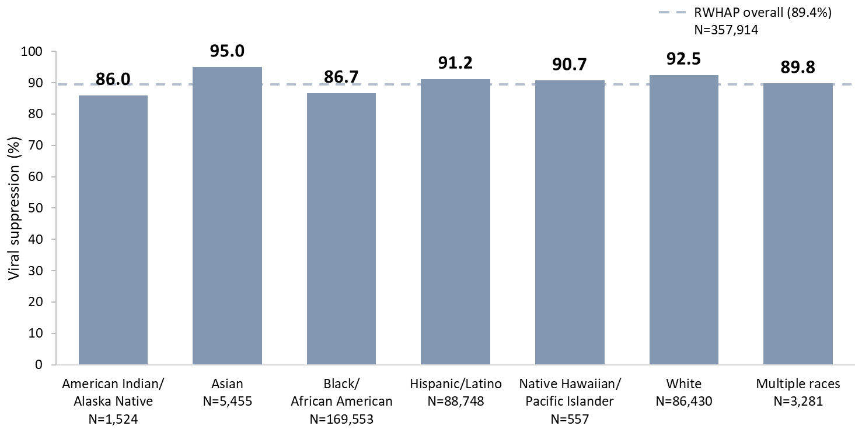
Viral Suppression among Clients Served by the Ryan White HIV/AIDS Program, by Race/Ethnicity, 2020—United States and 3 Territoriesª
N represents the total number of clients in the specific population.
Hispanics/Latinos can be of any race.
Viral suppression: ≥1 OAHS visit during the calendar year and ≥1 viral load reported, with the last viral load result <200 copies/mL.
ª Guam, Puerto Rico, and the U.S. Virgin Islands.
Notes:
In 2020, viral suppression was high across racial/ethnic subpopulations. However, differences existed, with the lowest percentage of viral suppression among American Indians/Alaska Natives (86.0%) and the highest percentage among Asians (95.0%).
Hispanics/Latinos can be of any race.
N represents the total number of clients in the specific subpopulation.
Viral suppression is defined as ≥1 outpatient/ambulatory health services visit during the calendar year and ≥1 viral load reported, with the last viral load result <200 copies/mL.
The three territories include Guam, Puerto Rico, and the U.S. Virgin Islands.

Slide 15
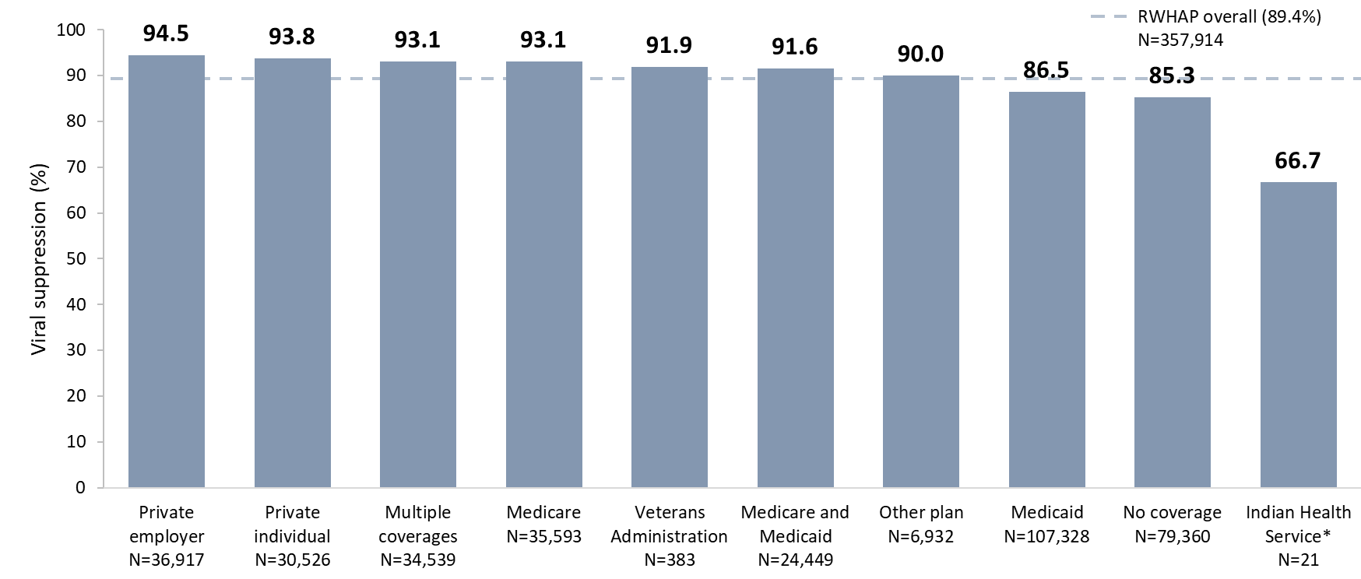
Viral Suppression among Clients Served by the Ryan White HIV/AIDS Program, by Health Care Coverage, 2020—United States and 3 Territoriesª
N represents the total number of clients in the specific population.
Viral suppression: ≥1 OAHS visit during the calendar year and ≥1 viral load reported, with the last viral load result <200 copies/mL.
ª Guam, Puerto Rico, and the U.S. Virgin Islands.
*Given the low numbers within this subpopulation, caution should be used when interpreting the percentages.
Notes:
In 2020, viral suppression was lowest among clients with Indian Health Service coverage (66.7%), followed by clients with no health care coverage (85.3%), and clients with Medicaid coverage (86.5%). Although viral suppression was lowest among clients with Indian Health Service coverage, caution should be used when interpreting this percentage due to the low number of clients in this subpopulation.
N represents the total number of clients in the specific subpopulation.
Viral suppression is defined as ≥1 outpatient/ambulatory health services visit during the calendar year and ≥1 viral load reported, with the last viral load result <200 copies/mL.
The three territories include Guam, Puerto Rico, and the U.S. Virgin Islands.

Slide 16
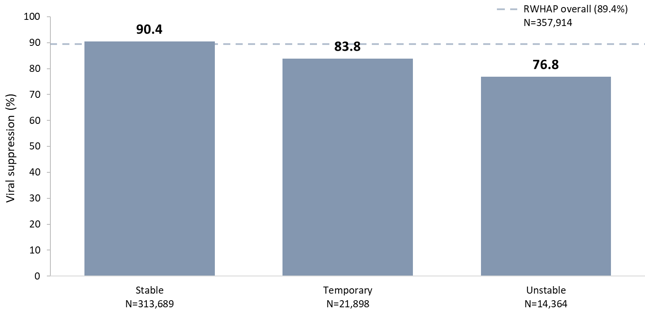
Viral Suppression among Clients Served by the Ryan White HIV/AIDS Program, by Housing Status, 2020—United States and 3 Territoriesª
N represents the total number of clients in the specific population.
Viral suppression: ≥1 OAHS visit during the calendar year and ≥1 viral load reported, with the last viral load result <200 copies/mL.
ª Guam, Puerto Rico, and the U.S. Virgin Islands.
Notes:
In 2020, viral suppression varied by housing status; 76.8% of clients with unstable housing achieved viral suppression, compared to 83.8% of clients with temporary housing and 90.4% of clients with stable housing.
N represents the total number of clients in the specific subpopulation.
Viral suppression is defined as ≥1 outpatient/ambulatory health services visit during the calendar year and ≥1 viral load reported, with the last viral load result <200 copies/mL.
The three territories include Guam, Puerto Rico, and the U.S. Virgin Islands.

Slide 17
Viral Suppression Among Clients Served by the RWHAP, 2020
Priority populations

Slide 18
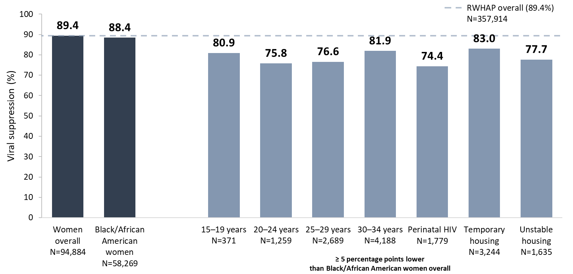
Viral Suppression among Black/African American Women Served by the Ryan White HIV/AIDS Program, 2020—United States and 3 Territoriesª
N represents the total number of clients in the specific population.
Includes females aged 13 years and older.
Viral suppression: ≥1 OAHS visit during the calendar year and ≥1 viral load reported, with the last viral load result <200 copies/mL.
ª Guam, Puerto Rico, and the U.S. Virgin Islands.
Notes:
In 2020, the percentage of Black/African American women who were virally suppressed (88.4%) was slightly lower than the national RWHAP average (89.4%) – indicated by the dashed grey line – and the percentage for women overall (89.4%).
Among Black/African American women, viral suppression was lowest in each 5-year age group from 15–34 years (range: 75.8% to 81.9%); those with perinatal HIV (74.4%); and those with temporary (83.0%) or unstable housing (77.7%).
N represents the total number of clients in the specific subpopulation.
Viral suppression is defined as ≥1 outpatient/ambulatory health services visit during the calendar year and ≥1 viral load reported, with the last viral load result <200 copies/mL.
The three territories include Guam, Puerto Rico, and the U.S. Virgin Islands.

Slide 19
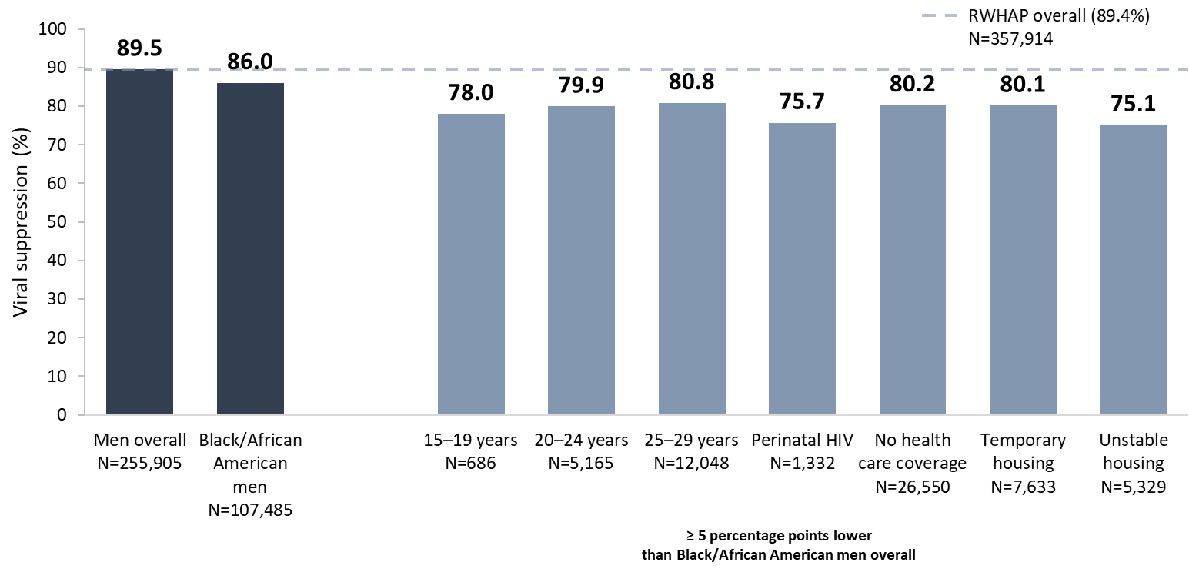
Viral Suppression among Black/African American Men Served by the Ryan White HIV/AIDS Program, 2020 —United States and 3 Territoriesª
N represents the total number of clients in the specific population.
Includes males aged 13 years and older.
Viral suppression: ≥1 OAHS visit during the calendar year and ≥1 viral load reported, with the last viral load result <200 copies/mL.
ª Guam, Puerto Rico, and the U.S. Virgin Islands.
Notes:
In 2020, the overall percentage of Black/African American men who reached viral suppression (86.0%) was lower than the percentages for the RWHAP overall (89.4%) – indicated by the dashed grey line – and that of men overall (89.5%).
Among Black/African American men, viral suppression was lowest in each 5-year age group from 15–29 years (range: 78.0% to 80.8%); those with perinatal HIV (75.7%); those with no health care coverage (80.2%); and those with temporary (80.1%) and unstable housing (75.1%).
N represents the total number of clients in the specific subpopulation.
Viral suppression is defined as ≥1 outpatient/ambulatory health services visit during the calendar year and ≥1 viral load reported, with the last viral load result <200 copies/mL.
The three territories include Guam, Puerto Rico, and the U.S. Virgin Islands.

Slide 20
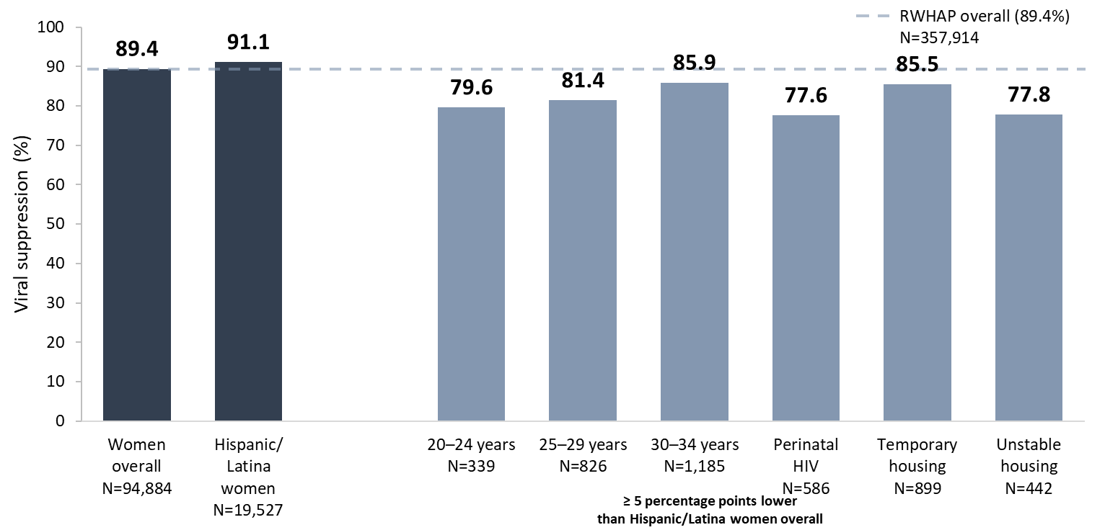
Viral Suppression among Hispanic/Latina Women Served by the Ryan White HIV/AIDS Program, 2020—United States and 3 Territoriesª
N represents the total number of clients in the specific population.
Includes females aged 13 years and older.
Hispanics/Latinos can be of any race.
Viral suppression: ≥1 OAHS visit during the calendar year and ≥1 viral load reported, with the last viral load result <200 copies/mL.
ª Guam, Puerto Rico, and the U.S. Virgin Islands.
Notes:
Overall, in 2020, viral suppression among Hispanic/Latina women (91.1%) was higher than the national RWHAP average (89.4%) – indicated by the dashed grey line – and that of women overall (89.4%).
Among Hispanic/Latina women, viral suppression was lowest in each 5-year age group from 20–34 years (range: 79.6% to 85.9%); those with perinatal HIV (77.6%); and those with temporary (85.5%) and unstable (77.8%) housing.
N represents the total number of clients in the specific subpopulation.
Hispanics/Latinas can be of any race.
Viral suppression is defined as ≥1 outpatient/ambulatory health services visit during the calendar year and ≥1 viral load reported, with the last viral load result <200 copies/mL.
The three territories include Guam, Puerto Rico, and the U.S. Virgin Islands.

Slide 21
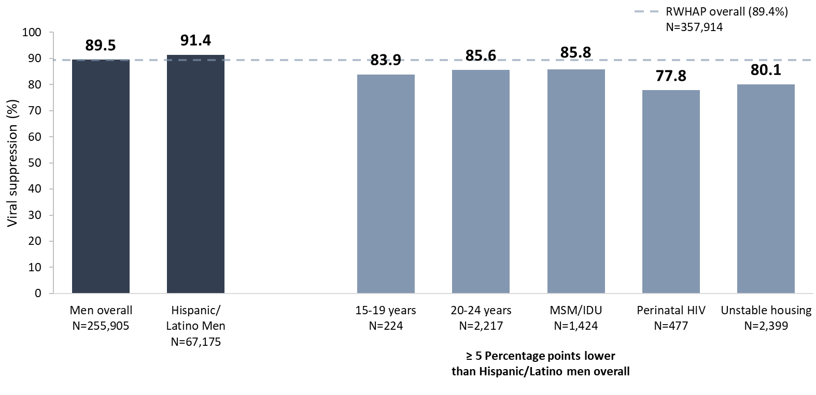
Viral Suppression among Hispanic/Latino Men Served by the Ryan White HIV/AIDS Program, 2020—United States and 3 Territoriesª
N represents the total number of clients in the specific population.
Hispanic/Latinos can be of any race.
Only includes men aged 13 years and older.
Viral suppression: ≥1 OAHS visit during the calendar year and ≥1 viral load reported, with the last viral load result <200 copies/mL.
ª Guam, Puerto Rico, and the U.S. Virgin Islands.
Notes:
Overall, in 2020, for Hispanic/Latino men, viral suppression (91.4%) was slightly higher than the national RWHAP average (89.4%) – indicated by the dashed grey line – and that of men overall (89.5%).
Among Hispanic/Latino men, viral suppression was lowest among those aged 15-19 (83.9%) and 20-24 (85.6%) years; those with HIV attributed to male-to-male sexual contact and injection drug use (85.8%); those with perinatal HIV (77.8%); and those with unstable housing (80.1%).
N represents the total number of clients in the specific subpopulation.
Hispanics/Latinos can be of any race.
Viral suppression is defined as ≥1 outpatient/ambulatory health services visit during the calendar year and ≥1 viral load reported, with the last viral load result <200 copies/mL.
The three territories include Guam, Puerto Rico, and the U.S. Virgin Islands.

Slide 22
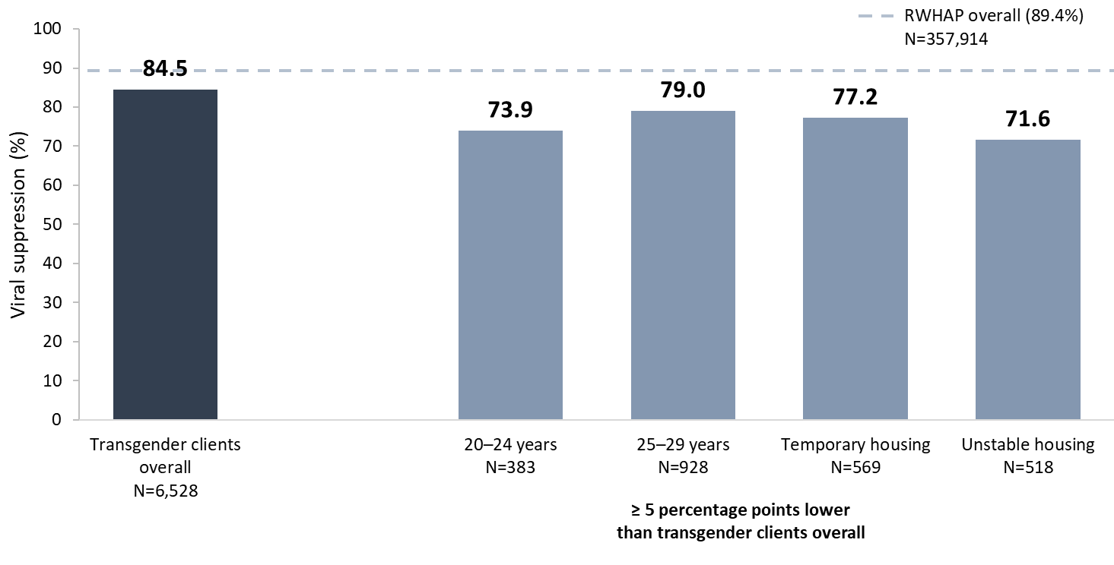
Viral Suppression among Transgender Adults and Adolescents Served by the Ryan White HIV/AIDS Program, 2020—United States and 3 Territoriesª
N represents the total number of clients in the specific population.
Includes transgender clients aged 15 years and older.
Viral suppression: ≥1 OAHS visit during the calendar year and ≥1 viral load reported, with the last viral load result <200 copies/mL.
ª Guam, Puerto Rico, and the U.S. Virgin Islands.
Notes:
In 2020, among transgender clients, viral suppression (84.5%) was lower than the national RWHAP average (89.4%) – indicated by the dashed grey line.
Viral suppression was lowest among transgender clients aged 20–24 years (73.9%), and 25–29 years (79.0%); and those with temporary (77.2%) and unstable (71.6%) housing.
N represents the total number of clients in the specific subpopulation.
Viral suppression is defined as ≥1 outpatient/ambulatory health services visit during the calendar year and ≥1 viral load reported, with the last viral load result <200 copies/mL.
The three territories include Guam, Puerto Rico, and the U.S. Virgin Islands.

Slide 23
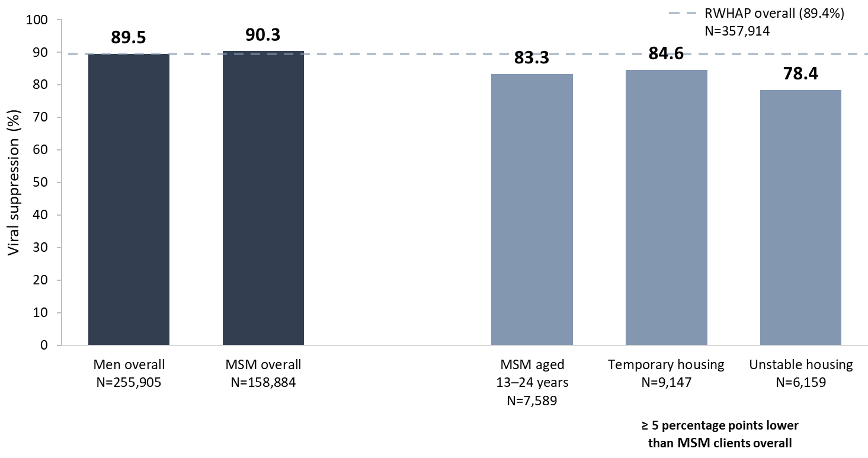
Viral Suppression among Men Who Have Sex With Men (MSM) Served by the Ryan White HIV/AIDS Program, 2020—United States and 3 Territoriesª
N represents the total number of clients in the specific population.
Includes males aged 13 years and older.
Viral suppression: ≥1 OAHS visit during the calendar year and ≥1 viral load reported, with the last viral load result <200 copies/mL.
ª Guam, Puerto Rico, and the U.S. Virgin Islands.
Notes:
In 2020, viral suppression among men who have sex with men (MSM; 90.3%) was slightly higher than the national RWHAP average (89.4%) – indicated by the dashed grey line – and that of men overall (89.5%). The lowest percentages of viral suppression among MSM were among those aged 13-24 years (83.3%) and those with temporary (84.6%) and unstable (78.4%) housing.
N represents the total number of clients in the specific subpopulation.
Includes males aged 13 years and older. Does not include MSM who also reported injection drug use as a transmission category.
Viral suppression is defined as ≥1 outpatient/ambulatory health services visit during the calendar year and ≥1 viral load reported, with the last viral load result <200 copies/mL.
The three territories include Guam, Puerto Rico, and the U.S. Virgin Islands.

Slide 24
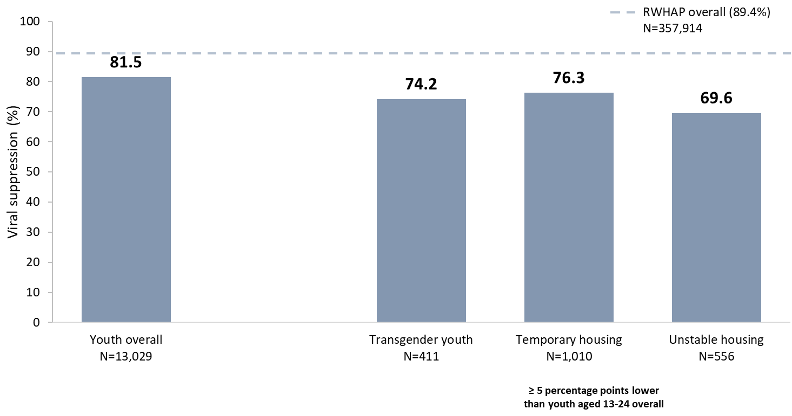
Viral Suppression among Youth Aged 13–24 Years Served by the Ryan White HIV/AIDS Program, 2020—United States and 3 Territoriesª
N represents the total number of clients in the specific population.
Viral suppression: ≥1 OAHS visit during the calendar year and ≥1 viral load reported, with the last viral load result <200 copies/mL.
ª Guam, Puerto Rico, and the U.S. Virgin Islands.
Notes:
In 2020, among youth aged 13–24 years, viral suppression (81.5%) was lower than the RWHAP average (89.4%) – indicated by the dashed grey line.
Viral suppression was lowest among transgender youth (74.2%), youth with temporary housing (76.3%) and youth with unstable housing (69.6%).
N represents the total number of clients in the specific subpopulation.
Viral suppression is defined as ≥1 outpatient/ambulatory health services visit during the calendar year and ≥1 viral load reported, with the last viral load result <200 copies/mL.
The three territories include Guam, Puerto Rico, and the U.S. Virgin Islands.

Slide 25
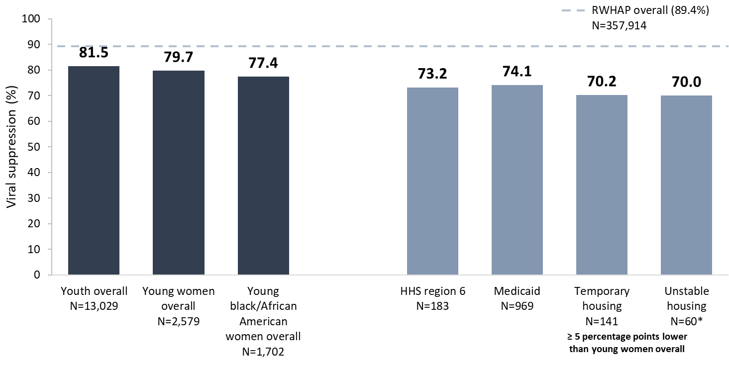
Viral Suppression among Young, Black/African American Women Aged 13–24 Years Served by the Ryan White HIV/AIDS Program, 2020—United States and 3 Territoriesª
N represents the total number of clients in the specific population.
Viral suppression: ≥1 OAHS visit during the calendar year and ≥1 viral load reported, with the last viral load result <200 copies/mL.
* Use caution when interpreting results based on small numbers.
ª Guam, Puerto Rico, and the U.S. Virgin Islands.
Notes:
In 2020, viral suppression for young, Black/African American women aged 13–24 years (77.4%) was lower than the national RWHAP average (89.4%) – indicated by the dashed grey line – lower than youth overall (81.5%), and slightly lower than young women overall (79.7%).
Viral suppression for young, Black/African American women was lowest among those receiving care in HHS Region 6 (73.2%), those with Medicaid coverage (74.1%), and those with temporary (70.2%) and unstable (70.0%) housing. Use caution when interpreting data on housing due to variability from small numbers.
N represents the total number of clients in the specific subpopulation.
Viral suppression is defined as ≥1 outpatient/ambulatory health services visit during the calendar year and ≥1 viral load reported, with the last viral load result <200 copies/mL.
The three territories include Guam, Puerto Rico, and the U.S. Virgin Islands.

Slide 26
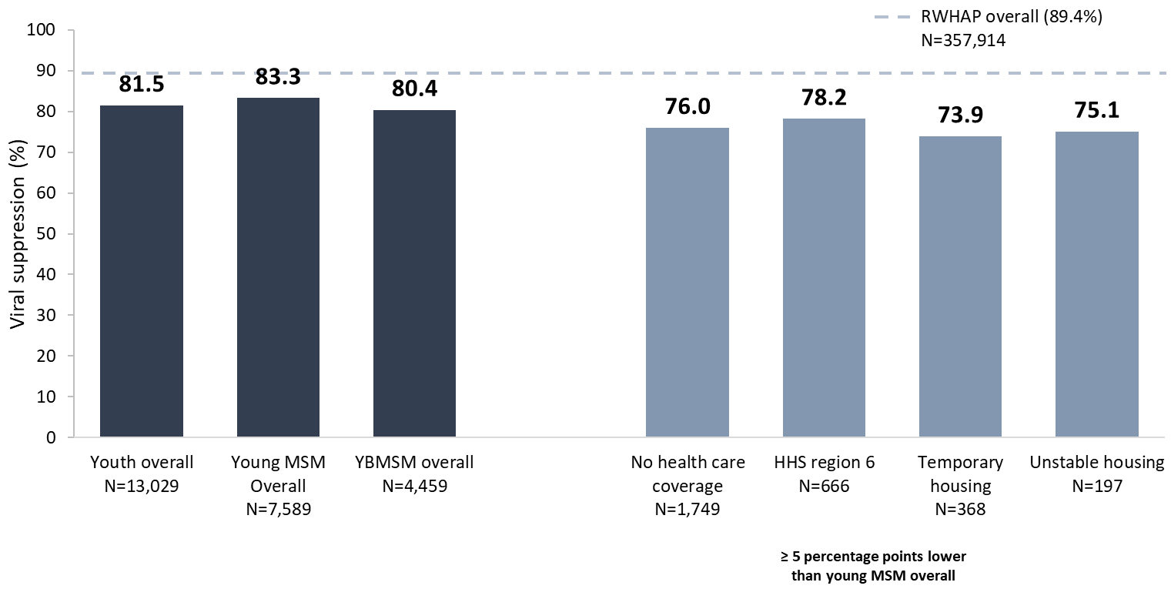
Viral Suppression among Young, Black/African American MSM (YBMSM) Aged 13–24 Years Served by the Ryan White HIV/AIDS Program, 2020—United States and 3 Territoriesª
N represents the total number of clients in the specific population.
Viral suppression: ≥1 OAHS visit during the calendar year and ≥1 viral load reported, with the last viral load result <200 copies/mL.
ª Guam, Puerto Rico, and the U.S. Virgin Islands.
Notes:
In 2020, viral suppression for young Black/African American MSM aged 13-24 years (YBMSM; 80.4%) was lower than the national RWHAP average (89.4%) – indicated by the dashed grey line – and slightly lower than the averages for young MSM overall (83.3%) and youth overall (81.5%).
Viral suppression for YBMSM was lowest among those with no health care coverage (76.0%); those in HHS region 6 (78.2%); and those with temporary (73.9%) and unstable (75.1%) housing.
N represents the total number of clients in the specific subpopulation.
Data for MSM include MSM who also reported injection drug use as a transmission risk category; data may not reflect current injection drug use behavior.
Viral suppression is defined as ≥1 outpatient/ambulatory health services visit during the calendar year and ≥1 viral load reported, with the last viral load result <200 copies/mL.
See Technical Notes of the Source document for the states/territories included in each HHS Region.
The three territories include Guam, Puerto Rico, and the U.S. Virgin Islands.

Slide 27
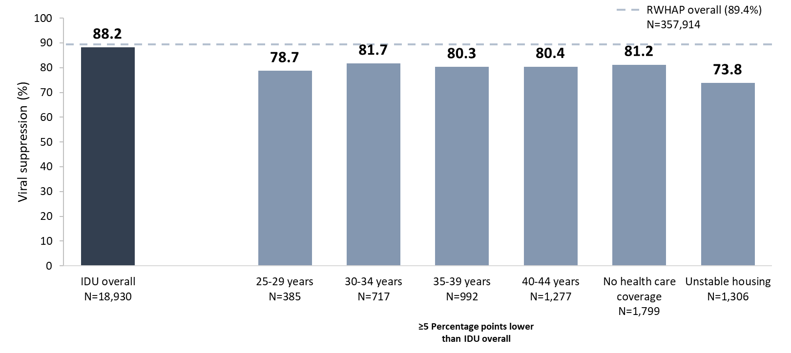
Viral Suppression among Clients with HIV Attributed to Injection Drug Use Aged ≥13 Years Served by the Ryan White HIV/AIDS Program, 2020—United States and 3 Territoriesª
IDU, injection drug use.
Includes clients aged 13 years and older. Data represent clients who reported injection drug use as their transmission risk category; data may not reflect current behavior. Data do not include male-to-male sexual contact and injection drug use among male clients nor sexual contact and injection drug use among transgender clients.
N represents the total number of clients in the specific subpopulation.
Viral suppression is defined as ≥1 OAHS visit during the calendar year and ≥1 viral load reported, with the last viral load result <200 copies/mL.
ª Guam, Puerto Rico, and the U.S. Virgin Islands.
Notes:
In 2020, for clients with HIV attributed to injection drug use (IDU), viral suppression (88.2%) was close but lower than the national RWHAP average (89.4%) – indicated by the dashed grey line.
Viral suppression was lowest among clients in each 5-year age group from 25-44 years (range: 78.7%-81.7%); among those with no health care coverage (81.2%); and among those with unstable (73.8%) housing.
Data represent clients who reported injection drug use as their transmission category; data may not reflect current behavior. Data do not include people with HIV attributed to male-to-male sexual contact and injection drug use nor sexual contact and injection drug use among transgender clients.
N represents the total number of clients in the specific subpopulation.
Viral suppression is defined as ≥1 outpatient ambulatory health services visit during the calendar year and ≥1 viral load reported, with the last viral load result <200 copies/mL.
The three territories include Guam, Puerto Rico, and the U.S. Virgin Islands.

Slide 28
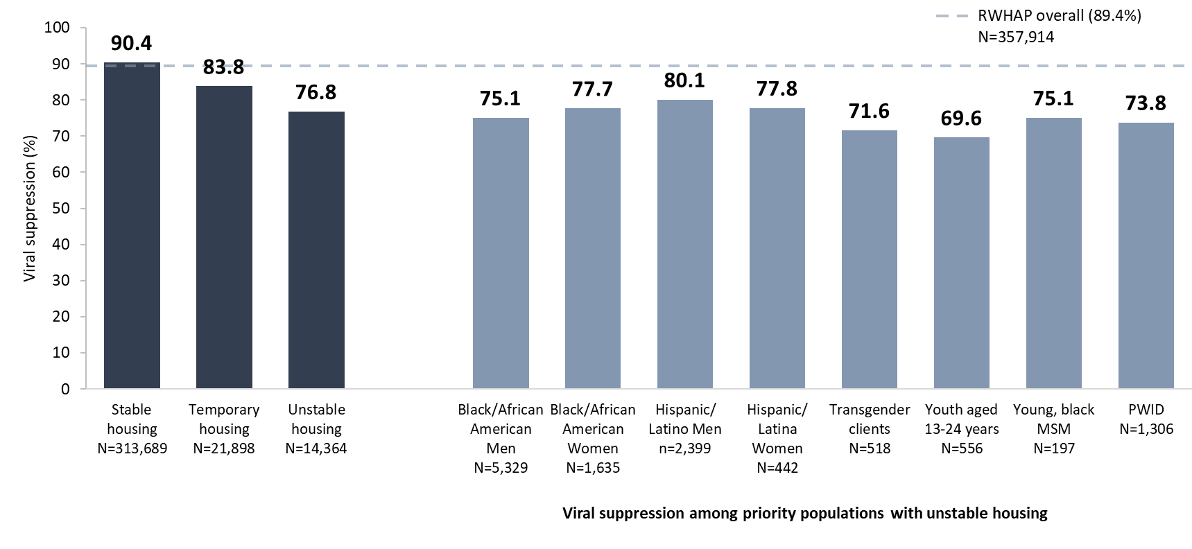
Viral Suppression among RWHAP Clients, by Housing Status and among Key Populations with Unstable Housing, 2020—United States and 3 Territoriesª
PWID, people who inject drugs (i.e., HIV attributed to injection drug use).
N represents the total number of clients in the specific population.
Viral suppression: ≥1 OAHS visit during the calendar year and ≥1 viral load reported, with the last viral load result <200 copies/mL.
ª Guam, Puerto Rico, and the U.S. Virgin Islands.
Notes:
Housing stability is a significant predictor of viral suppression. Among RWHAP clients with unstable housing, 76.8% reached viral suppression in 2020, compared with 83.8% among those with temporary housing, and 90.4% among those with stable housing. Among key populations of RWHAP clients with unstable housing, the lowest percentages of viral suppression were among transgender clients (71.6%), youth aged 13-24 years (69.6%), and clients with HIV attributed to injection drug use (73.8%).
N represents the total number of clients in the specific subpopulation.
Viral suppression is defined as ≥1 outpatient ambulatory health services visit during the calendar year and ≥1 viral load reported, with the last viral load result <200 copies/mL.
The three territories include Guam, Puerto Rico, and the U.S. Virgin Islands.

