Slide 1
Clients Enrolled in the Ryan White HIV/AIDS Program (RWHAP) AIDS Drug Assistance Program (ADAP) 2022
Overview
October 2024
Notes:
HRSA is on four social media platforms. We encourage you to follow along and share our content on Twitter, Facebook, LinkedIn and Instagram to stay up-to-date on the latest HRSA news. Our account/handle on each platform is @HRSAgov.
Additionally, we also encourage you to sign up for HRSA’s e-News, a biweekly email of comprehensive HRSA news, and to sign up for HRSA press releases. You can also visit our website www.HRSA.gov for more detailed information about all of our programs.

Slide 2
ADAP Data Report (ADR) Technical Notes
Submitted annually by AIDS Drug Assistance Programs (ADAPs) from each of the 50 U.S. states, the District of Columbia, Guam, Puerto Rico, and the U.S. Virgin Islands
Client-level data (deidentified) for all clients enrolled in ADAP
ADAP Data Report (ADR) data include:
ADAP client demographics and socioeconomic factors
Service utilization among ADAP clients
Many clients receive both ADAP and non-ADAP RWHAP services. However, data from non-ADAP RWHAP services are reported through the Ryan White HIV/AIDS Program Services Report (RSR). Therefore, ADR data do not include non-ADAP RWHAP services received (e.g., outpatient ambulatory health services
Notes:
The ADAP Data Report (ADR) is the HRSA HAB’s primary source of annual client-level data to evaluate the reach of the Ryan White HIV/AIDS Program (RWHAP) AIDS Drug Assistance Program (ADAP) on a national level. The ADR allows HRSA HAB to describe individuals enrolled in the program and the ADAP-funded services being used and to delineate costs associated with these services. While many clients receive both ADAP and non-ADAP RWHAP services, ADR data do not include-non ADAP services received, or which clients overlap with receipt of non-ADAP RWHAP services.

Slide 3
AIDS Drug Assistance Program (ADAP) Clients by Year, 2015–2022—United States and 3 Territoriesª
ª Guam, Puerto Rico, and the U.S. Virgin Islands.
Note: An ADAP client is any person who is certified as eligible to receive ADAP services during the reporting period, regardless of whether they used ADAP services during the reporting period.
Notes:
The RWHAP AIDS Drug Assistance Program (ADAP) serves over a quarter million people each year. The number of ADAP clients has fluctuated from 2015-2022, increasing by over 30,000 clients from 259,531 in 2015 to 291,169 clients in 2022.
The three territories include Guam, Puerto Rico, and the U.S. Virgin Islands.
Source: HRSA. Ryan White HIV/AIDS Program AIDS Drug Assistance Program (ADAP) Report 2022.

Slide 4
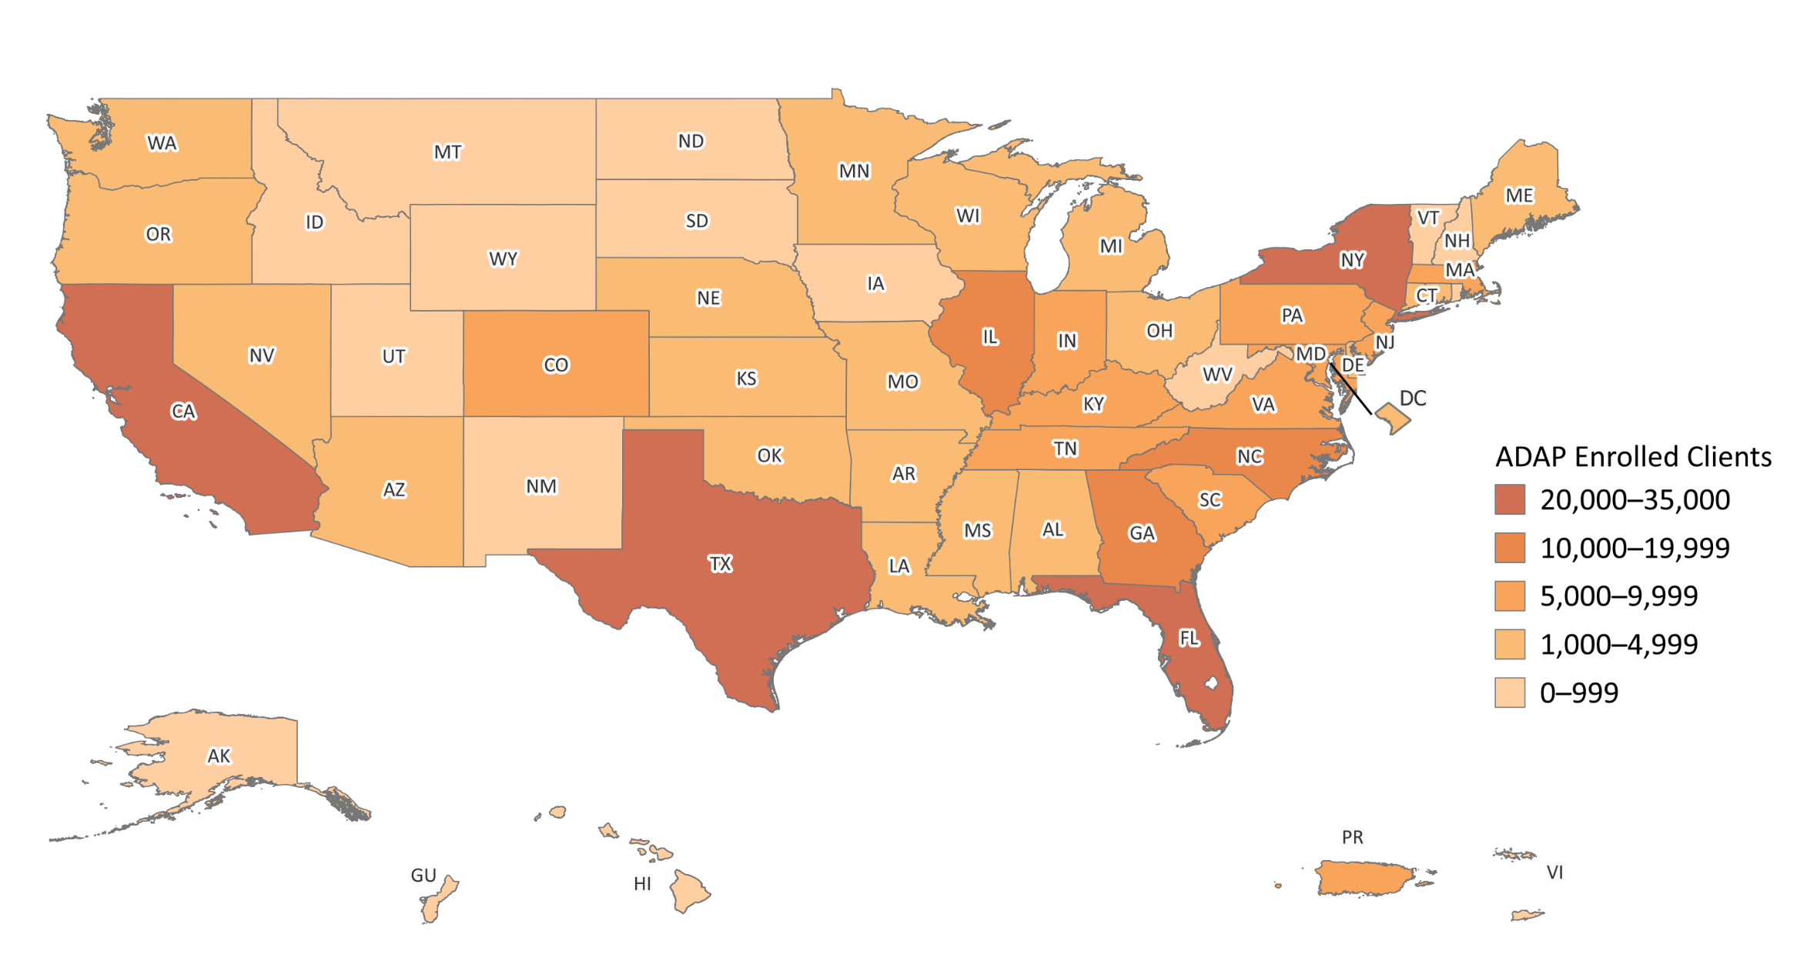
AIDS Drug Assistance Program (ADAP) Clients by State, 2022—United States and 3 Territoriesª
ª Guam, Puerto Rico and the U.S. Virgin Islands.
An ADAP client is any person who is certified as eligible to receive ADAP services during the reporting period, regardless of whether they used ADAP services during the reporting period.
Notes:
This map shows that the states with the highest numbers of ADAP enrolled clients (CA, TX, FL, and NY) are also the most populous states. By region, 48%, or nearly half of ADAP enrolled clients in 2022 lived in the South; 21.2% lived in the West, 17% lived in the Northeast, and 13.8% lived in the Midwest.
Regions used in the CDC’s National HIV Surveillance System: Northeast: CT, ME, MA, NH, NJ, NY, PA, RI, VT Midwest: IL, IN, IA, KS, MI, MN, MO, NE, ND, OH, SD, WI South: AL, AR, DE, DC, FL, GA, KY, LA, MD, MS, NC, OK, SC, TN, TX, VA, WV West: AK, AZ, CA, CO, HI, ID, MT, NV, NM, OR, UT, WA, WY
Source: HRSA. Ryan White HIV/AIDS Program AIDS Drug Assistance Program (ADAP) Report 2022.

Slide 5
AIDS Drug Assistance Program (ADAP) Clients, by Age Group, 2014 and 2022—United States and 3 Territoriesª
ª Guam, Puerto Rico, and the U.S. Virgin Islands.
Note: An ADAP client is any person who is certified as eligible to receive ADAP services during the reporting period, regardless of whether they used ADAP services during the reporting period.
Notes:
The RWHAP client population is aging. As this slide indicates, clients aged 55 and older accounted for 35.4%, over one-third of all clients in 2022, an increase from 22.1% in 2014.
The three territories include Guam, Puerto Rico, and the U.S. Virgin Islands.
Source: HRSA. Ryan White HIV/AIDS Program Services Report (RSR) 2022. Does not include AIDS Drug Assistance Program data.

Slide 6
AIDS Drug Assistance Program (ADAP) Clients, by Race/Ethnicity, 2022—United States and 3 Territoriesª
N=287,974
American Indian/Alaskan Native
Asian
Black/African American
Hispanic/Latino^{b}
Native Hawaiian/Pacific Islander
White
Multiple races
ª Guam, Puerto Rico, and the U.S. Virgin Islands.
^{b} Hispanics/Latinos can be of any race.
Note: An ADAP client is any person who is certified as eligible to receive ADAP services during the reporting period, regardless of whether they used ADAP services during the reporting period.
Notes:
Seven out of 10 ADAP clients are from racial/ethnic minority populations. In 2022, of the 287,974 clients with reported race/ethnicity information, 37.9% self-identified as Black/African American, 29.7% as Hispanic/Latino, and less than 2% each as American Indian/Alaska Native, Asian, Native Hawaiian/Pacific Islander, and people of multiple races. White clients accounted for 29.2% of all ADAP clients.
Hispanics/Latinos can be of any race.
The three territories include Guam, Puerto Rico, and the U.S. Virgin Islands.
Source: HRSA. Ryan White HIV/AIDS Program AIDS Drug Assistance Program (ADAP) Report 2022.

Slide 7
AIDS Drug Assistance Program (ADAP) Clients, by Gender, 2022—United States and 3 Territoriesª
ª Guam, Puerto Rico, and the U.S. Virgin Islands.
Note: An ADAP client is any person who is certified as eligible to receive ADAP services during the reporting period, regardless of whether they used ADAP services during the reporting period.
Notes:
In 2022, of the 290,930 clients with a reported gender, 78.5% were male, 19.7% were female, and 1.9% were transgender.
The three territories include Guam, Puerto Rico, and the U.S. Virgin Islands.
Source: HRSA. Ryan White HIV/AIDS Program AIDS Drug Assistance Program (ADAP) Report 2022.

Slide 8
AIDS Drug Assistance Program (ADAP) Clients, by Poverty Level, 2022—United States and 3 Territoriesª
ª Guam, Puerto Rico, and the U.S. Virgin Islands.
Note: An ADAP client is any person who is certified as eligible to receive ADAP services during the reporting period, regardless of whether they used ADAP services during the reporting period.
Notes:
In 2022, 43.6% of the 283,516 ADAP clients with income information were living at or below 100% of the federal poverty level (FPL).
The three territories include Guam, Puerto Rico, and the U.S. Virgin Islands.
Source: HRSA. Ryan White HIV/AIDS Program AIDS Drug Assistance Program (ADAP) Report 2022.

Slide 9
AIDS Drug Assistance Program (ADAP) Clients, by Health Care Coverage, 2022—United States and 3 Territoriesª
ª Guam, Puerto Rico, and the U.S. Virgin Islands.
Note: An ADAP client is any person who is certified as eligible to receive ADAP services during the reporting period, regardless of whether they used ADAP services during the reporting period.
Notes:
In 2022, over 65% of ADAP clients were covered by some form of health care coverage. In 2022, of the 284,632 clients with reported health care coverage, 21.7% were covered by private individual coverage, 14.3% were covered by Medicare, and 10.8% were covered by Medicaid. Multiple coverages includes any combination of coverage types except for the joint Medicaid and Medicare category, which is displayed separately. Over one-third (34.8%) of ADAP clients had no health care coverage in 2022.
The three territories include Guam, Puerto Rico, and the U.S. Virgin Islands.
Source: HRSA. Ryan White HIV/AIDS Program AIDS Drug Assistance Program (ADAP) Report 2022.

Slide 10
AIDS Drug Assistance Program (ADAP) Clients, by Service Utilization, 2022—United States and 3 Territoriesª
Only full-pay medication support
Only health care coverage premium assistance
Only medication co-pay/deductible services^{b}
Multiple services
ª Guam, Puerto Rico, and the U.S. Virgin Islands.
^{b} Includes Medicare Part D co-insurance, co-payment, or donut hole coverage.
Note: An ADAP client is any person who is certified as eligible to receive ADAP services during the reporting period, regardless of whether they used ADAP services during the reporting period.
Notes:
Among ADAP clients with service utilization information in 2022, 43.8% received only full-pay medication support only, 18.8% received only medication co-pay/deductible services, and 5.6% received only health care coverage premium assistance. Nearly one-third of clients (31.8%) received multiple ADAP services in 2022.
Source: HRSA. Ryan White HIV/AIDS Program AIDS Drug Assistance Program (ADAP) Report 2022.

