Slide 1
Clients Served by the Ryan White HIV/AIDS Program 2022
Overview
Released June 2024
Notes:
HRSA is on four social media platforms. We encourage you to follow along and share our content on Twitter, Facebook, LinkedIn and Instagram to stay up-to-date on the latest HRSA news. Our account/handle on each platform is @HRSAgov.
Additionally, we also encourage you to sign up for HRSA’s e-News, a biweekly email of comprehensive HRSA news, and to sign up for HRSA press releases. You can also visit our website www.HRSA.gov for more detailed information about all of our programs.

Slide 2
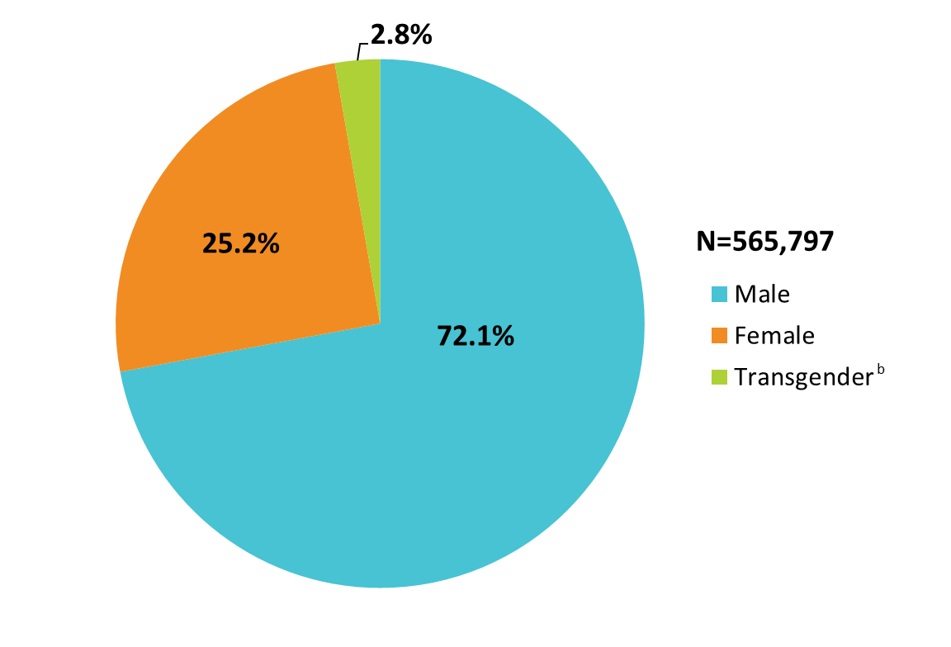
Clients Served by the Ryan White HIV/AIDS Program, by Gender, 2022 — United States and 3 Territoriesª
ª Guam, Puerto Rico, and the U.S. Virgin Islands.
^{b} Transgender clients includes clients who identify as transgender male, transgender female, or other gender identity.
Notes:
The RWHAP serves over half a million people each year. In 2022, of the 565,797 clients with a reported gender, 72.1% were male, 25.2% were female, and 2.8% were transgender (2.3% identified as transgender female, 0.3% identified as transgender male, and 0.2% identified as an other gender identity).
Transgender clients includes clients who identify as transgender male, transgender female, or other gender identity.
The three territories include Guam, Puerto Rico, and the U.S. Virgin Islands.
Due to rounding, percentages may not sum to 100.0%.

Slide 3
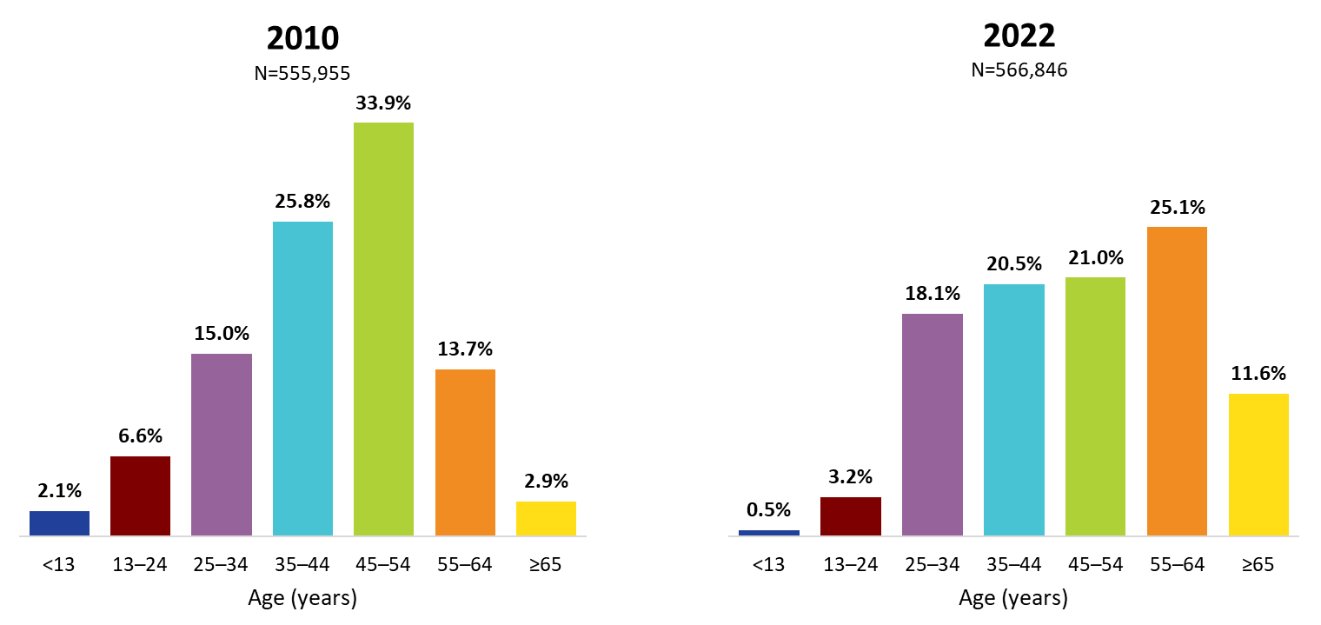
Ryan White HIV/AIDS Program Clients, by Age Group, 2010 and 2022—United States and 3 Territoriesª
ª Guam, Puerto Rico, and the U.S. Virgin Islands.
Notes:
The age distribution is shifting among RWHAP clients. From 2010 through 2022, the percentage of clients aged 35–54 years decreased (combined, 59.7% of the RWHAP population was aged 35–54 in 2010, decreasing to 41.5% in 2022), while the percentage increased during this time for those aged 55 and older (combined, from 16.6% in 2010 to 36.7% in 2022). Clients aged 65 years and older accounted for 11.6% of all clients in 2022, but nearly one-third (31.6%) of clients aged 55 and older.
The three territories include Guam, Puerto Rico, and the U.S. Virgin Islands.

Slide 4
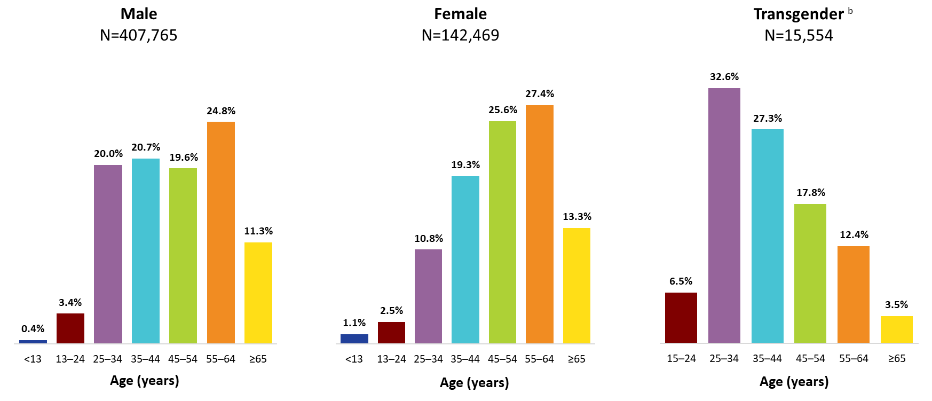
Clients Served by the Ryan White HIV/AIDS Program, by Gender and Age Group, 2022—United States and 3 Territoriesª
ª Guam, Puerto Rico, and the U.S. Virgin Islands.
^{b} Transgender clients includes clients who identify as transgender male, transgender female, or other gender identity.
To ensure confidentiality, data have been suppressed for transgender clients aged less than 15 years.
Notes:
In 2022, among male clients, 44.4% were aged 45–64 years (19.6% aged 45–54 years and 24.8% aged 55–64 years).
Among female clients, 53.0% were aged 45–64 years (25.6% aged 45–54 years and 27.4% aged 55–64 years).
Transgender clients were younger than male and female clients; 59.9% were aged 25–44 years (32.6% aged 25–34 and 27.3% aged 35–44 years).
The three territories include Guam, Puerto Rico, and the U.S. Virgin Islands.
Transgender clients includes clients who identify as transgender male, transgender female, or other gender identity.
To ensure confidentiality, data were suppressed for transgender clients aged less than 15 years.
Due to rounding, percentages may not sum to 100.0%.

Slide 5
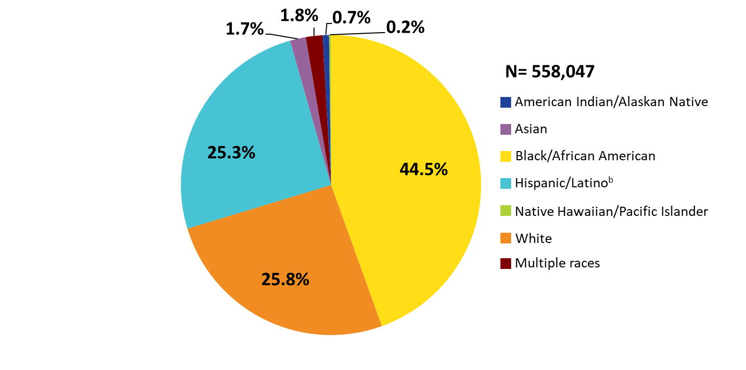
Clients Served by the Ryan White HIV/AIDS Program, by Race/Ethnicity, 2022—United States and 3 Territoriesª
ª Guam, Puerto Rico, and the U.S. Virgin Islands.
^{b} Hispanics/Latinos can be of any race.
Notes:
Nearly three-quarters (74.2%) of RWHAP clients were from racial and ethnic minority groups. In 2022, of the 558,047 clients with reported race/ethnicity information, 44.5% self-identified as Black/African American, 25.3% Hispanic/Latino, and less than 5% each American Indian/Alaska Native, Asian, Native Hawaiian/Pacific Islander, and people of multiple races. Clients who self-identified as White accounted for 25.8% of clients. The percentage distribution of race/ethnicity has remained consistent since 2010.
Hispanics/Latinos can be of any race.
The three territories include Guam, Puerto Rico, and the U.S. Virgin Islands.

Slide 6
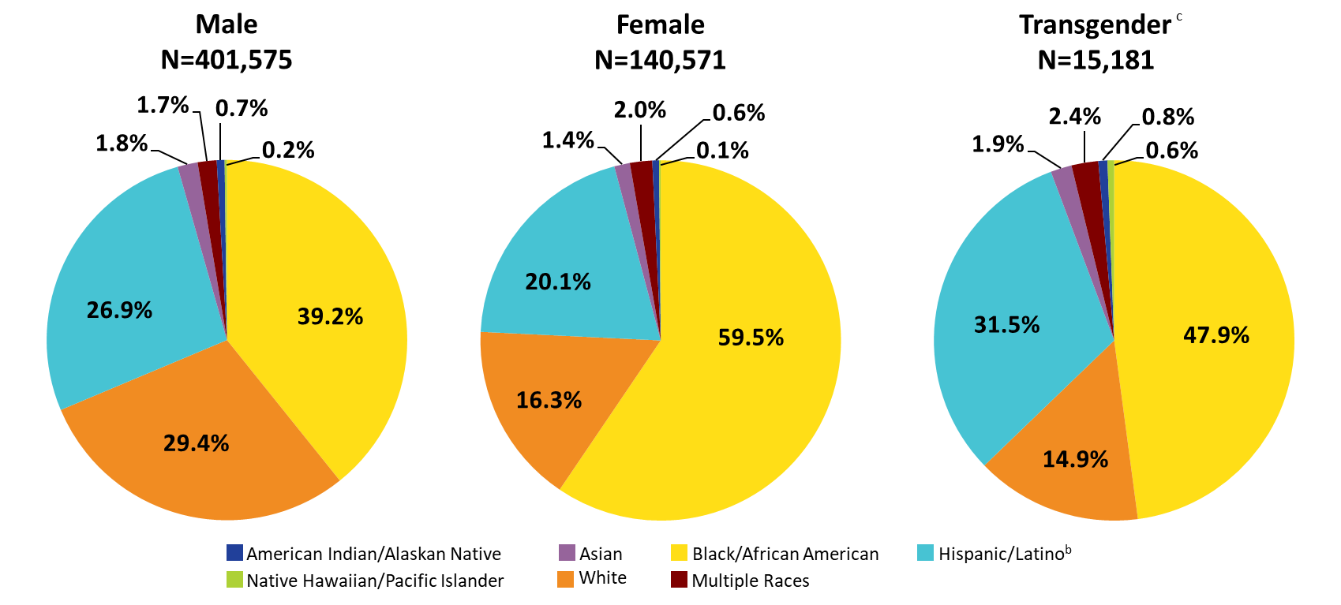
Clients Served by the Ryan White HIV/AIDS Program, by Gender and Race/Ethnicity, 2022—United States and 3 Territoriesª
ª Guam, Puerto Rico, and the U.S. Virgin Islands.
^{b} Hispanics/Latinos can be of any race.
^{c} Transgender clients includes clients who identify as transgender male, transgender female, or other gender identity.
Notes:
In 2022, 70.6% of male clients, 83.7% of female clients, and 85.1% of transgender clients were from racial and ethnic minority groups. For reference, White clients appear in each pie chart in orange shading.
Hispanics/Latinos can be of any race.
Transgender clients includes clients who identify as transgender male, transgender female, or other gender identity.
The three territories include Guam, Puerto Rico, and the U.S. Virgin Islands.

Slide 7
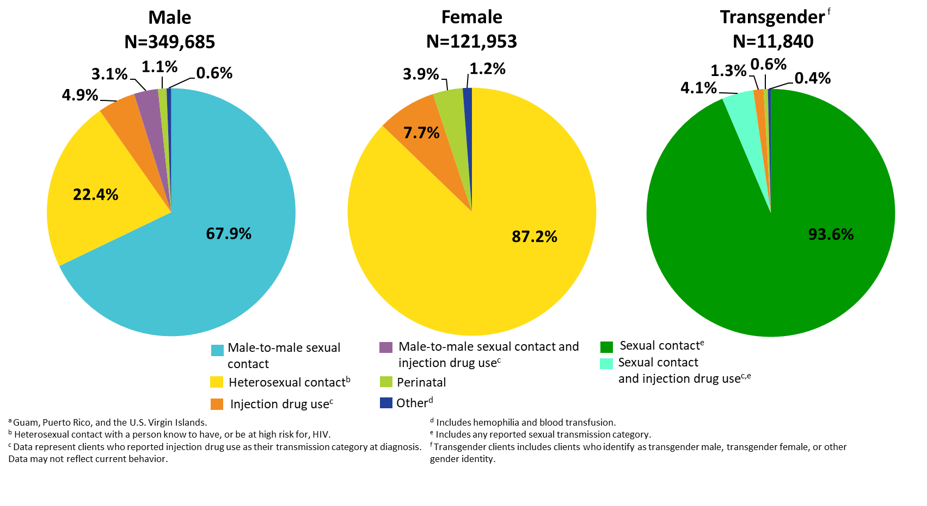
Clients Served by the Ryan White HIV/AIDS Program by Gender and Transmission Category, 2022—United States and 3 Territoriesª
Notes:
By gender and transmission category, among male clients, 67.9% had HIV attributed at diagnosis to male-to-male sexual contact; 22.4% to heterosexual contact; 4.9% to injection drug use; 3.1% to male-to-male sexual contact and injection drug use; and 1.1% to perinatal transmission.
Among female clients, 87.2% had HIV attributed at diagnosis to heterosexual contact; 7.7% to injection drug use, and 3.9% to perinatal transmission.
Among transgender clients, 93.6% had HIV attributed at diagnosis to some form of sexual contact, 4.1% to sexual contact and injection drug use, and 1.3% to injection drug use.
Heterosexual contact includes specific heterosexual contact with a person known to have, or to be at high risk for, HIV.
Other includes hemophilia, blood transfusion, and unknown factor.
Sexual contact includes any reported sexual transmission category for transgender clients.
Transgender clients includes clients who identify as transgender male, transgender female, or other gender identity.
The three territories include Guam, Puerto Rico, and the U.S. Virgin Islands.

Slide 8
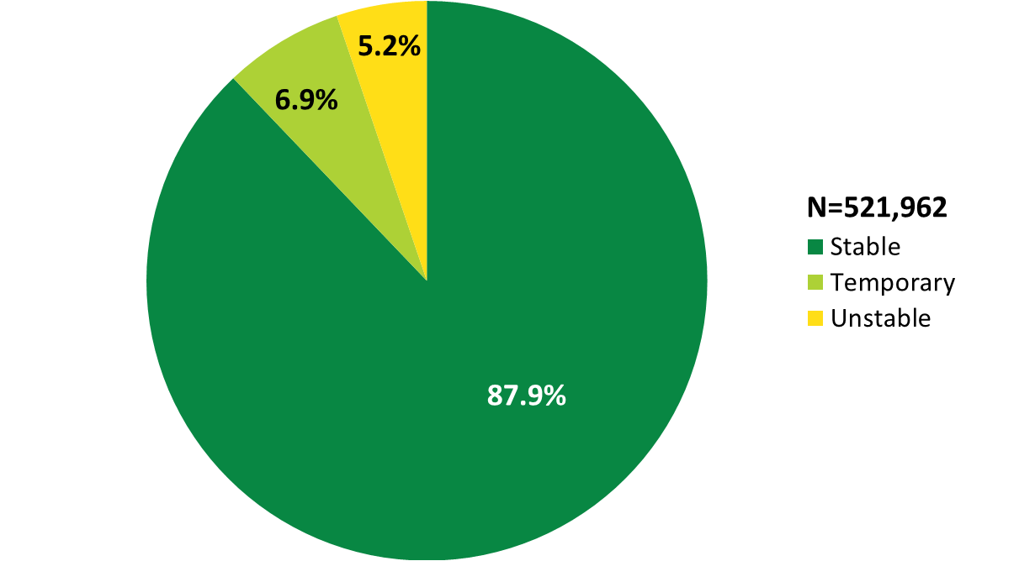
Clients Served by the Ryan White HIV/AIDS Program, by Housing Status, 2022—United States and 3 Territoriesª
ª Guam, Puerto Rico, and the U.S. Virgin Islands.
Notes:
In 2022, of the 521,962 clients with reported housing status, 6.9% experienced temporary housing and 5.2% experienced unstable housing.
The three territories include Guam, Puerto Rico, and the U.S. Virgin Islands.

Slide 9
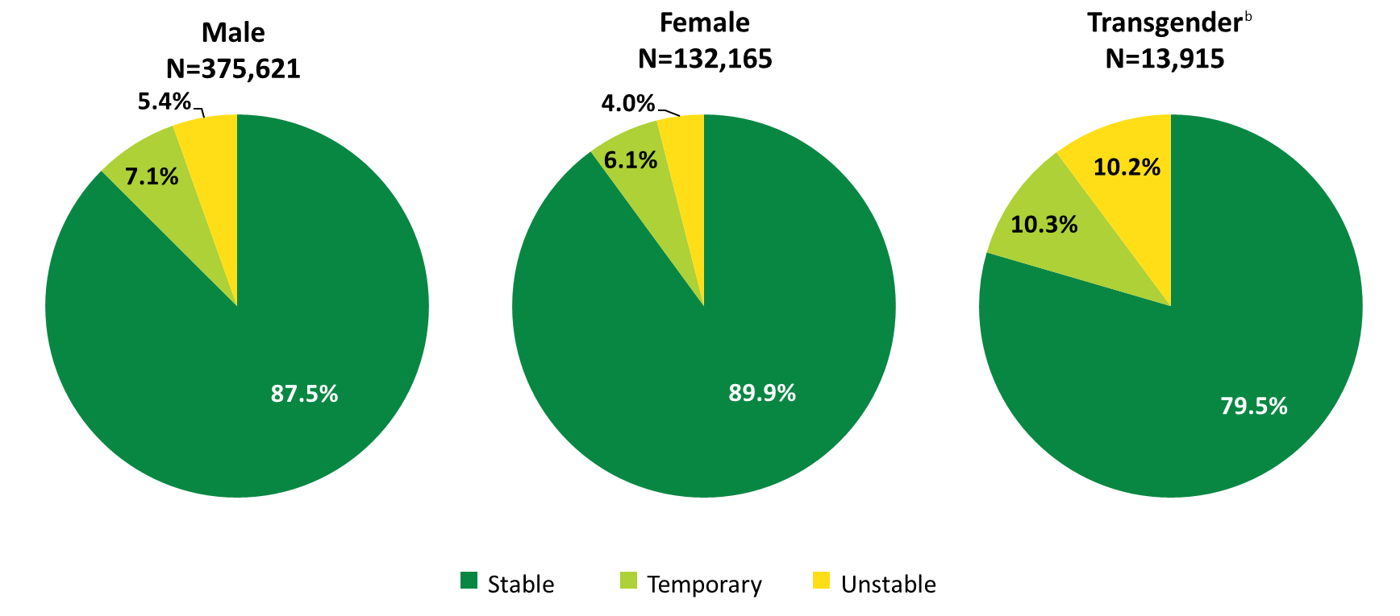
Clients Served by the Ryan White HIV/AIDS Program, by Gender and Housing Status, 2022—United States and 3 Territoriesª
ª Guam, Puerto Rico, and the U.S. Virgin Islands.
^{b} Transgender clients includes clients who identify as transgender male, transgender female, or other gender identity.
Notes:
A greater proportion of female RWHAP clients experienced stable housing in 2022, compared with male and transgender clients. Among female RWHAP clients, 6.1% experienced temporary housing and 4.0% experienced unstable housing. Among male clients, 7.1% experienced temporary housing and 5.4% experienced unstable housing. Among transgender clients, more than one-fifth of clients did not have stable housing: 10.3% experienced temporary housing and 10.2% experienced unstable housing.
Transgender clients includes clients who identify as transgender male, transgender female, or other gender identity.
The three territories include Guam, Puerto Rico, and the U.S. Virgin Islands.

Slide 10
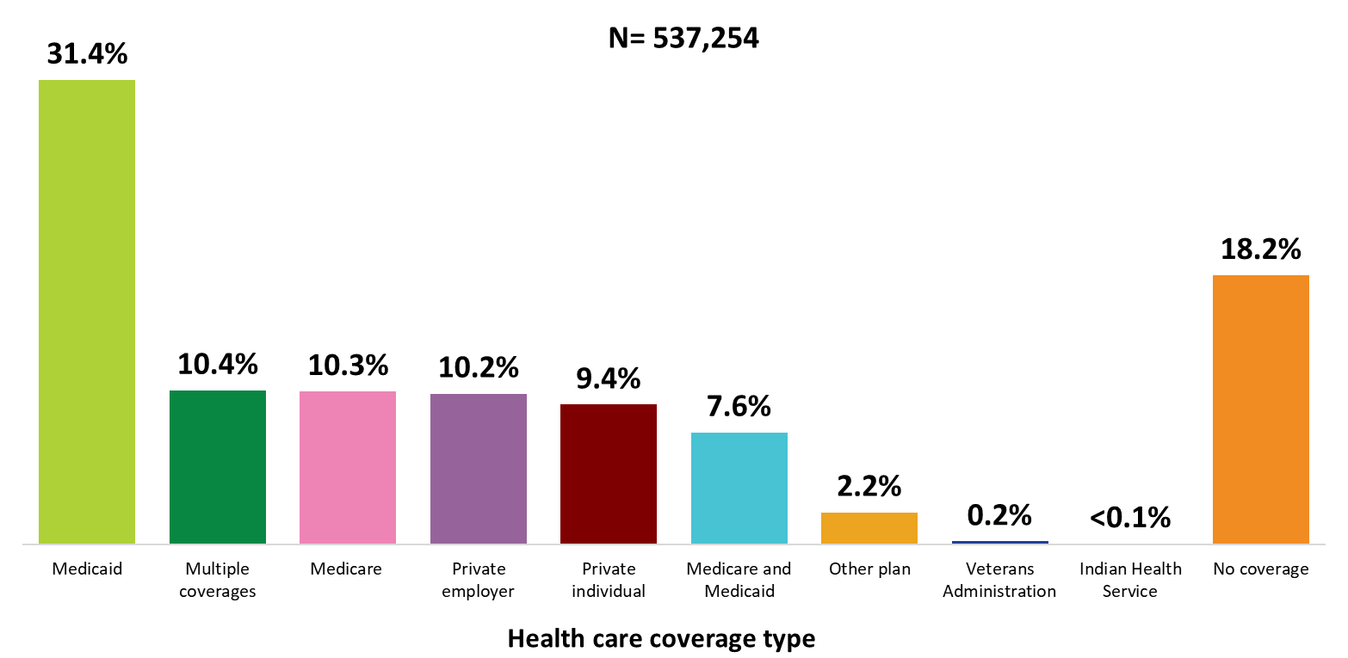
Clients Served by the Ryan White HIV/AIDS Program, by Health Care Coverage, 2022—United States and 3 Territoriesª
ª Guam, Puerto Rico, and the U.S. Virgin Islands.
Notes:
In 2022, 81.8% of RWHAP clients had some form of health care coverage. Of the 537,254 clients with reported health care coverage information, 31.4% were covered by Medicaid, 10.4% had multiple forms of coverage, 10.3% were covered by Medicare, 10.2% had private employer coverage, 9.4% had private individual coverage, and 7.6% had both Medicare and Medicaid dual coverage. Nearly one-fifth (18.2%) of RWHAP clients had no health care coverage in 2022.
Multiple coverage includes any combination of coverage types except for the Medicare and Medicaid dual enrollment category, which is displayed separately.
The three territories include Guam, Puerto Rico, and the U.S. Virgin Islands.

Slide 11
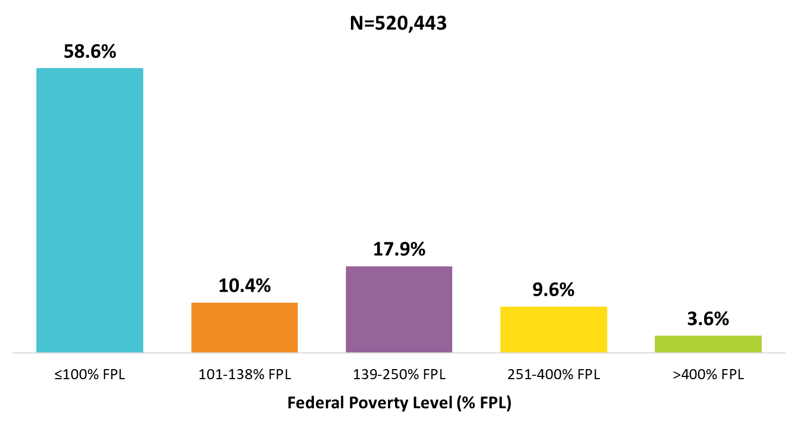
Clients Served by the Ryan White HIV/AIDS Program, by Poverty Level, 2022—United States and 3 Territoriesª
ª Guam, Puerto Rico, and the U.S. Virgin Islands.
Notes:
In 2022, 58.6% of the 520,443 clients with income information were living at or below 100% of the federal poverty level (FPL).
The three territories include Guam, Puerto Rico, and the U.S. Virgin Islands.

Slide 12
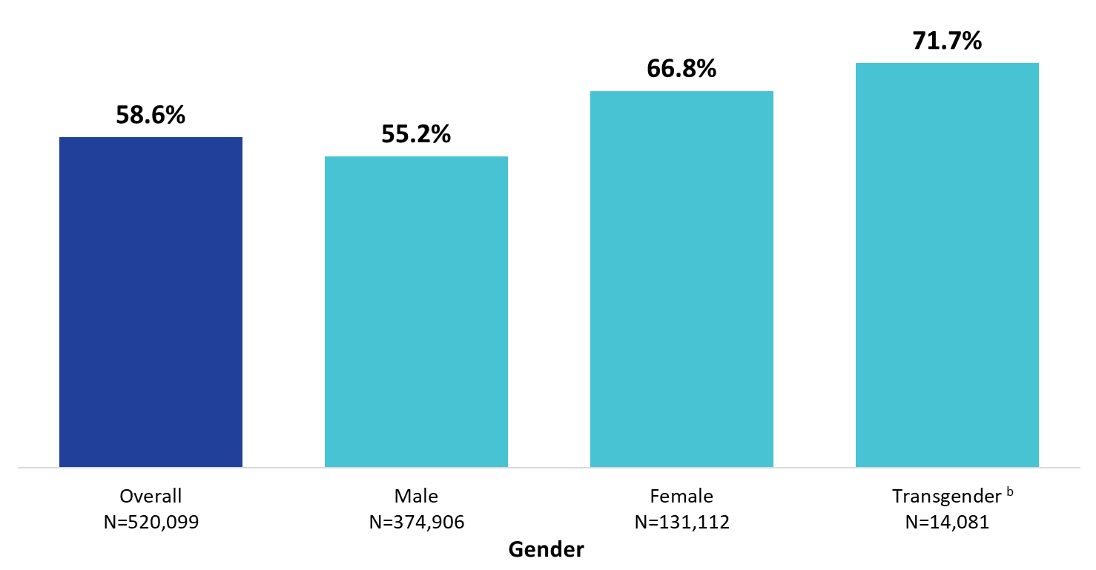
Clients Served by the Ryan White HIV/AIDS Program Living ≤100% of the Federal Poverty Level, by Gender, 2022—United States and 3 Territoriesª
ª Guam, Puerto Rico, and the U.S. Virgin Islands.
^{b} Transgender clients includes clients who identify as transgender male, transgender female, or other gender identity.
Notes:
Female and transgender clients had lower incomes than male clients. Among the 131,112 female clients with poverty level information in 2022, 66.8% were living at or below 100% of the federal poverty level (FPL). Among the 14,081 transgender clients with poverty level information, 71.7% were living at or below 100% FPL. These percentages are compared to 55.2% of male clients and the average across all RWHAP clients of 58.6%.
Transgender clients includes clients who identify as transgender male, transgender female, or other gender identity.
The three territories include Guam, Puerto Rico, and the U.S. Virgin Islands.

Slide 13
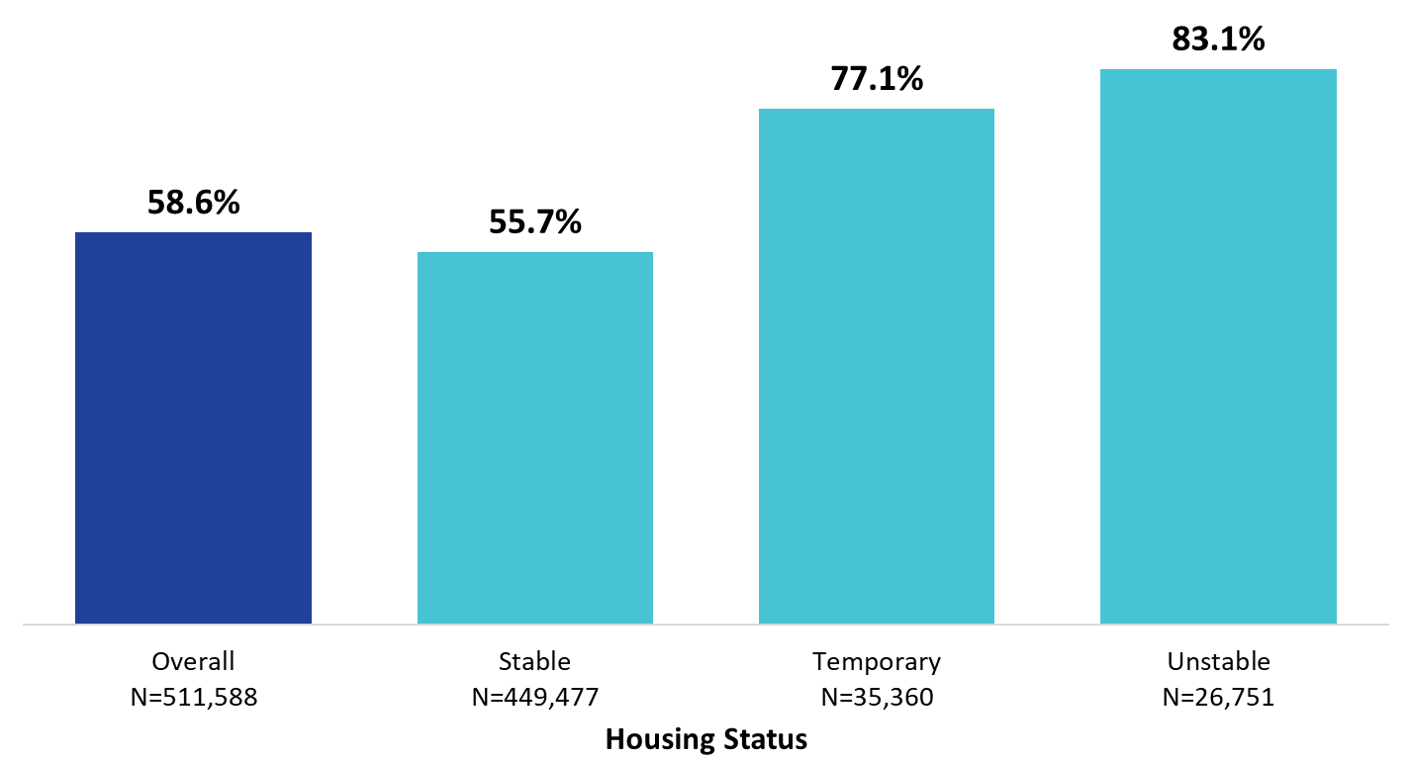
Clients Served by the Ryan White HIV/AIDS Program Living ≤100% of the Federal Poverty Level, by Housing Status, 2022—United States and 3 Territoriesª
ª Guam, Puerto Rico, and the U.S. Virgin Islands.
Notes:
Among clients who experienced stable housing who had reported poverty level information in 2022, 55.7% were living ≤100% FPL. Among clients who experienced temporary housing, 77.1% were living ≤100% FPL. Among clients who experienced unstable housing, 83.1% were living ≤100% FPL.
The three territories include Guam, Puerto Rico, and the U.S. Virgin Islands.

Slide 14
Connect with the Ryan White HIV/AIDS Program
Learn more about our program at our website:
ryanwhite.hrsa.gov
Sign up for the Ryan White HIV/AIDS Program Listserv:
https://public.govdelivery.com/accounts/USHHSHRSA/signup/29907

Slide 15
Connect with HRSA
Learn more about our agency at:
www.HRSA.gov
Sign up for the HRSA eNews
FOLLOW US:

