Slide 1
Clients Served by the Ryan White HIV/AIDS Program 2022
HIV Care Outcomes: Viral Suppression
Released June 2024
Notes:
HRSA is on four social media platforms. We encourage you to follow along and share our content on Twitter, Facebook, LinkedIn and Instagram to stay up-to-date on the latest HRSA news. Our account/handle on each platform is @HRSAgov.
Additionally, we also encourage you to sign up for HRSA’s e-News, a biweekly email of comprehensive HRSA news, and to sign up for HRSA press releases. You can also visit our website www.HRSA.gov for more detailed information about all of our programs.

Slide 2
Trends in Viral Suppression Among Clients Served by the Ryan White HIV/AIDS Program, 2010–2022
Select characteristics and priority populations

Slide 3
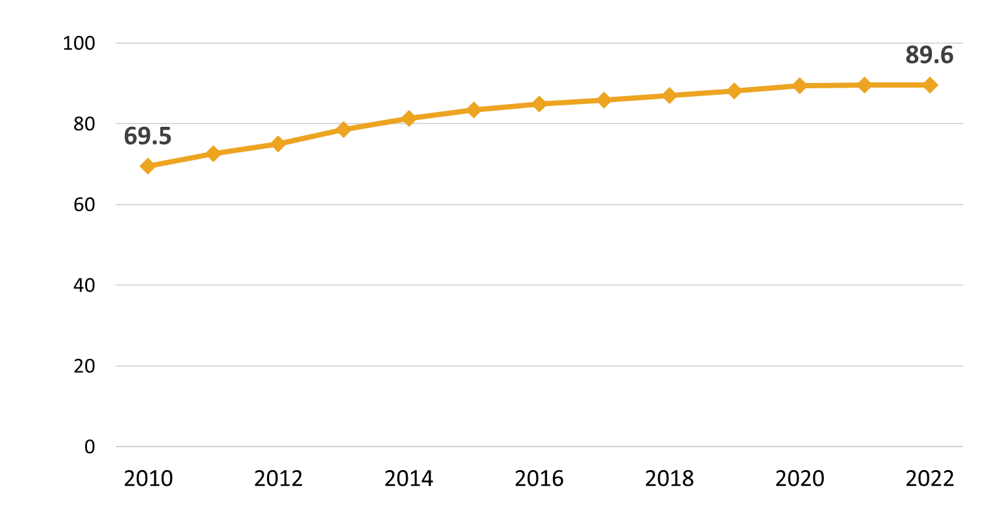
Viral Suppression among Clients Served by the Ryan White HIV/AIDS Program (non-ADAP), 2010–2022—United States and 3 Territoriesª
Viral suppression: ≥1 OAHS visit during the calendar year and ≥1 viral load reported, with the last viral load result <200 copies/mL.
ª Guam, Puerto Rico, and the U.S. Virgin Islands.
Notes:
This chart shows the proportion of RWHAP clients that reached viral suppression from 2010 to 2022. Viral suppression increased steadily over the thirteen-year period, from 69.5% in 2010 to 89.6% in 2022.
Viral suppression is defined as ≥1 outpatient/ambulatory health services visit during the calendar year and ≥1 viral load reported, with the last viral load result <200 copies/mL.
The three territories include Guam, Puerto Rico, and the U.S. Virgin Islands. 2019 and 2020 data for Guam are unavailable.

Slide 4
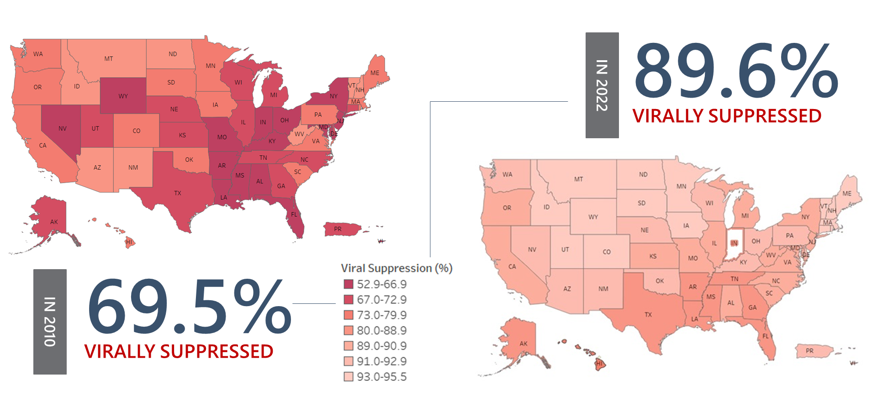
Viral Suppression among RWHAP Clients, by State, 2010 and 2022—United States and 2 Territoriesª
Viral suppression: ≥1 OAHS visit during the calendar year and ≥1 viral load reported, with the last viral load result <200 copies/mL.
ª Guam, Puerto Rico, and the U.S. Virgin Islands. *2022 data for Indiana are unavailable.
Notes:
This slide shows the variation in viral suppression by state in 2010 and in 2022, with darker red indicating lower percentages of viral suppression and lighter shades indicating higher percentages.
From 2010 through 2022, all states showed increases in viral suppression; however, some states, particularly in the Southern U.S. continued to have room for improvement.
Viral suppression is defined as ≥1 outpatient/ambulatory health services visit during the calendar year and ≥1 viral load reported, with the last viral load result <200 copies/mL.
The two territories include Puerto Rico and the U.S. Virgin Islands.

Slide 5
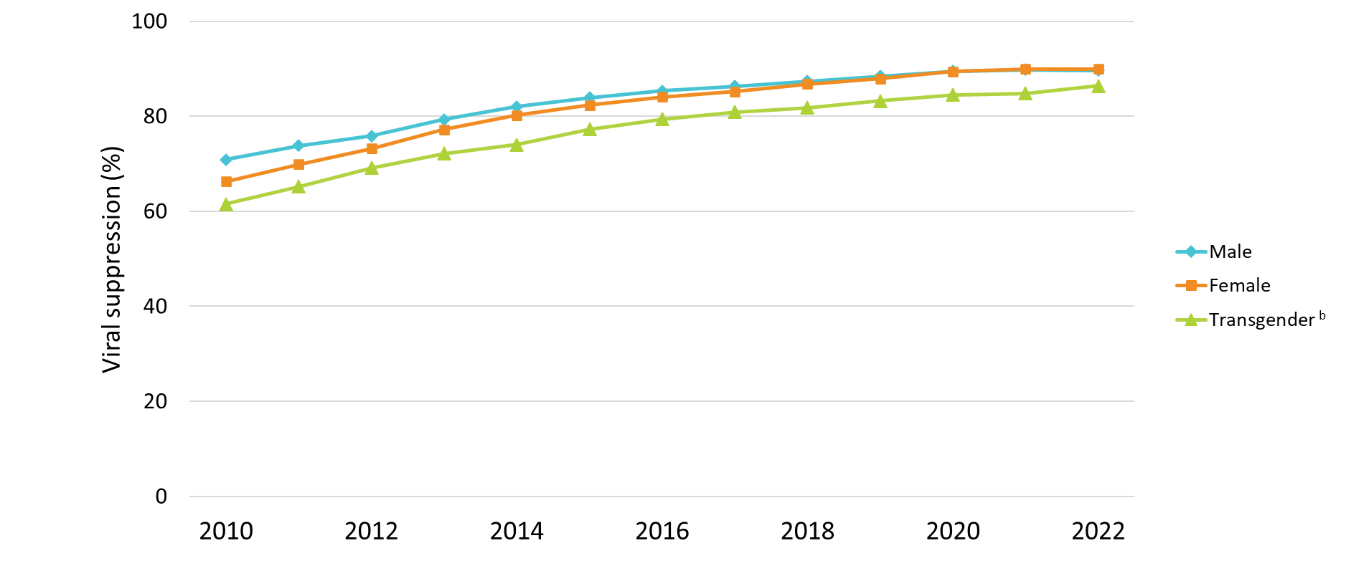
Viral Suppression among Clients Served by the Ryan White HIV/AIDS Program, by Gender, 2010–2022—United States and 3 Territoriesª
Viral suppression: ≥1 OAHS visit during the calendar year and ≥1 viral load reported, with the last viral load result <200 copies/mL.
ª Guam, Puerto Rico, and the U.S. Virgin Islands.
^{b} Transgender clients includes clients who identify as transgender male, transgender female, or other gender identity.
ª Guam, Puerto Rico, and the U.S. Virgin Islands.
^{b} Transgender clients includes clients who identify as transgender male, transgender female, or other gender identity.
Notes:
Viral suppression has increased steadily over time; however, differences continue to exist across subgroups, including by gender. From 2010 through 2022, viral suppression increased from 70.9% to 89.6% among male clients; 66.3% to 89.9% among female clients; and 61.5% to 86.4% among transgender clients.
Viral suppression is defined as ≥1 outpatient/ambulatory health services visit during the calendar year and ≥1 viral load reported, with the last viral load result <200 copies/mL.
The three territories include Guam, Puerto Rico, and the U.S. Virgin Islands. 2019 and 2020 data for Guam are unavailable.
Transgender clients includes clients who identify as transgender male, transgender female, or other gender identity.

Slide 6
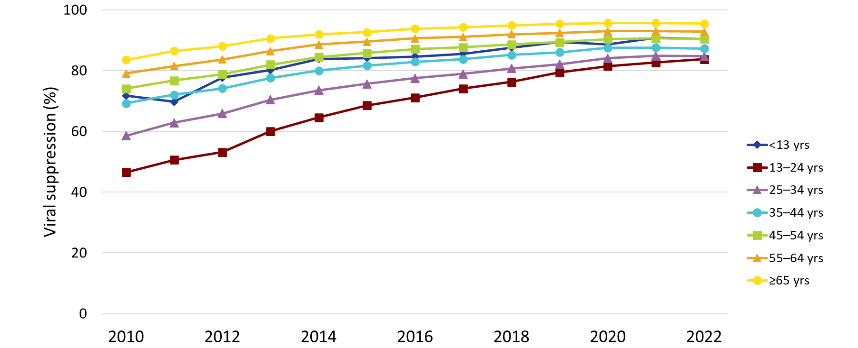
Viral Suppression among Clients Served by the Ryan White HIV/AIDS Program, by Age Group, 2010–2022—United States and 3 Territoriesª
Viral suppression: ≥1 OAHS visit during the calendar year and ≥1 viral load reported, with the last viral load result <200 copies/mL.
ª Guam, Puerto Rico, and the U.S. Virgin Islands.
Notes:
Young people aged 13–24 years and 25–34 years continue to have the lowest percentages of viral suppression across age groups; however, the gap is narrowing. Among clients aged 13–24 years, viral suppression increased from 46.6% in 2010 to 83.8% in 2022. Among clients aged 25–34 years, viral suppression increased from 58.6% in 2010 to 84.7% in 2022. Comparatively, 95.5% of clients aged 65 and older reached viral suppression in 2022.
Viral suppression is defined as ≥1 outpatient/ambulatory health services visit during the calendar year and ≥1 viral load reported, with the last viral load result <200 copies/mL.
The three territories include Guam, Puerto Rico, and the U.S. Virgin Islands. 2019 and 2020 data for Guam are unavailable.

Slide 7
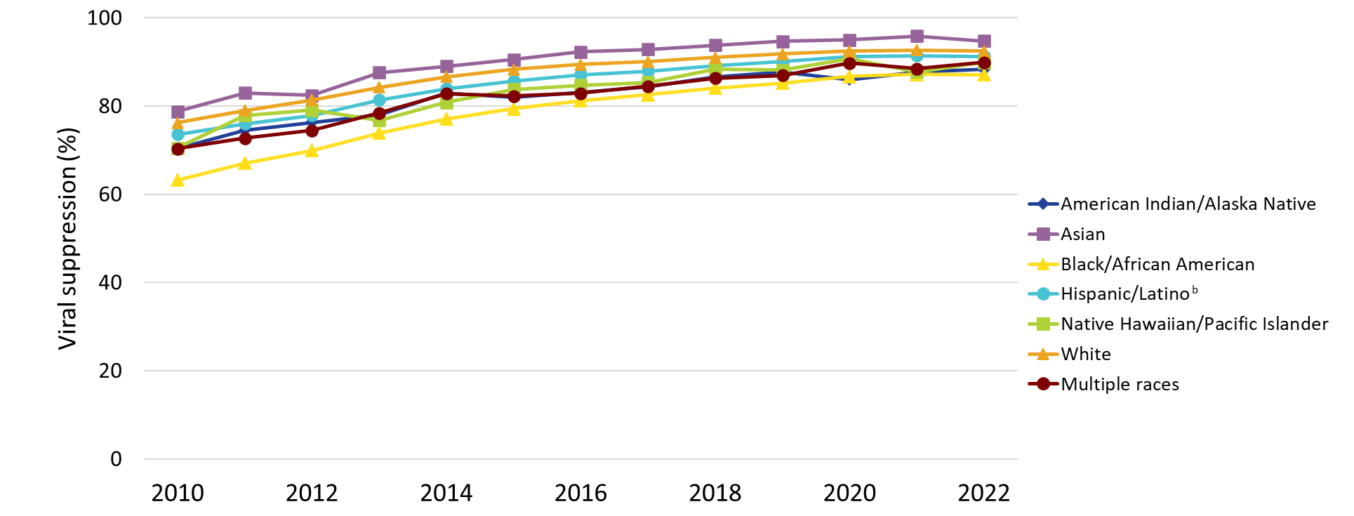
Viral Suppression among Clients Served by the Ryan White HIV/AIDS Program, by Race/Ethnicity, 2010–2022—United States and 3 Territoriesª
Viral suppression: ≥1 OAHS visit during the calendar year and ≥1 viral load reported, with the last viral load result <200 copies/mL.
ª Guam, Puerto Rico, and the U.S. Virgin Islands.
^{b} Hispanics/Latinos can be of any race.
Notes:
Nearly three-quarters of RWHAP clients are from racial and ethnic minority groups. From 2021 to 2022, viral suppression was lowest among Black/African American clients (87.2% to 87.1%, respectively).
Hispanics/Latinos can be of any race.
Viral suppression is defined as ≥1 outpatient/ambulatory health services visit during the calendar year and ≥1 viral load reported, with the last viral load result <200 copies/mL.
The three territories include Guam, Puerto Rico, and the U.S. Virgin Islands. 2019 and 2020 data for Guam are unavailable.

Slide 8
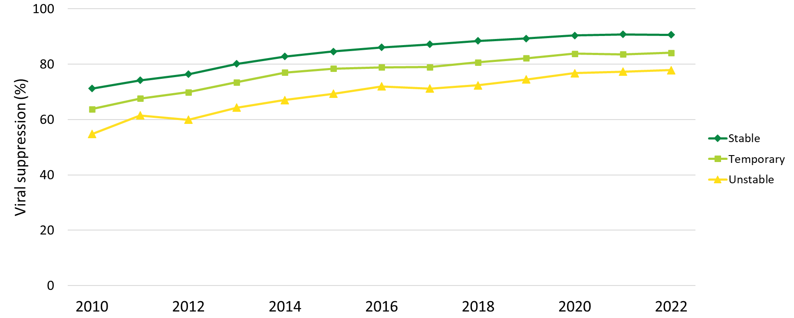
Viral Suppression among Clients Served by the Ryan White HIV/AIDS Program, by Housing Status, 2010–2022—United States and 3 Territoriesª
Viral suppression: ≥1 OAHS visit during the calendar year and ≥1 viral load reported, with the last viral load result <200 copies/mL.
ª Guam, Puerto Rico, and the U.S. Virgin Islands.
Notes:
Clients served by the RWHAP with temporary or unstable housing continue to have the lowest percentages of viral suppression, although percentages are steadily increasing. Among clients with temporary housing, viral suppression increased from 63.7% in 2010 to 84.1% in 2022. Among clients with unstable housing, viral suppression increased from 54.8% in 2010 to 77.9% in 2022. Comparatively, viral suppression among clients with stable housing increased from 71.2% in 2010 to 90.6% in 2022.
Viral suppression is defined as ≥1 outpatient/ambulatory health services visit during the calendar year and ≥1 viral load reported, with the last viral load result <200 copies/mL.
The three territories include Guam, Puerto Rico, and the U.S. Virgin Islands. 2019 and 2020 data for Guam are unavailable.

Slide 9
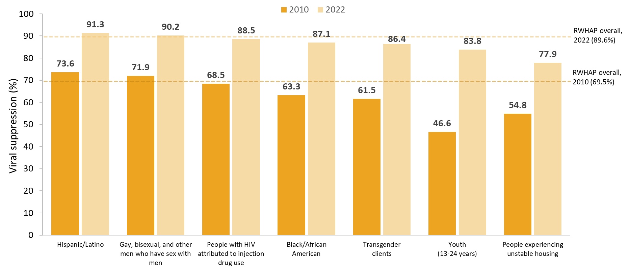
Viral Suppression among Priority Populations Served by the Ryan White HIV/AIDS Program, 2010 and 2022—United States and 3 Territoriesª
Hispanics/Latinos can be of any race.
Viral suppression: ≥1 OAHS visit during the calendar year and ≥1 viral load reported, with the last viral load result <200 copies/mL.
ª Guam, Puerto Rico, and the U.S. Virgin Islands.
Notes:
This chart shows viral suppression among priority populations served by the RWHAP. It shows a side-by-side comparison of viral suppression for each subpopulation in 2010 – indicated by a dark orange bar, and in 2022 – indicated by a light orange bar. For comparison, viral suppression for all RWHAP clients overall in 2010 was 69.5% indicated by the dark orange line and was 89.6% in 2022 indicated by the light orange line. This upward trend in viral suppression occurred across all priority populations.
However, it is important to note that challenges remain in reaching viral suppression for certain populations. Most notably, in 2022, the client subpopulations with viral suppression lower than the overall percentage of 89.6% were people with HIV attributed at diagnosis to injection drug use (88.5%), Blacks/African Americans (87.1%), transgender clients (86.4%), youth aged 13-24 years (83.8%), and people experiencing unstable housing (77.9%).
Hispanics/Latinos can be of any race.
Viral suppression is defined as ≥1 outpatient/ambulatory health services visit during the calendar year and ≥1 viral load reported, with the last viral load result <200 copies/mL.
The three territories include Guam, Puerto Rico, and the U.S. Virgin Islands.

Slide 10
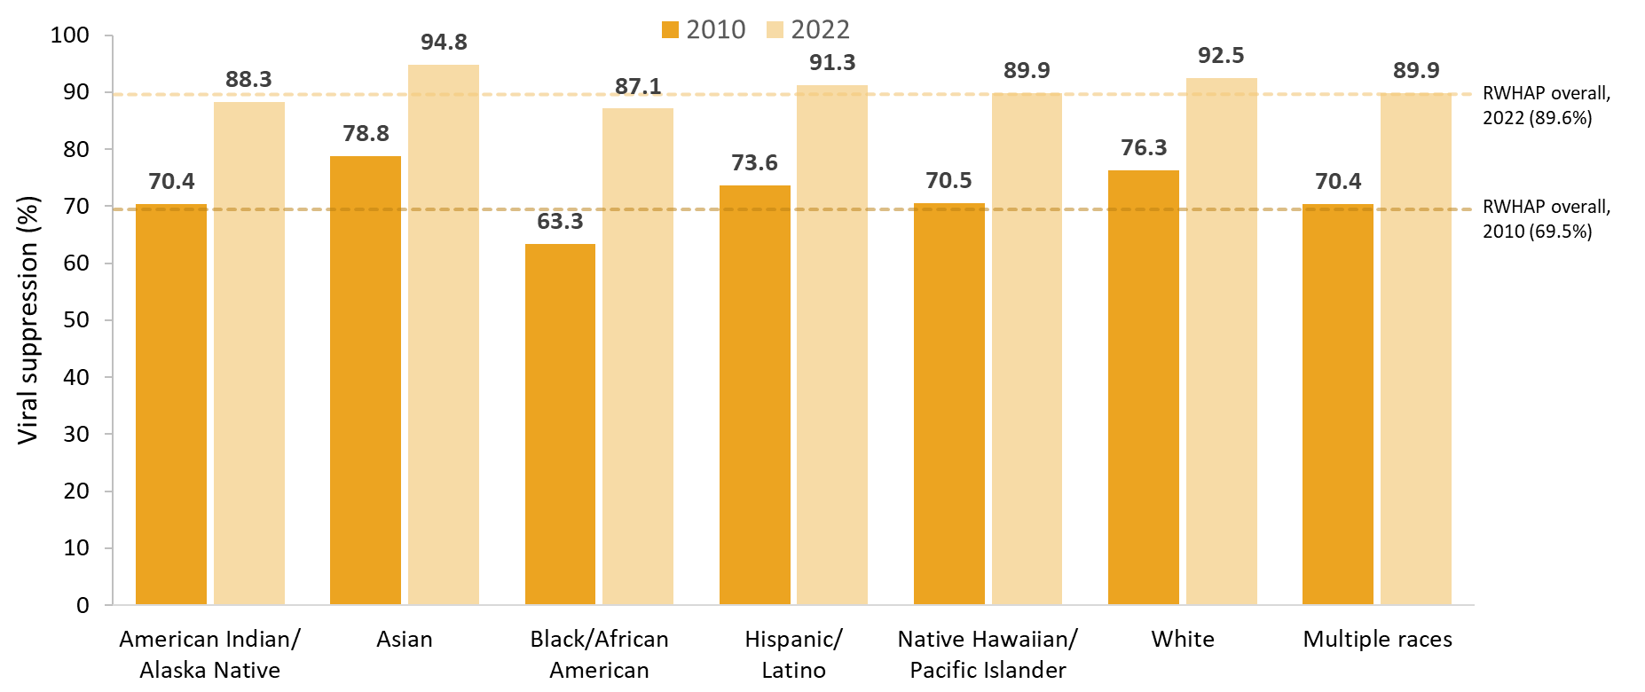
Viral Suppression among Clients Served by the Ryan White HIV/AIDS Program, by Race/Ethnicity, 2010 and 2022—United States and 3 Territoriesª
Hispanics/Latinos can be of any race.
Viral suppression: ≥1 OAHS visit during the calendar year and ≥1 viral load reported, with the last viral load result <200 copies/mL.
ª Guam, Puerto Rico, and the U.S. Virgin Islands.
Notes:
This chart shows viral suppression among clients served by the RWHAP by race/ethnicity. It shows a side-by-side comparison of viral suppression for each subpopulation in 2010 – indicated by a dark grey bar, and in 2022 – indicated by a light grey bar. For comparison, viral suppression for all RWHAP clients overall in 2010 was 69.5% indicated by the dark grey line and was 89.6% in 2022 indicated by the light grey line.
Nearly three-quarters of RWHAP clients are from racial and ethnic minority groups. Viral suppression among Blacks/African Americans increased from 63.3% in 2010 to 87.1% in 2022; although viral suppression continued to be lowest among Black/African American clients compared with most other race/ethnicity groups, the disparity has decreased substantially.
Hispanics/Latinos can be of any race.
Viral suppression is defined as ≥1 outpatient/ambulatory health services visit during the calendar year and ≥1 viral load reported, with the last viral load result <200 copies/mL.
The three territories include Guam, Puerto Rico, and the U.S. Virgin Islands.

Slide 11
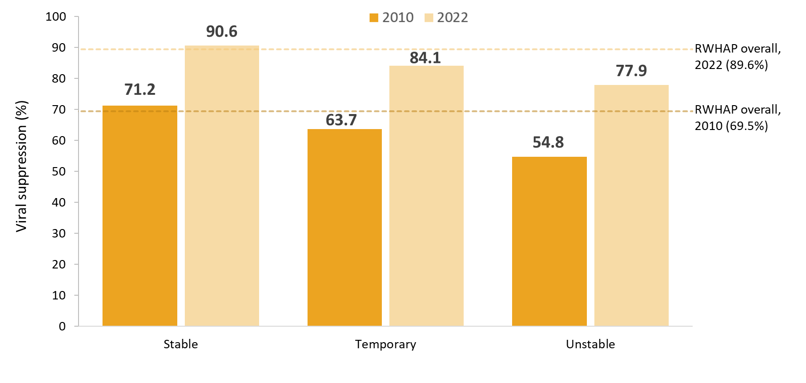
Viral Suppression among Ryan White HIV/AIDS Program Clients by Housing Status, 2010 and 2022 —United States and 3 Territoriesª
Viral suppression: ≥1 OAHS visit during the calendar year and ≥1 viral load reported, with the last viral load result <200 copies/mL.
ª Guam, Puerto Rico, and the U.S. Virgin Islands.
Notes:
This chart shows viral suppression among clients experiencing stable, temporary or unstable housing. It shows a side-by-side comparison of viral suppression for housing status in 2010 – indicated by a dark grey bar, and in 2022 – indicated by a light grey bar. For comparison, viral suppression for all RWHAP clients overall in 2010 was 69.5% indicated by the dark grey line and was 89.6% in 2022 indicated by the light grey line.
Viral suppression increased from 63.7% in 2010 to 84.1% in 2022 among clients experiencing temporary housing. Among clients experiencing unstable housing, viral suppression increased from 54.8% in 2010 to 77.9% in 2022.
Viral suppression is defined as ≥1 outpatient/ambulatory health services visit during the calendar year and ≥1 viral load reported, with the last viral load result <200 copies/mL.
The three territories include Guam, Puerto Rico, and the U.S. Virgin Islands.

Slide 12
Viral Suppression Among Clients Served by the RWHAP, 2022
Select characteristics

Slide 13
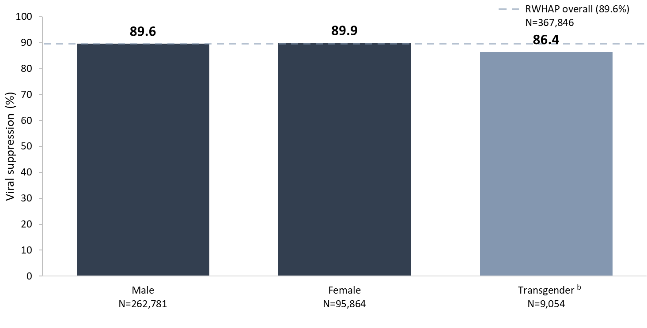
Viral Suppression among Clients Served by the Ryan White HIV/AIDS Program, by Gender, 2022—United States and 3 Territoriesª
N represents the total number of clients in the specific population.
Viral suppression: ≥1 OAHS visit during the calendar year and ≥1 viral load reported, with the last viral load result <200 copies/mL.
ª Guam, Puerto Rico, and the U.S. Virgin Islands.
^{b} Transgender clients includes clients who identify as transgender male, transgender female, or other gender identity.
Notes:
In 2022, viral suppression varied by gender; 86.4% of transgender clients achieved viral suppression, compared to 89.9% of female clients and 89.6% of male clients.
N represents the total number of clients in the specific subpopulation.
Viral suppression is defined as ≥1 outpatient/ambulatory health services visit during the calendar year and ≥1 viral load reported, with the last viral load result <200 copies/mL.
The three territories include Guam, Puerto Rico, and the U.S. Virgin Islands.
Transgender clients includes clients who identify as transgender male, transgender female, or other gender identity.

Slide 14
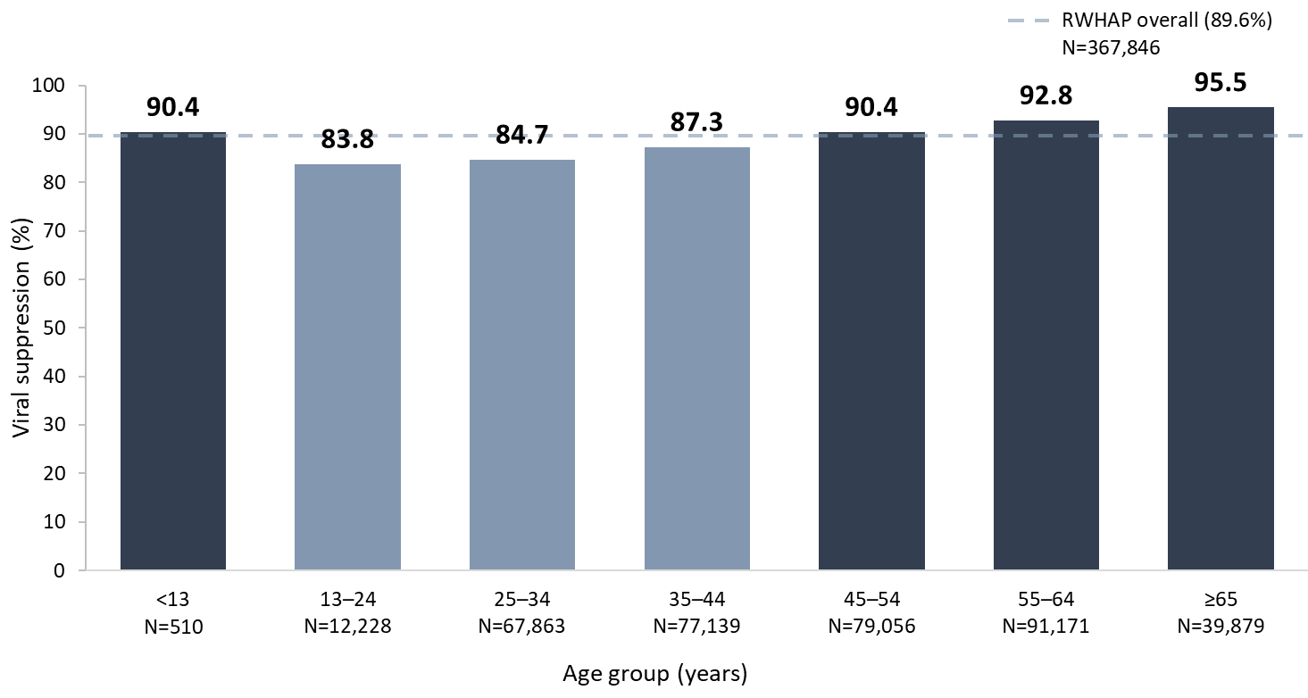
Viral Suppression among Clients Served by the Ryan White HIV/AIDS Program, by Age Group, 2022—United States and 3 Territoriesª
N represents the total number of clients in the specific population.
Viral suppression: ≥1 OAHS visit during the calendar year and ≥1 viral load reported, with the last viral load result <200 copies/mL.
ª Guam, Puerto Rico, and the U.S. Virgin Islands.
Notes:
Young people continue to have the lowest percentages of viral suppression compared to other age groups. In 2022, clients aged 13–24 years (83.8%), 25–34 years (84.7%), and 35–44 years (87.3%) had the lowest percentages of viral suppression by age group.
N represents the total number of clients in the specific subpopulation.
Viral suppression is defined as ≥1 outpatient/ambulatory health services visit during the calendar year and ≥1 viral load reported, with the last viral load result <200 copies/mL.
The three territories include Guam, Puerto Rico, and the U.S. Virgin Islands.

Slide 15
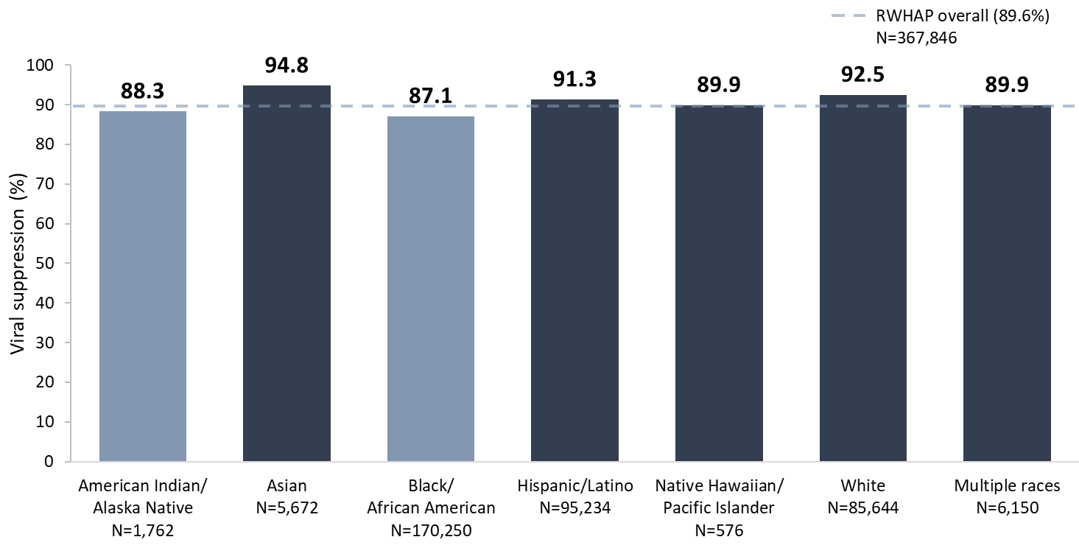
Viral Suppression among Clients Served by the Ryan White HIV/AIDS Program, by Race/Ethnicity, 2022—United States and 3 Territoriesª
N represents the total number of clients in the specific population.
Hispanics/Latinos can be of any race.
Viral suppression: ≥1 OAHS visit during the calendar year and ≥1 viral load reported, with the last viral load result <200 copies/mL.
ª Guam, Puerto Rico, and the U.S. Virgin Islands.
Notes:
In 2022, viral suppression was high across racial/ethnic subpopulations. However, differences existed, with the lowest percentage of viral suppression among Black/African Americans (87.1%) and American Indians/Alaska Natives (88.3%); and the highest percentage among Asians (94.8%).
Hispanics/Latinos can be of any race.
N represents the total number of clients in the specific subpopulation.
Viral suppression is defined as ≥1 outpatient/ambulatory health services visit during the calendar year and ≥1 viral load reported, with the last viral load result <200 copies/mL.
The three territories include Guam, Puerto Rico, and the U.S. Virgin Islands.

Slide 16
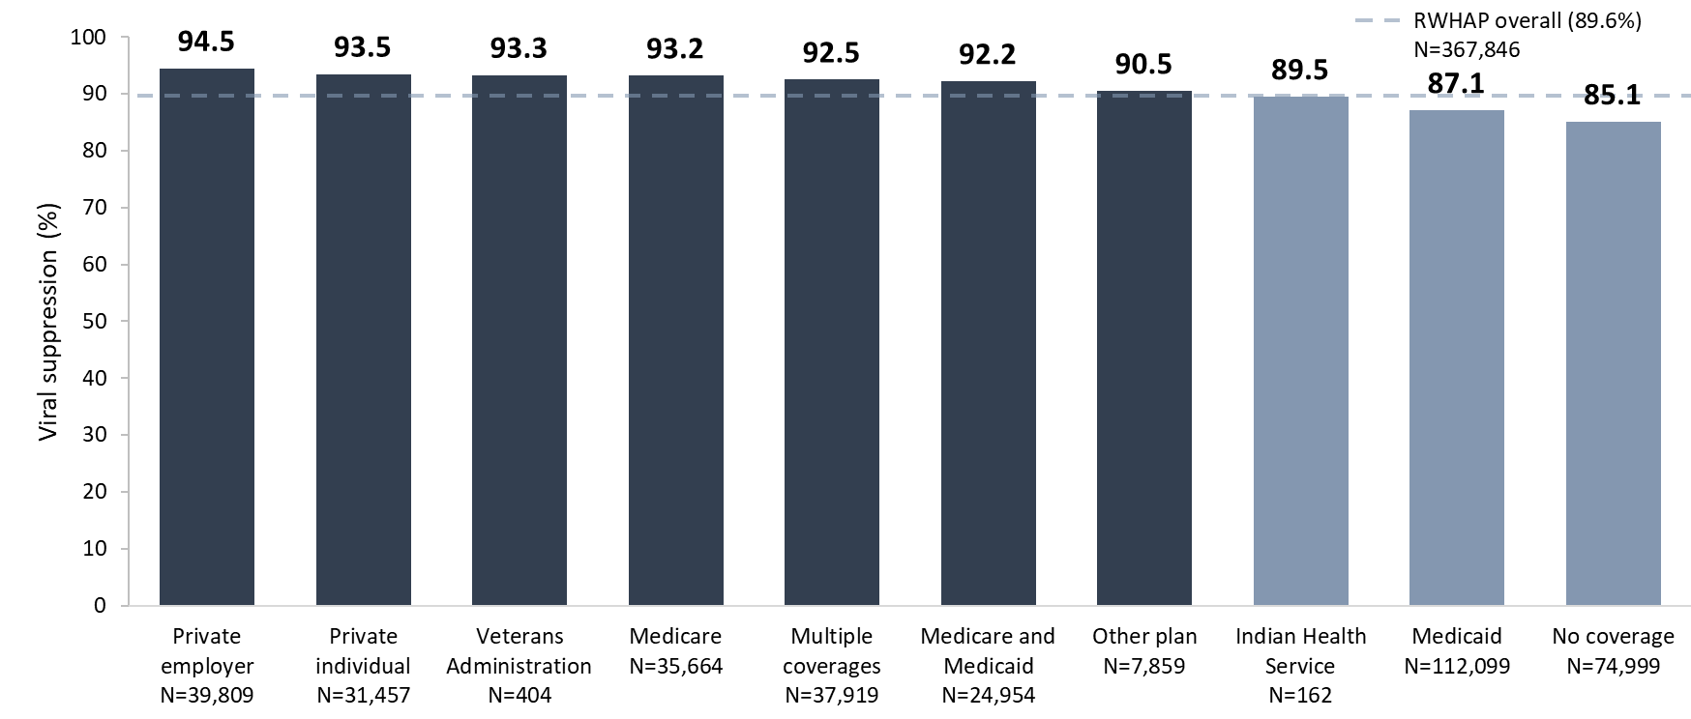
Viral Suppression among Clients Served by the Ryan White HIV/AIDS Program, by Health Care Coverage, 2022—United States and 3 Territoriesª
N represents the total number of clients in the specific population.
Viral suppression: ≥1 OAHS visit during the calendar year and ≥1 viral load reported, with the last viral load result <200 copies/mL.
ª Guam, Puerto Rico, and the U.S. Virgin Islands.
Notes:
In 2022, viral suppression was lowest among clients with no health care coverage (85.1%), followed by clients with Medicaid-only coverage (87.1%), and clients with Indian Health Service coverage (89.5%).
N represents the total number of clients in the specific subpopulation.
Viral suppression is defined as ≥1 outpatient/ambulatory health services visit during the calendar year and ≥1 viral load reported, with the last viral load result <200 copies/mL.
The three territories include Guam, Puerto Rico, and the U.S. Virgin Islands.

Slide 17
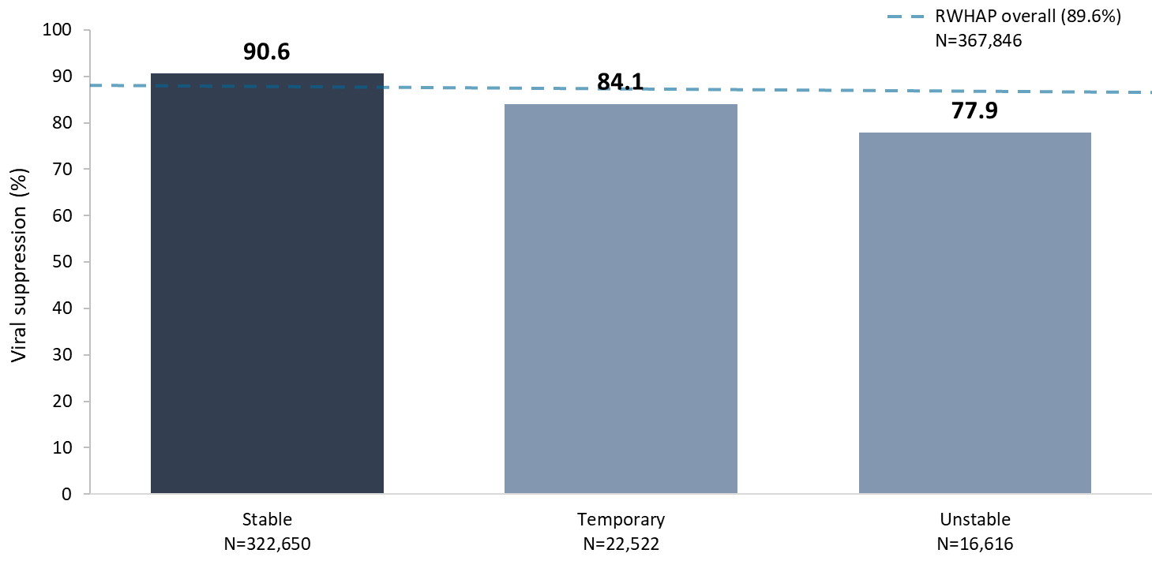
Viral Suppression among Clients Served by the Ryan White HIV/AIDS Program, by Housing Status, 2022—United States and 3 Territoriesª
N represents the total number of clients in the specific population.
Viral suppression: ≥1 OAHS visit during the calendar year and ≥1 viral load reported, with the last viral load result <200 copies/mL.
ª Guam, Puerto Rico, and the U.S. Virgin Islands.
Notes:
In 2022, viral suppression varied by housing status; 77.9% of clients experiencing unstable housing achieved viral suppression, compared to 84.1% of clients experiencing temporary housing and 90.6% of clients experiencing stable housing.
N represents the total number of clients in the specific subpopulation.
Viral suppression is defined as ≥1 outpatient/ambulatory health services visit during the calendar year and ≥1 viral load reported, with the last viral load result <200 copies/mL.
The three territories include Guam, Puerto Rico, and the U.S. Virgin Islands.

Slide 18
Viral Suppression Among Clients Served by the RWHAP, 2022
Disparities within priority populations

Slide 19
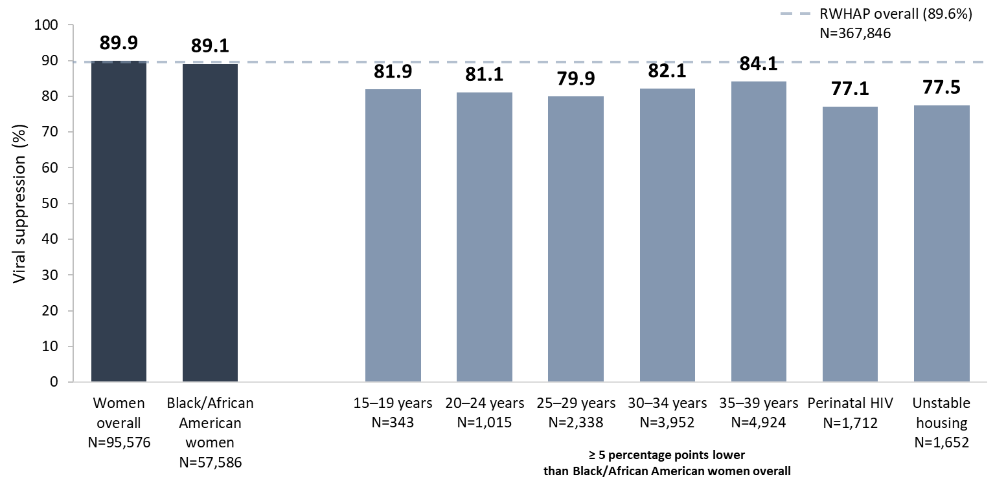
Viral Suppression among Black/African American Women Served by the Ryan White HIV/AIDS Program, 2022—United States and 3 Territoriesª
N represents the total number of clients in the specific population.
Includes females aged 13 years and older.
Viral suppression: ≥1 OAHS visit during the calendar year and ≥1 viral load reported, with the last viral load result <200 copies/mL.
ª Guam, Puerto Rico, and the U.S. Virgin Islands.
Notes:
In 2022, the percentage of Black/African American women who were virally suppressed (89.1%) was slightly lower than the national RWHAP average (89.6%) – indicated by the dashed grey line – and the percentage for women overall (89.9%).
Among Black/African American women, viral suppression was lowest in each 5-year age group from 15–39 years (range: 79.9% to 82.1%); those with perinatal HIV (77.1%); and those experiencing unstable housing (77.5%).
N represents the total number of clients in the specific subpopulation.
Viral suppression is defined as ≥1 outpatient/ambulatory health services visit during the calendar year and ≥1 viral load reported, with the last viral load result <200 copies/mL.
The three territories include Guam, Puerto Rico, and the U.S. Virgin Islands.

Slide 20
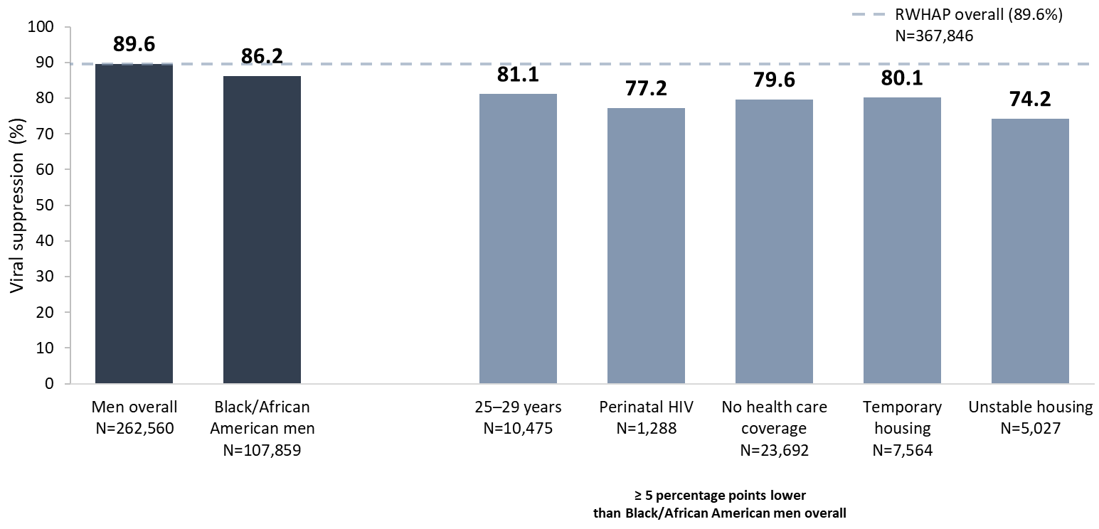
Viral Suppression among Black/African American Men Served by the Ryan White HIV/AIDS Program, 2022 —United States and 3 Territoriesª
N represents the total number of clients in the specific population.
Includes males aged 13 years and older.
Viral suppression: ≥1 OAHS visit during the calendar year and ≥1 viral load reported, with the last viral load result <200 copies/mL.
ª Guam, Puerto Rico, and the U.S. Virgin Islands.
Notes:
In 2022, the overall percentage of Black/African American men who reached viral suppression (86.5%) was lower than the percentages for the RWHAP overall (89.6%) – indicated by the dashed grey line – and that of men overall (89.6%).
Among Black/African American men, viral suppression was lowest among men aged 25–29 years (81.1%); those with perinatal HIV (77.2%); those with no health care coverage (79.6%); and those experiencing temporary (80.1%) and unstable housing (74.2%).
N represents the total number of clients in the specific subpopulation.
Viral suppression is defined as ≥1 outpatient/ambulatory health services visit during the calendar year and ≥1 viral load reported, with the last viral load result <200 copies/mL.
The three territories include Guam, Puerto Rico, and the U.S. Virgin Islands.

Slide 21
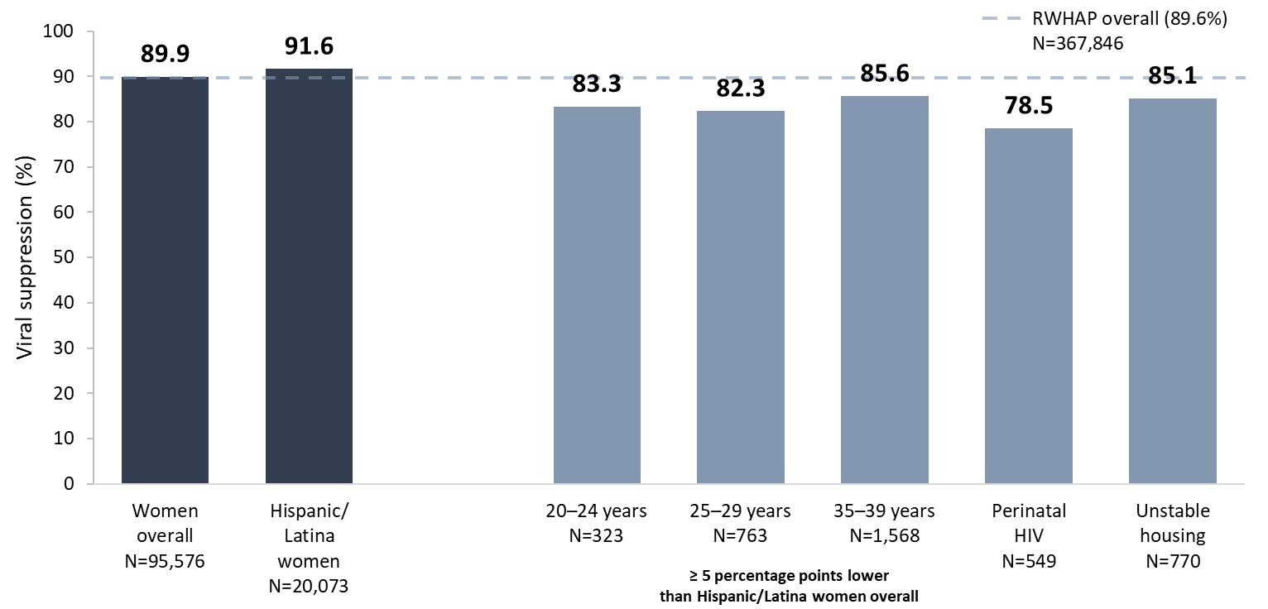
Viral Suppression among Hispanic/Latina Women Served by the Ryan White HIV/AIDS Program, 2022—United States and 3 Territoriesª
N represents the total number of clients in the specific population.
Includes females aged 13 years and older.
Hispanics/Latinos can be of any race.
Viral suppression: ≥1 OAHS visit during the calendar year and ≥1 viral load reported, with the last viral load result <200 copies/mL.
ª Guam, Puerto Rico, and the U.S. Virgin Islands.
Notes:
Overall, in 2022, viral suppression among Hispanic/Latina women (91.6%) was higher than the national RWHAP average (89.6%) – indicated by the dashed grey line – and that of women overall (89.9%).
Among Hispanic/Latina women, viral suppression was lowest among women aged 20–39 years (range: 82.3 to 85.6%); those with perinatal HIV (78.5%); and those experiencing unstable housing (85.1%).
N represents the total number of clients in the specific subpopulation.
Hispanics/Latinas can be of any race.
Viral suppression is defined as ≥1 outpatient/ambulatory health services visit during the calendar year and ≥1 viral load reported, with the last viral load result <200 copies/mL.
The three territories include Guam, Puerto Rico, and the U.S. Virgin Islands.

Slide 22
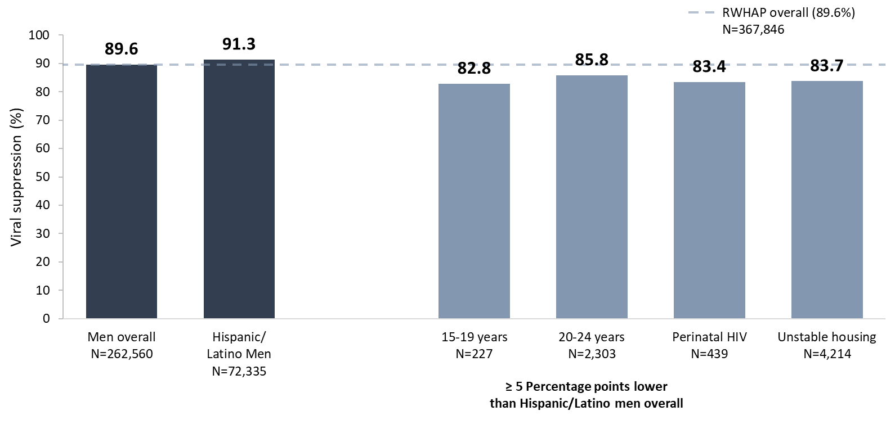
Viral Suppression among Hispanic/Latino Men Served by the Ryan White HIV/AIDS Program, 2022—United States and 3 Territoriesª
N represents the total number of clients in the specific population.
Hispanic/Latinos can be of any race.
Only includes men aged 13 years and older.
Viral suppression: ≥1 OAHS visit during the calendar year and ≥1 viral load reported, with the last viral load result <200 copies/mL.
ª Guam, Puerto Rico, and the U.S. Virgin Islands.
Notes:
Overall, in 2022, for Hispanic/Latino men, viral suppression (91.3%) was slightly higher than the national RWHAP average (89.6%) – indicated by the dashed grey line – and that of men overall (89.6%).
Among Hispanic/Latino men, viral suppression was lowest among those aged 15-24 years (range: 82.8% to 85.8%); those with perinatal HIV (83.4%); and those experiencing unstable housing (83.7%).
N represents the total number of clients in the specific subpopulation.
Hispanics/Latinos can be of any race.
Viral suppression is defined as ≥1 outpatient/ambulatory health services visit during the calendar year and ≥1 viral load reported, with the last viral load result <200 copies/mL.
The three territories include Guam, Puerto Rico, and the U.S. Virgin Islands.

Slide 23
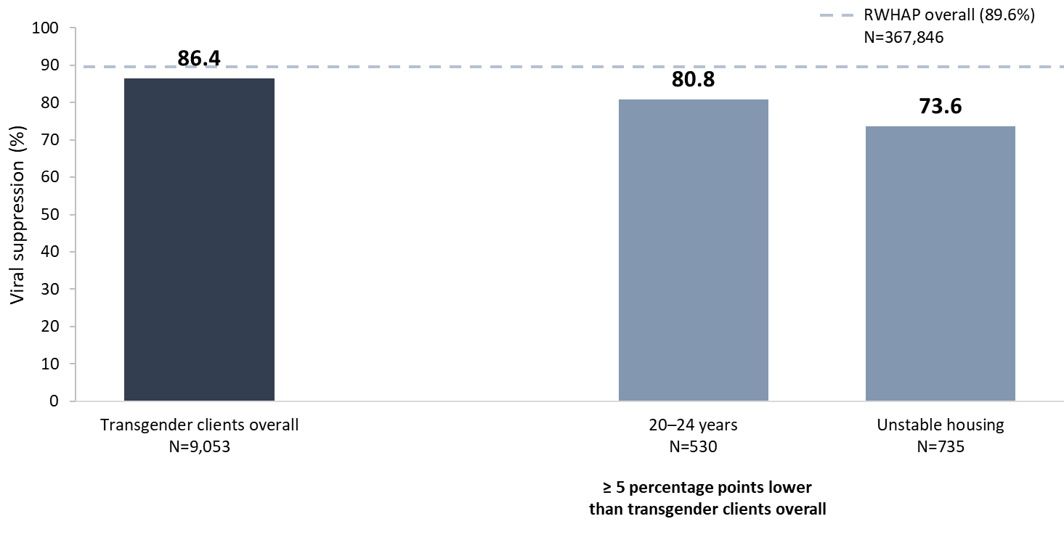
Viral Suppression among Transgender Adults and Adolescents Served by the Ryan White HIV/AIDS Program, 2022—United States and 3 Territoriesª
N represents the total number of clients in the specific population.
Includes transgender clients aged 15 years and older.
Viral suppression: ≥1 OAHS visit during the calendar year and ≥1 viral load reported, with the last viral load result <200 copies/mL.
ª Guam, Puerto Rico, and the U.S. Virgin Islands.
Notes:
In 2022, among transgender clients, viral suppression (86.4%) was lower than the national RWHAP average (89.6%) – indicated by the dashed grey line.
Viral suppression was lowest among transgender clients aged 20–24 years (80.8%); and those experiencing unstable (73.6%) housing.
N represents the total number of clients in the specific subpopulation.
Viral suppression is defined as ≥1 outpatient/ambulatory health services visit during the calendar year and ≥1 viral load reported, with the last viral load result <200 copies/mL.
The three territories include Guam, Puerto Rico, and the U.S. Virgin Islands.
Transgender clients includes clients who identify as transgender male, transgender female, or other gender identity.

Slide 24
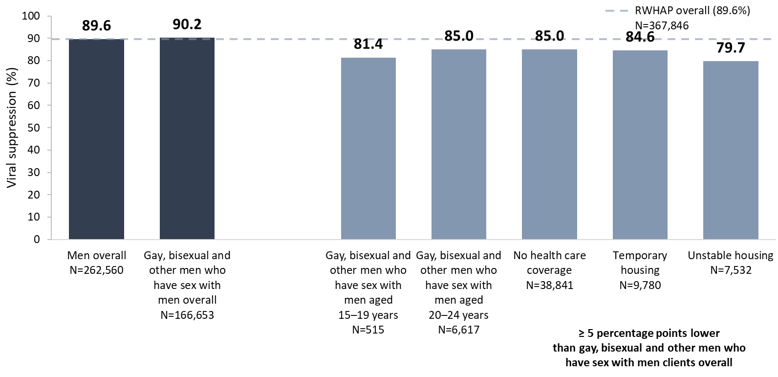
Viral Suppression among Gay, Bisexual, and Other Men Who Have Sex With Men Served by the Ryan White HIV/AIDS Program, 2022—United States and 3 Territoriesª
N represents the total number of clients in the specific population.
Includes males aged 13 years and older.
Viral suppression: ≥1 OAHS visit during the calendar year and ≥1 viral load reported, with the last viral load result <200 copies/mL.
ª Guam, Puerto Rico, and the U.S. Virgin Islands.
Notes:
In 2022, viral suppression among gay, bisexual, and other men who have sex with men (90.2%) was slightly higher than the national RWHAP average (89.6%) – indicated by the dashed grey line – and that of men overall (89.6%). The lowest percentages of viral suppression among gay, bisexual, and other men who have sex with men were among those aged 15–24 years (range: 81.4 to 85.0%); those with no health care coverage (85.0%); and those experiencing temporary (84.6%) and unstable (79.7%) housing.
N represents the total number of clients in the specific subpopulation.
Includes males aged 13 years and older. Does not include gay, bisexual, or other men who have sex with men who also reported injection drug use as a transmission category.
Viral suppression is defined as ≥1 outpatient/ambulatory health services visit during the calendar year and ≥1 viral load reported, with the last viral load result <200 copies/mL.
The three territories include Guam, Puerto Rico, and the U.S. Virgin Islands.

Slide 25
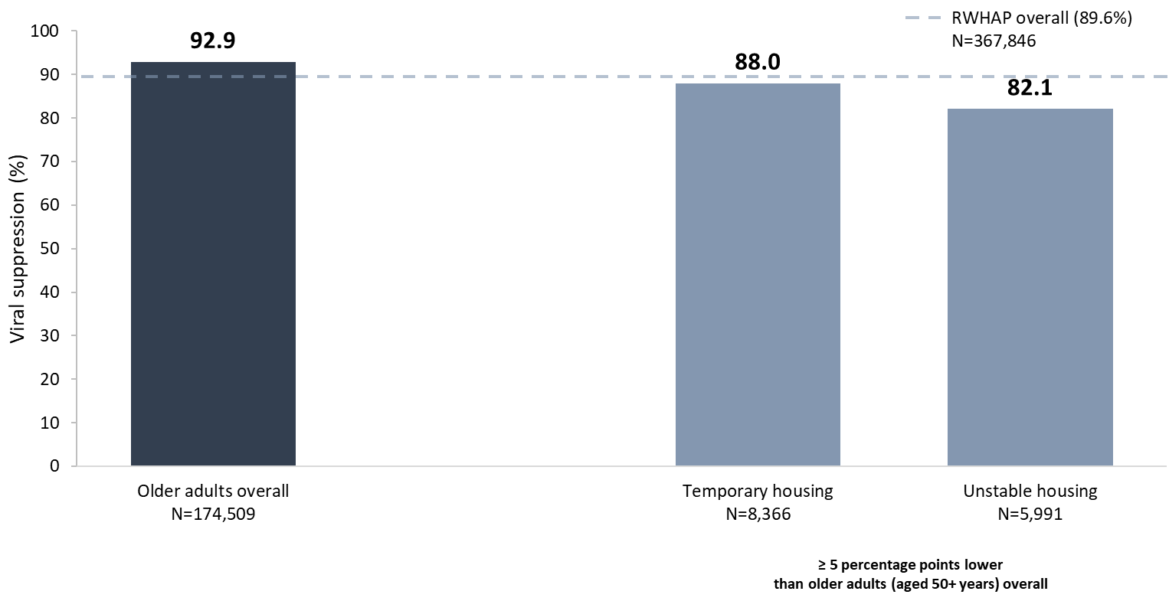
Viral Suppression among Adults Aged 50 Years and Older Served by the Ryan White HIV/AIDS Program, 2022—United States and 3 Territoriesª
N represents the total number of clients in the specific population.
Viral suppression: ≥1 OAHS visit during the calendar year and ≥1 viral load reported, with the last viral load result <200 copies/mL.
ª Guam, Puerto Rico, and the U.S. Virgin Islands.
Notes:
In 2022, among adults aged 50 years and older, viral suppression (92.9%) was higher than the RWHAP average (89.6%) – indicated by the dashed grey line.
Viral suppression was lowest among older transgender adults experiencing temporary housing (88.0%) and older adults experiencing unstable housing (82.1%).
N represents the total number of clients in the specific subpopulation.
Viral suppression is defined as ≥1 outpatient/ambulatory health services visit during the calendar year and ≥1 viral load reported, with the last viral load result <200 copies/mL.
The three territories include Guam, Puerto Rico, and the U.S. Virgin Islands.
Transgender clients includes clients who identify as transgender male, transgender female, or other gender identity.

Slide 26
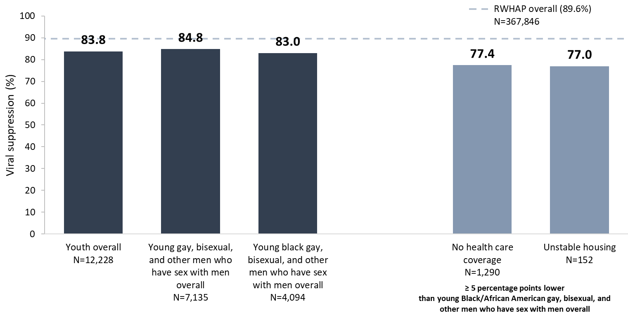
Viral Suppression among Young, Black/African American Gay, Bisexual, and Other Men Who Have Sex with Men Aged 13–24 Years Served by the Ryan White HIV/AIDS Program, 2022—United States and 3 Territoriesª
N represents the total number of clients in the specific population.
Viral suppression: ≥1 OAHS visit during the calendar year and ≥1 viral load reported, with the last viral load result <200 copies/mL.
ª Guam, Puerto Rico, and the U.S. Virgin Islands.
Notes:
In 2022, viral suppression for young Black/African American gay, bisexual, and other men who have sex with men aged 13-24 years (83.0%) was lower than the national RWHAP average (89.6%) – indicated by the dashed grey line – and slightly lower than the averages for young gay, bisexual, and other men who have sex with men overall (84.8%) and youth overall (83.8%).
Viral suppression for young Black/African American gay, bisexual, and other men who have sex with men was lowest among those with no health care coverage (77.4%) and those experiencing unstable (77.0%) housing.
N represents the total number of clients in the specific subpopulation.
Data for gay, bisexual, and other men who have sex with men include gay, bisexual, and other men who have sex with men who also reported injection drug use as a transmission category; data may not reflect current injection drug use behavior.
Viral suppression is defined as ≥1 outpatient/ambulatory health services visit during the calendar year and ≥1 viral load reported, with the last viral load result <200 copies/mL.
See Technical Notes of the Source document for the states/territories included in each HHS Region.
The three territories include Guam, Puerto Rico, and the U.S. Virgin Islands.

Slide 27
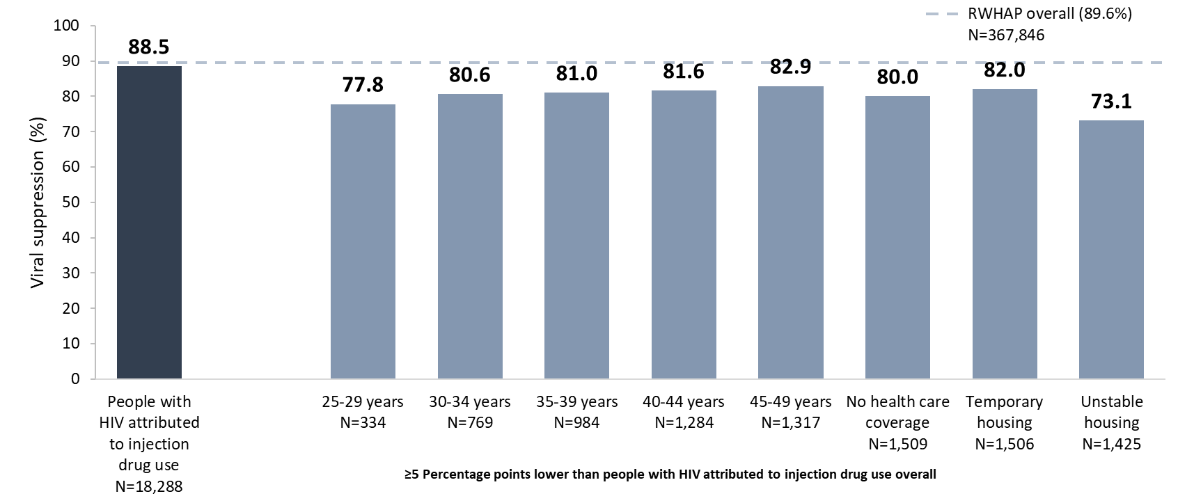
Viral Suppression among Clients with HIV Attributed at Diagnosis to Injection Drug Use Aged ≥13 Years Served by the Ryan White HIV/AIDS Program, 2022—United States and 3 Territoriesª
IDU, injection drug use.
Includes clients aged 13 years and older. Data represent clients who reported injection drug use as their transmission category; data may not reflect current behavior. Data do not include male-to-male sexual contact and injection drug use among male clients nor sexual contact and injection drug use among transgender clients.
N represents the total number of clients in the specific subpopulation.
Viral suppression is defined as ≥1 OAHS visit during the calendar year and ≥1 viral load reported, with the last viral load result <200 copies/mL.
ª Guam, Puerto Rico, and the U.S. Virgin Islands.
Notes:
In 2022, for clients with HIV attributed at diagnosis to injection drug use, viral suppression (88.5%) was slightly lower than the national RWHAP average (89.6%) – indicated by the dashed grey line.
Viral suppression was lowest among clients in each 5-year age group from 25-49 years (range: 77.8%-82.9%); among those with no health care coverage (80.0%); and among those experiencing temporary (82.0%) and unstable (73.1%) housing.
Data represent clients who reported injection drug use as their transmission category; data may not reflect current behavior. Data do not include people with HIV attributed at diagnosis to male-to-male sexual contact and injection drug use nor sexual contact and injection drug use among transgender clients.
N represents the total number of clients in the specific subpopulation.
Viral suppression is defined as ≥1 outpatient ambulatory health services visit during the calendar year and ≥1 viral load reported, with the last viral load result <200 copies/mL.
The three territories include Guam, Puerto Rico, and the U.S. Virgin Islands.

Slide 28
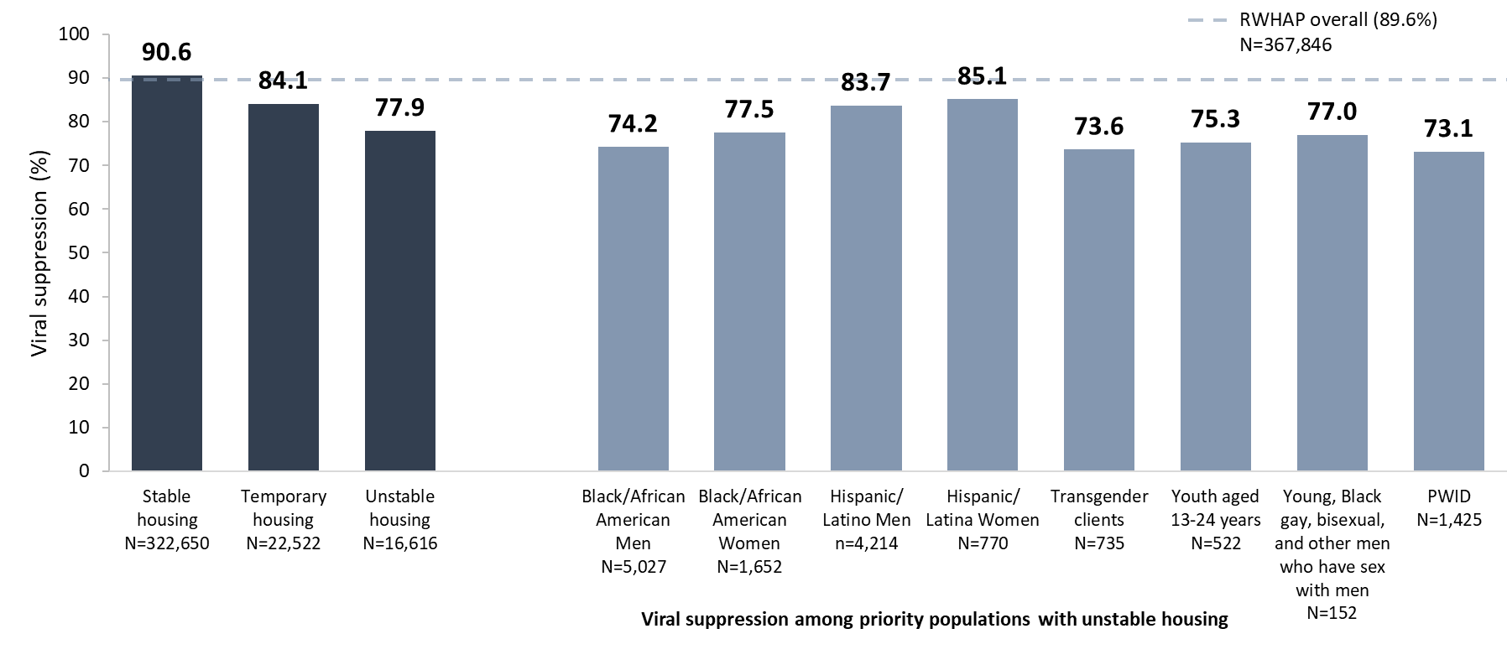
Viral Suppression among RWHAP Clients, by Housing Status and among Key Populations with Unstable Housing, 2022—United States and 3 Territoriesª
PWID, people who inject drugs (i.e., HIV attributed to injection drug use).
N represents the total number of clients in the specific population.
Viral suppression: ≥1 OAHS visit during the calendar year and ≥1 viral load reported, with the last viral load result <200 copies/mL.
ª Guam, Puerto Rico, and the U.S. Virgin Islands.
Notes:
Housing stability is a significant predictor of viral suppression. Among RWHAP clients experiencing unstable housing, 77.9% reached viral suppression in 2022, compared with 84.1% among those experiencing temporary housing, and 90.6% among those experiencing stable housing. Among priority populations of RWHAP clients experiencing unstable housing, the lowest percentages of viral suppression were among clients with HIV attributed at diagnosis to injection drug use (73.1%), transgender clients (73.6%), and Black/African American men (74.2%).
N represents the total number of clients in the specific subpopulation.
Viral suppression is defined as ≥1 outpatient ambulatory health services visit during the calendar year and ≥1 viral load reported, with the last viral load result <200 copies/mL.
The three territories include Guam, Puerto Rico, and the U.S. Virgin Islands.

Slide 29
Connect with the Ryan White HIV/AIDS Program
Learn more about our program at our website:
ryanwhite.hrsa.gov
Sign up for the Ryan White HIV/AIDS Program Listserv:
https://public.govdelivery.com/accounts/USHHSHRSA/signup/29907

Slide 30
Connect with HRSA
Learn more about our agency at:
www.HRSA.gov
Sign up for the HRSA eNews
FOLLOW US:

